Slide 1
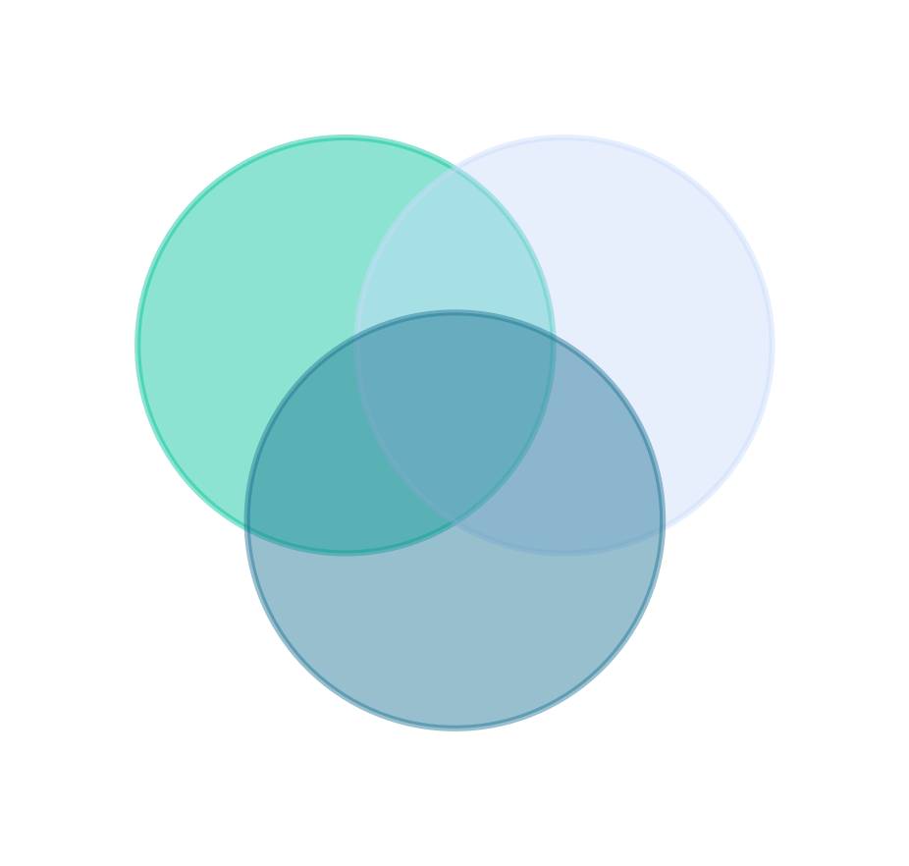
Set Theory
Lecture 1 · Computer Discrete Mathematics
Elements · notation · Venn diagrams · subsets · power sets · tuples
Notes:
The foundational language of the whole course. We build up from what a set is, how to write and picture one, through subsets, cardinality, the power set, and ordered tuples — finishing with software applications and the most common mistakes.

Slide 2
Why start with sets?
The course's language
Relations, logic, graphs, probability, automata — all defined as sets.
The software mirror
Hash sets, SQL, types, permissions are sets in disguise.
The basis of proof
Precise definitions of 'collection', 'equal', 'contains' make rigor possible.
Notes:
Everything downstream is phrased in the language of sets, that language mirrors real software constructs, and it gives us the precision proofs need.

Slide 3
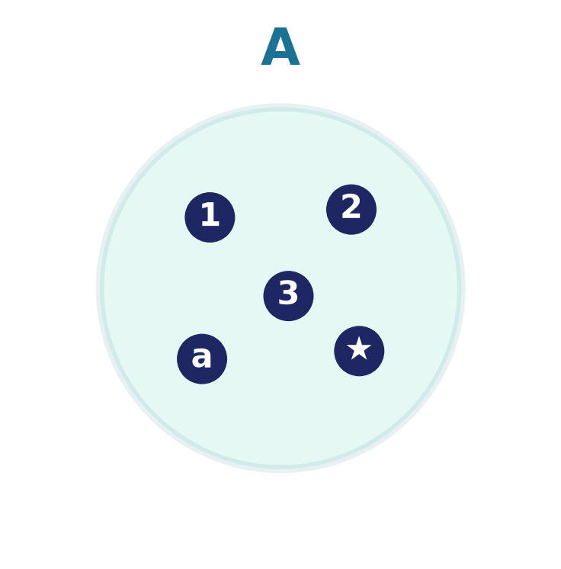
What is a set?
A collection of distinct objects.
An unordered collection of distinct objects — its elements.
No order: {1, 2, 3} = {3, 1, 2}
No duplicates: {1, 2, 2} = {1, 2}
Notes:
A set is fixed entirely by which elements it contains — not their order and not how many times they are listed. One caution: a naive 'set of everything' is inconsistent — Russell's paradox (the set of all sets that don't contain themselves) shows we must always carve sets out of some agreed domain rather than collecting unrestrictedly.

Slide 4
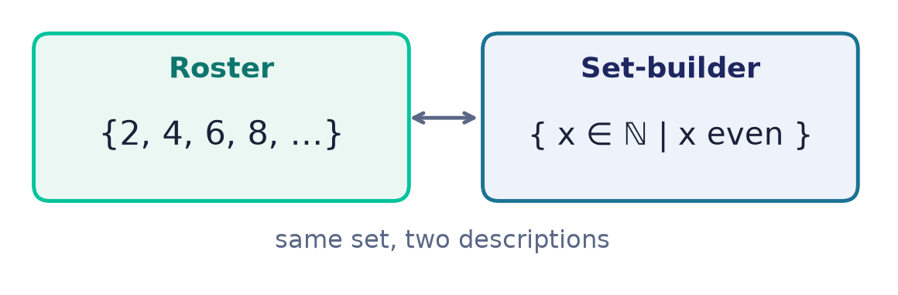
Two ways to write a set
Roster & set-builder
Roster — list the elements: {2, 4, 6, 8, …}
Set-builder — state the rule: { x ∈ ℕ | x is even }
Both describe the same set.
Notes:
Roster is convenient for small or patterned sets; set-builder is essential when a set is defined by a property rather than a list. (The symbol ∈ means 'is an element of' — defined on the next-but-one slide.)

Slide 5
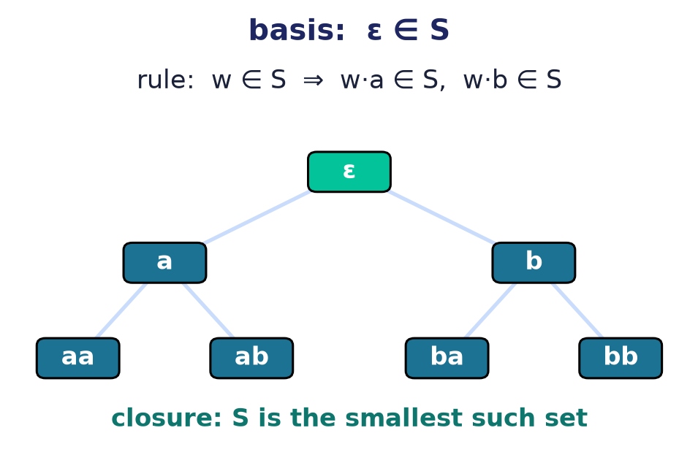
A third way: recursive definition
Basis · rule · closure
Basis: name a few starting elements.
Rule: build new elements from old ones.
Closure: nothing else belongs to the set.
Notes:
Beyond roster and set-builder, many important sets are defined recursively: a basis case, a rule that generates more elements, and the understanding that the set is the smallest one closed under that rule. Strings over an alphabet (Σ*), well-formed formulas, and data structures such as lists and trees are all defined this way — and this exact pattern is what structural induction, in Lecture 7, lets us prove things about.

Slide 6
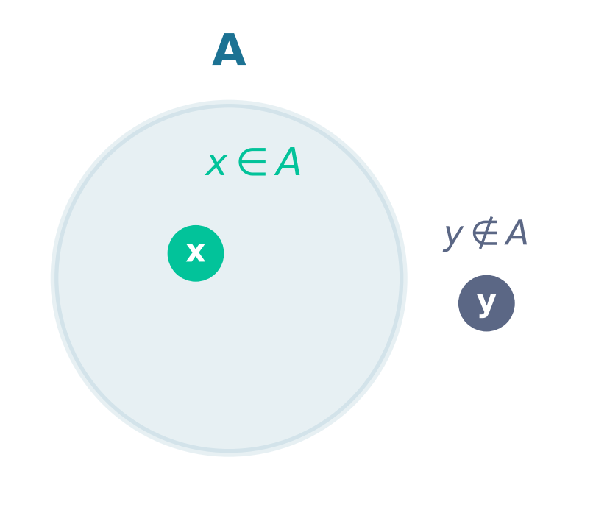
Membership: ∈ and ∉
x ∈ A
“x is an element of A.”
The one relation everything else is built on.
y ∉ A
“y is not an element of A.”
Notes:
Membership is atomic: subsets, operations, and cardinality are all defined in terms of ∈.

Slide 7
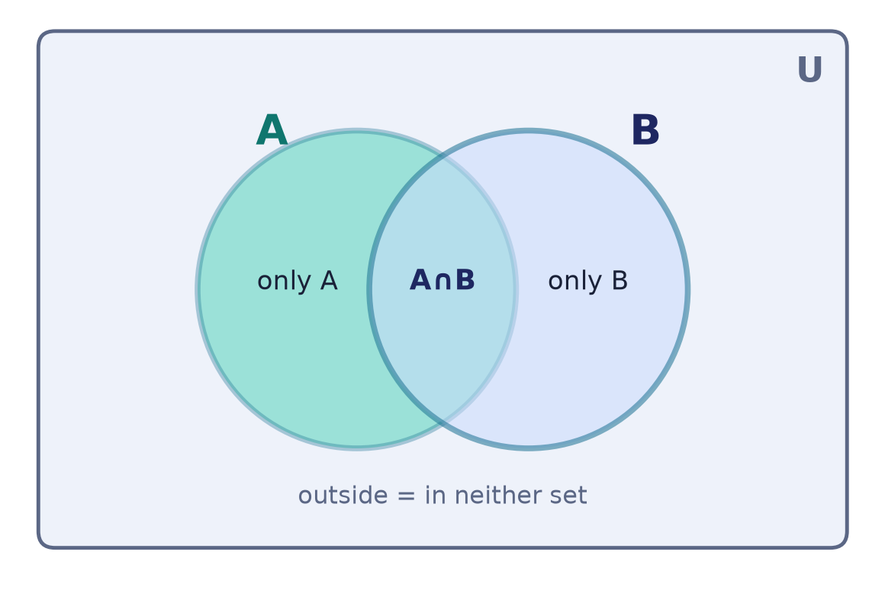
Picturing sets: Venn / Euler diagrams
A diagram, not a proof.
Each circle is a set; the box is the universe U.
Overlap = elements shared by both sets.
We use these throughout to see relationships.
Notes:
Before we combine sets we introduce the picture we'll rely on. A circle stands for a set inside a universe U; regions show 'only A', the overlap A∩B, 'only B', and everything outside. It builds intuition but is not itself a proof.

Slide 8
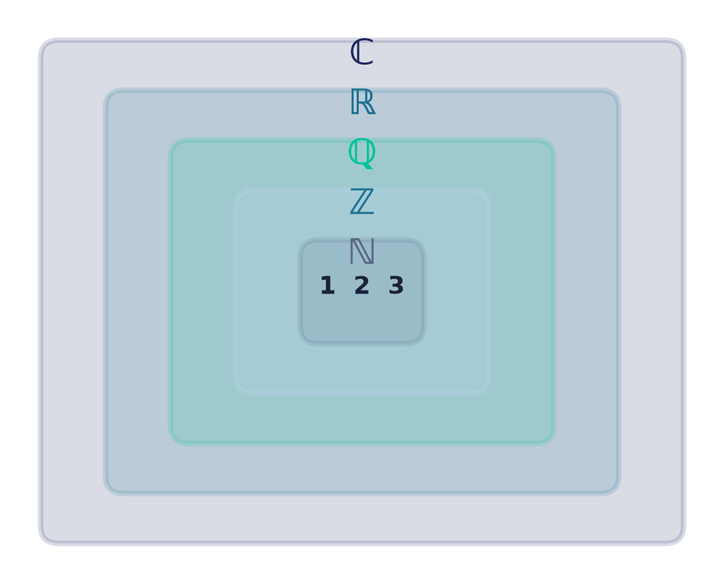
The number sets
ℕ ⊂ ℤ ⊂ ℚ ⊂ ℝ ⊂ ℂ
Naturals, integers, rationals, reals, complex — each contains the previous.
Notes:
The number systems nest. Knowing which system a value lives in tells you which operations stay inside it.

Slide 9
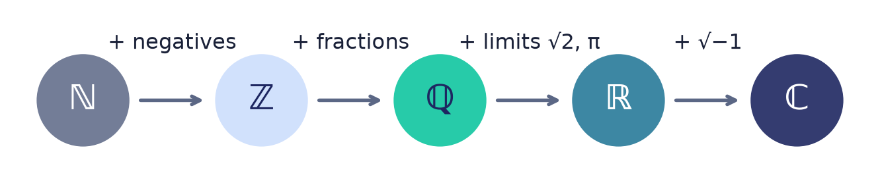
Why each new number set?
Each extension is forced by an operation the previous set can't always do.
Notes:
ℕ can't subtract freely → ℤ; ℤ can't divide → ℚ; ℚ has gaps (√2, π) → ℝ; ℝ can't solve x²=−1 → ℂ. Each system is the smallest that closes the previous one under a new operation.

Slide 10
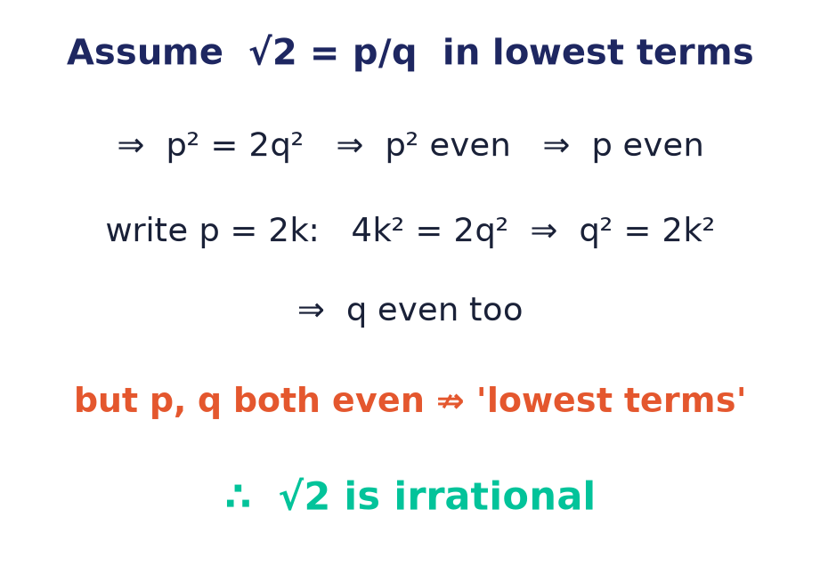
√2 is not rational — a worked proof
Proof by contradiction
Suppose √2 = p/q in lowest terms.
Then p² = 2q², forcing first p, then q, even.
Both even contradicts 'lowest terms'.
Notes:
We just asserted that ℚ has gaps such as √2; here we actually prove one. Assuming √2 were a fraction already in lowest terms forces both numerator and denominator to be even — impossible for a reduced fraction. That contradiction shows no such fraction exists, so √2 is irrational and ℝ is strictly larger than ℚ. It is the course's first proof by contradiction, a technique we return to in Lecture 7.

Slide 11
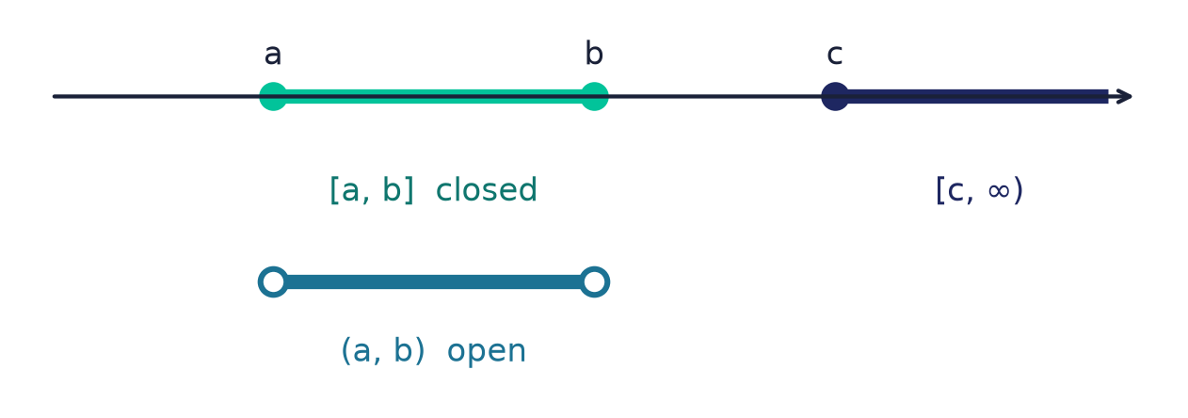
Intervals — sets of real numbers
[a,b], (a,b), [c,∞)
Closed [a,b] includes its endpoints; open (a,b) excludes them.
A ray extends to infinity.
Filled dot = included, hollow = excluded.
Notes:
Intervals are the sets of reals you'll meet most — in analysis, in ranges, in loop bounds. The bracket vs parenthesis distinction is exactly endpoint membership.

Slide 12
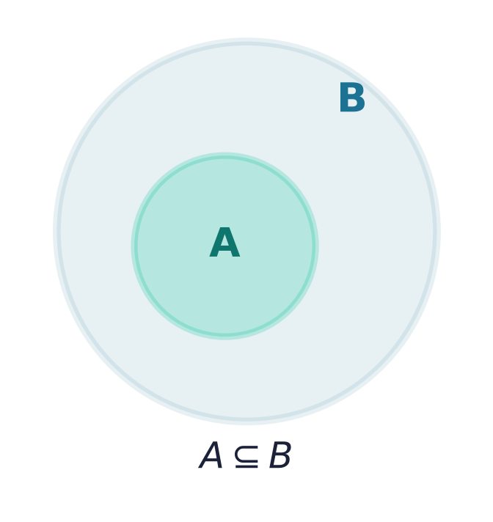
Subsets: ⊆
A ⊆ B
Every element of A is also in B.
A ⊆ A always, and ∅ ⊆ A always.
Notes:
Subset is the natural order on sets. Every set has itself and the empty set as subsets — and ∅ ⊆ A holds vacuously: there is no element of ∅ that could fail to be in A, so the requirement is satisfied by default.

Slide 13
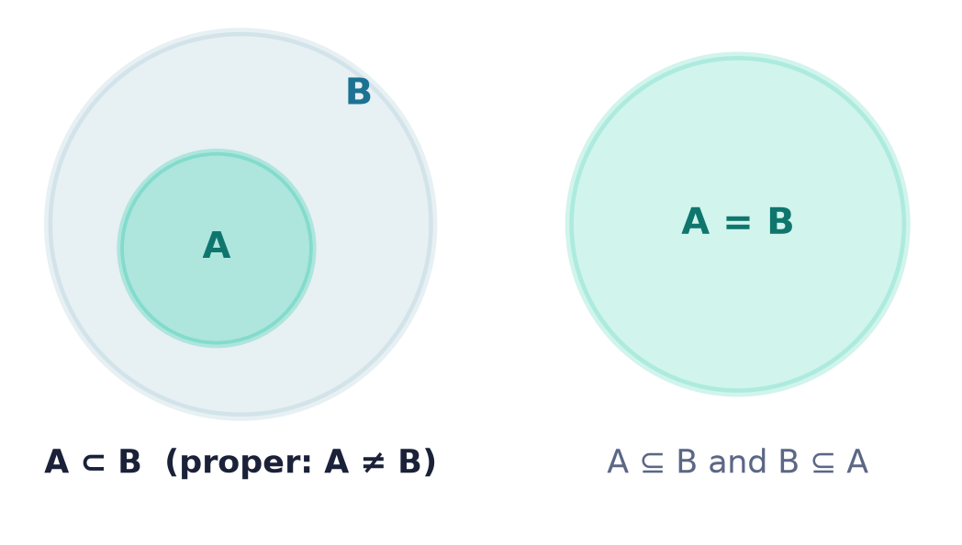
Proper subset & equality
⊂ vs =
A ⊂ B: A ⊆ B but A ≠ B (B has something A lacks).
A = B ⇔ A ⊆ B and B ⊆ A.
Proving equality by double inclusion is a core technique.
Notes:
Proper subset is strict containment. Set equality is proved by showing each is a subset of the other — a pattern reused in every later proof about sets.

Slide 14
The empty set ∅
∅ = { }
The unique set with no elements; |∅| = 0.
∅ ⊆ A for every set A.
Careful: ∅ ≠ {∅} (the second has one element).
∅
Notes:
There is exactly one empty set, and it is a subset of everything. The classic trap is confusing ∅ with {∅}, a set that contains the empty set and so has one element.

Slide 15
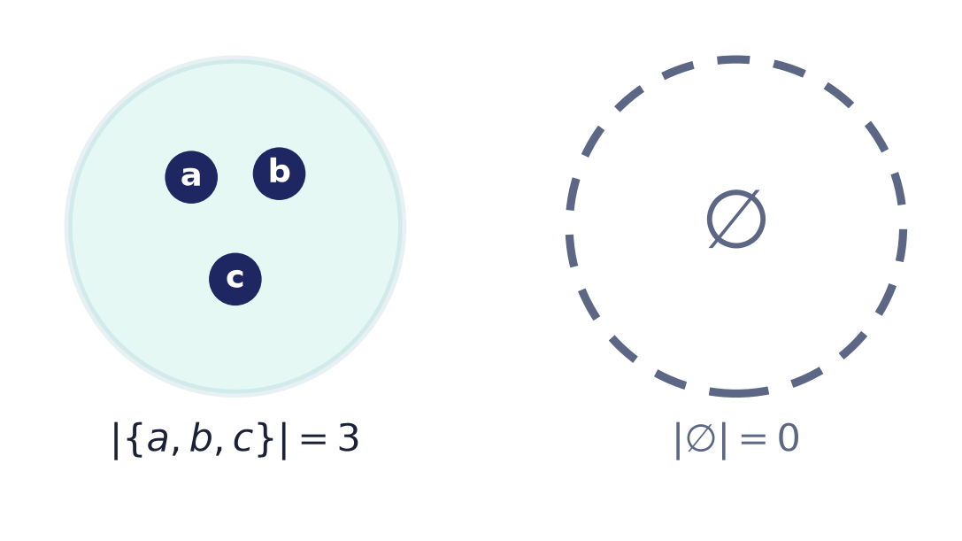
Cardinality — the size of a set
|A|
The number of distinct elements of A.
Finite: |{a,b,c}| = 3. Infinite: |ℕ| — a size in its own right.
The empty set has |∅| = 0.
Notes:
Cardinality generalises 'how many'. Some sets are finite; others infinite — and, as we'll see, infinite sets themselves come in different sizes.

Slide 16
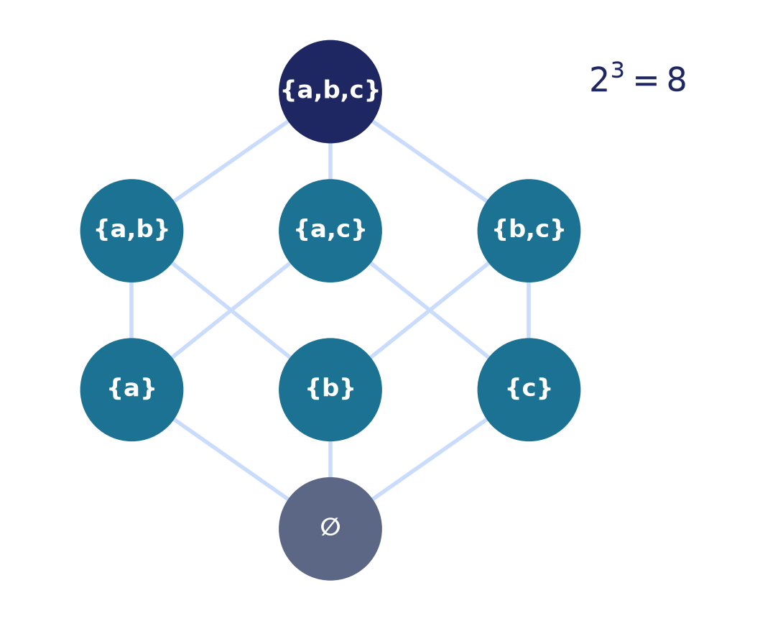
The power set P(A)
P(A)
The set of all subsets of A — including ∅ and A itself.
P({a,b,c}) has 8 elements, shown as a lattice by inclusion.
Notes:
The power set collects every subset. Ordered by inclusion they form a Boolean lattice — a structure that reappears in Boolean algebra and bit-vectors.

Slide 17
Counting subsets: 2ⁿ
Each element is independently IN or OUT of a subset.
a
in / out
×
b
in / out
×
c
in / out
n choices of 2 ⇒ |P(A)| = 2ⁿ
Notes:
There is one binary choice per element — in or out — and the choices are independent, so an n-element set has 2·2·…·2 = 2ⁿ subsets.

Slide 18
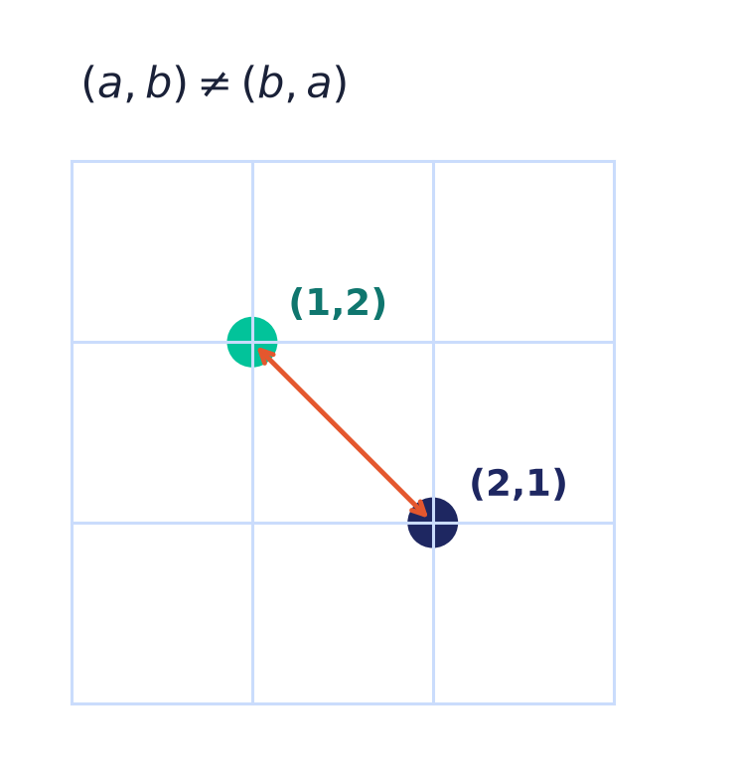
Ordered tuples
(a, b)
An ordered pair — order matters.
(a, b) ≠ (b, a) in general, unlike the set {a, b}.
Generalises to n-tuples (a₁, …, aₙ).
Notes:
Tuples add order and position to a collection — the missing ingredient the unordered set lacks, and the basis for the Cartesian product next.

Slide 19
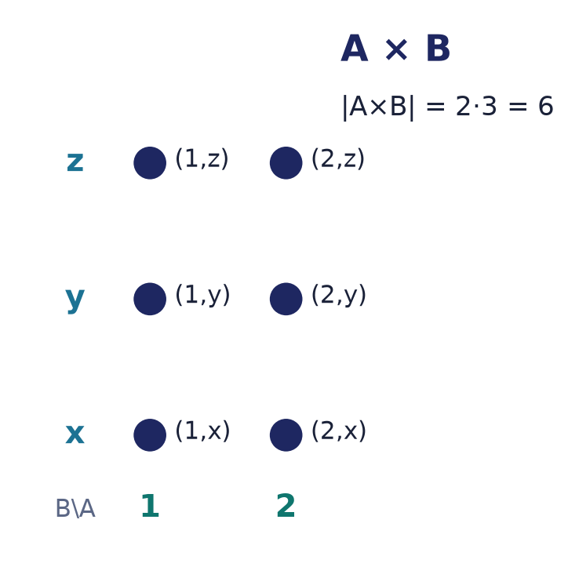
The Cartesian product A × B
A × B
All ordered pairs (a, b) with a ∈ A and b ∈ B.
|A × B| = |A| · |B|.
The foundation of relations — next lecture.
Notes:
Pairing every element of A with every element of B gives the Cartesian product — a grid whose size is the product of the sizes. Relations, and much of the next lecture, live inside it.

Slide 20
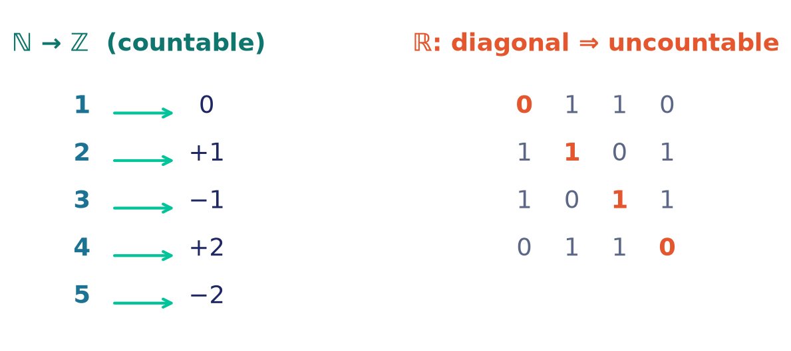
How big is infinity?
Countable
ℕ, ℤ, ℚ — their elements can be listed.
Uncountable
ℝ — Cantor's diagonal builds a real missing from any list.
Notes:
Two sets have the same size if their elements pair one-to-one. ℚ can be enumerated; ℝ cannot — the diagonal argument produces a real absent from any proposed list. Infinity has sizes.

Slide 21
Cantor's theorem: no largest infinity
|A| < |P(A)|
For EVERY set A, the power set is strictly bigger.
No map A → P(A) can hit every subset (no surjection).
So |A| < |P(A)| — even when A is infinite.
The diagonal set
Given any f : A → P(A), form
D = { a ∈ A : a ∉ f(a) }.
D equals no f(a) — it disagrees at a itself. So f misses D, and cannot be onto.
⇒ |A| < |P(A)| < |P(P(A))| < … — the infinities never stop.
Notes:
Cantor's theorem says every set is strictly smaller than its power set — there is no surjection from A onto P(A). The proof is the diagonal argument in pure form: given any candidate f from A to P(A), the set D of elements a that are NOT in their own image f(a) cannot equal f(a) for any a, because it disagrees with f(a) precisely at a. So f is never onto. Taking A = ℕ shows P(ℕ) is uncountable; iterating gives an endless tower of ever-larger infinities, so there is no largest set and no largest infinity.

Slide 22
Russell's paradox
R = { x : x ∉ x }
Naive rule: any property defines a set.
Take the property 'x is not a member of itself'.
Now ask the fatal question: is R ∈ R?
Either answer explodes
If R ∈ R, the property fails → R ∉ R.
If R ∉ R, the property holds → R ∈ R.
R ∈ R ⇔ R ∉ R — a contradiction. No such set exists.
The barber. He shaves exactly the men who don't shave themselves — so who shaves the barber?
The fix. ZF set theory only carves { x ∈ U : P(x) } from a set U already known to exist — so always give the domain.
Notes:
Russell's paradox ended naive set theory. Under unrestricted comprehension — any property determines a set — form R, the set of all sets that are not members of themselves, and ask whether R belongs to itself. If it does, its defining property says it does not; if it does not, the property says it does. Either way R ∈ R iff R ∉ R, a flat contradiction, so R cannot exist. The barber who shaves exactly those who do not shave themselves is the same puzzle in miniature. The modern fix is the axiom of separation: you may only carve a subset { x ∈ U : P(x) } from a set U already known to exist — which is why this course always writes set-builder notation with a domain.

Slide 23
Where sets show up in software
Hash sets
Deduplication and O(1) membership — the structure IS a set.
Databases (SQL)
DISTINCT, UNION, INTERSECT, EXCEPT operate on sets of rows.
Type systems
A type is the set of its values; subtyping is ⊆.
Access control
Permissions are sets; an auth check is an ∈ test.
Notes:
Sets are everywhere in code: hash sets, SQL set operators, types as sets of values with subtyping as subset, and permission/authorization checks as membership tests.

Slide 24
Common mistakes
∈ vs ⊆
1 ∈ {1,2} ✓ but 1 ⊆ {1,2} ✗. Use {1} ⊆ {1,2} ✓.
∅ vs {∅}
∅ is empty; {∅} has one element (namely ∅).
Order & duplicates
{1,2,2} = {1,2} and {1,2} = {2,1}.
|P(A)| = 2ⁿ
The power set has 2ⁿ elements — not n, not 2n.
Notes:
The four that trip up almost everyone: element-of vs subset-of; {∅} is not empty; order and repeats never matter; and the power set has 2ⁿ elements.

Slide 25
Summary
— Set = unordered collection of distinct elements.
— Write sets by roster or set-builder; picture them with Venn diagrams.
— ∈ (element) is not ⊆ (subset); ⊂ is strict.
— ℕ ⊂ ℤ ⊂ ℚ ⊂ ℝ ⊂ ℂ; intervals are sets of reals.
— |A| cardinality; ∅ empty; P(A) has 2ⁿ subsets.
— Tuples are ordered → Cartesian product A × B.
Notes:
Every term here — membership, subset, cardinality, power set, tuple, Cartesian product — is used in every remaining lecture.

Slide 26
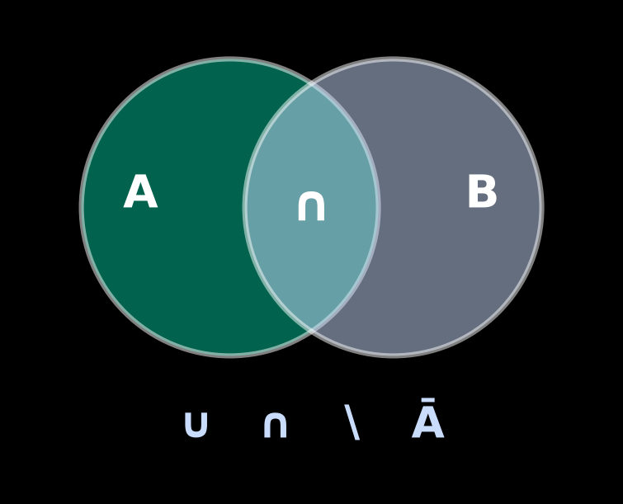
Next → Lecture 2: Set algebra
We have sets. Now we combine them.
Union ∪ · Intersection ∩ · Difference ∖ · Complement Ā
…and the laws they obey — commutativity, distributivity, De Morgan — read straight off Venn diagrams.
Notes:
Set algebra turns these operations into a calculus with provable laws — and the Venn diagrams introduced today are exactly how we'll read them off. The bridge to logic, Boolean algebra, and probability.

