Slide 1
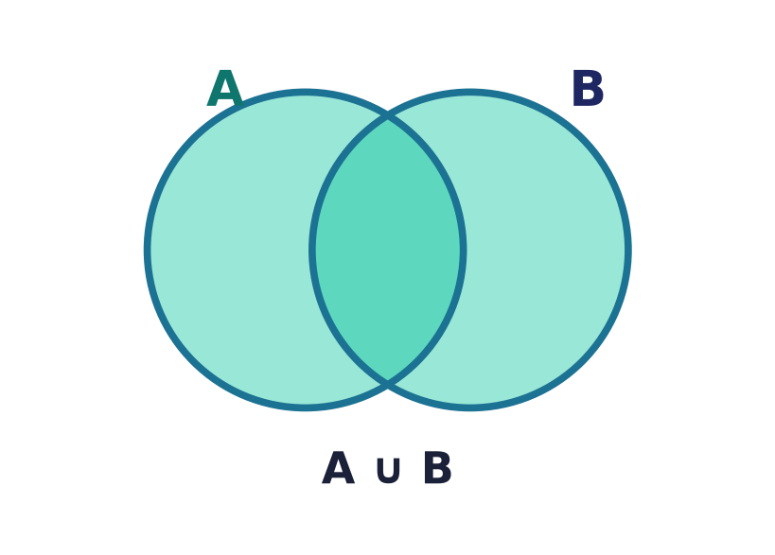
Set Algebra
Lecture 2 · Computer Discrete Mathematics
Operations on sets · the laws · characteristic functions · Cartesian product
Notes:
With sets in hand, we now combine them. Today: the four operations, symmetric difference, the algebra of sets and its proofs, characteristic functions and bit-vectors, the Cartesian product, and inclusion–exclusion.

Slide 2
Recap — from Lecture 1
Sets
Unordered collections of distinct elements; ∈ and ⊆.
Venn diagrams
Circles in a universe U — how we'll read every law today.
The plan
Combine sets with operations, then prove the laws they obey.
Notes:
We reuse Lecture 1's vocabulary — membership, subset — and especially the Venn diagram, which is the picture behind every identity in this lecture.

Slide 3
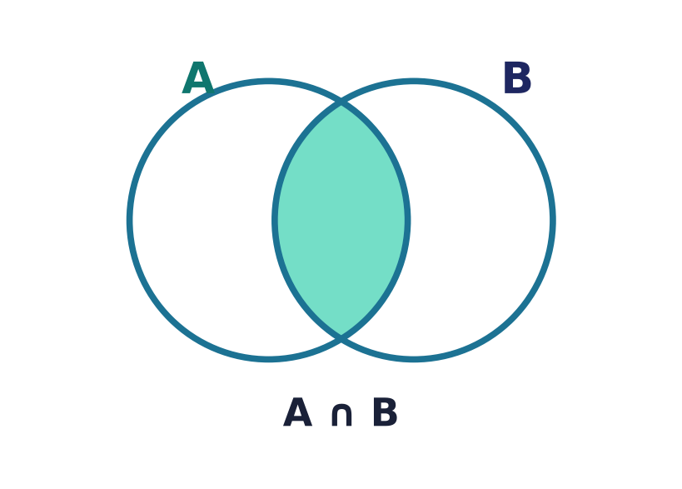
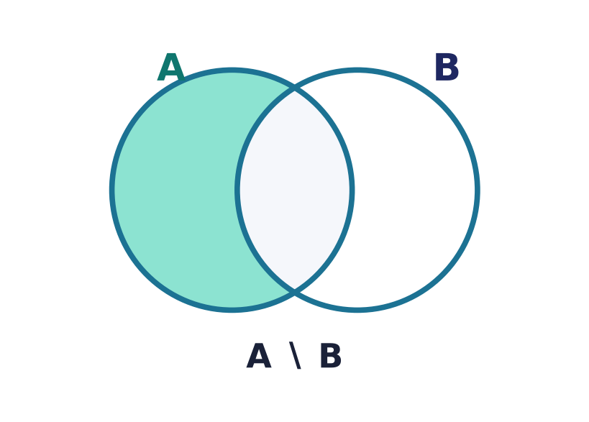
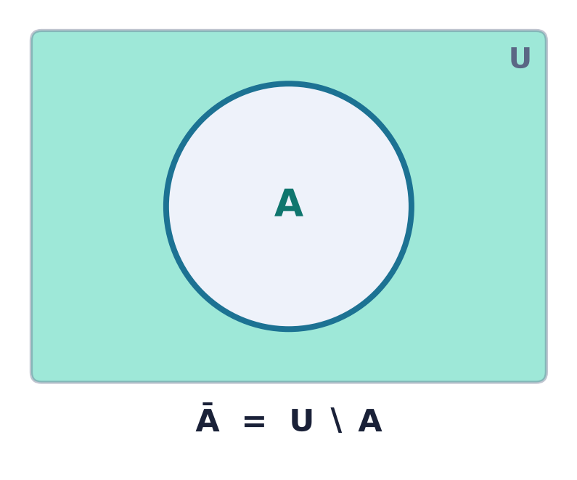
Four ways to combine sets
Union ∪
everything in A or B
Intersection ∩
in both A and B
Difference ∖
in A but not B
Complement Ā
everything not in A
Notes:
Four core operations. Each corresponds to a logical connective — or, and, and-not, not — a link we'll make precise in the logic lectures.

Slide 4
Union ∪
A ∪ B
{ x | x ∈ A or x ∈ B }.
Everything in either set (or both).
|A ∪ B| ≤ |A| + |B|.

Slide 5
Intersection ∩
A ∩ B
{ x | x ∈ A and x ∈ B }.
The elements common to both sets.
If empty, the sets are disjoint.

Slide 6
Difference ∖
A ∖ B
{ x | x ∈ A and x ∉ B }.
In A, with B's elements removed.
Not symmetric: A ∖ B ≠ B ∖ A in general.

Slide 7
Complement Ā
Ā = U ∖ A
Everything in the universe U that is not in A.
Always relative to a fixed universe U.
A ∪ Ā = U and A ∩ Ā = ∅.

Slide 8
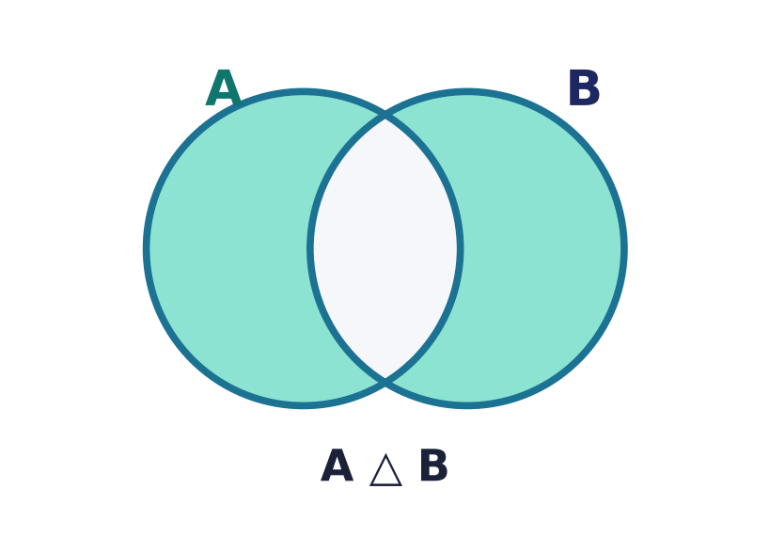
Symmetric difference △
A △ B
In exactly one of the two sets.
A △ B = (A ∖ B) ∪ (B ∖ A).
The 'exclusive or' of sets.

Slide 9
The algebra of symmetric difference
△ behaves like XOR
Commutative and associative: A △ B = B △ A.
Identity ∅, and every set is its own inverse: A △ A = ∅.
A △ U = A̅ — complement as a special case.
Cancellation law
A △ B = A △ C ⇒ B = C
take △ with A on both sides — A cancels itself.
On bit-vectors, △ is exactly XOR.
Notes:
Unlike union and intersection, symmetric difference has a rich algebra. It is commutative and associative, has the empty set as identity, and — the key fact — every set is its own inverse, since A △ A = ∅. Complementing is the special case A △ U = the complement of A. The self-inverse property gives an instant cancellation law: from A △ B = A △ C, take the symmetric difference with A on both sides and A cancels, leaving B = C. On stored bit-vectors symmetric difference is computed as a bitwise XOR — the same structure met in Lecture 4.

Slide 10
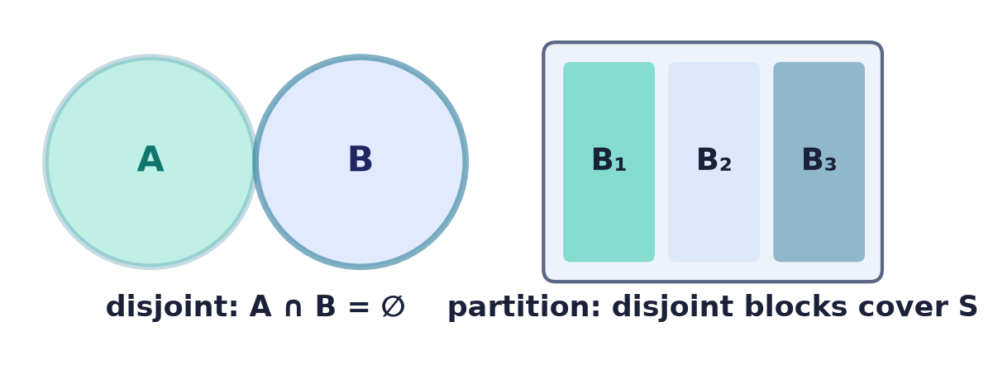
Disjoint sets & partitions
Disjoint · Partition
Disjoint: A ∩ B = ∅ — no shared elements.
A partition of S: disjoint, non-empty blocks whose union is S.
Every element lands in exactly one block.
Notes:
Partitions — disjoint blocks that cover a set — are how equivalence relations organise a set in the next lecture, and how sample spaces split in probability.

Slide 11
The algebra of sets
Commutative
A∪B = B∪A, A∩B = B∩A
Associative
(A∪B)∪C = A∪(B∪C)
Distributive
A∩(B∪C) = (A∩B)∪(A∩C)
Identity
A∪∅ = A, A∩U = A
Complement
A∪A̅ = U, A∩A̅ = ∅
De Morgan
A̅∪̅B̅ = A̅∩B̅
also: idempotent A∪A=A · absorption A∪(A∩B)=A · domination A∪U=U, A∩∅=∅ · involution A → A̅ → A
Notes:
These identities form a Boolean algebra — the same laws govern logic and bits. Beyond the six shown, the algebra also has the idempotent, absorption, domination, and involution (double-complement) laws. Each is proved element-by-element, by a membership table, or via characteristic functions.

Slide 12
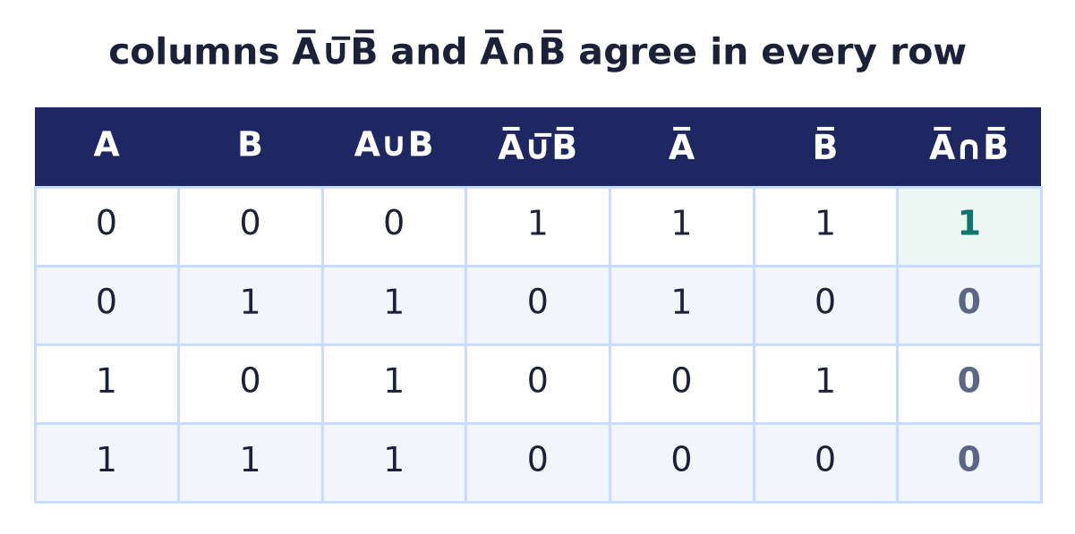
Proving the laws — not by picture
Three rigorous methods
Membership table: check all 0/1 cases exhaustively.
Double inclusion: show A ⊆ B and B ⊆ A.
Characteristic-function algebra on χ.
Notes:
A Venn diagram suggests a law but never proves it — three methods do. The membership table checks every element's in/out case exhaustively; here the complement-of-(A∪B) and (complement-of-A ∩ complement-of-B) columns are identical in all four rows, which proves De Morgan. Double inclusion proves an equality A=B by showing each side is a subset of the other. And characteristic-function arithmetic, coming up, turns such a proof into algebra on 0/1 values.

Slide 13
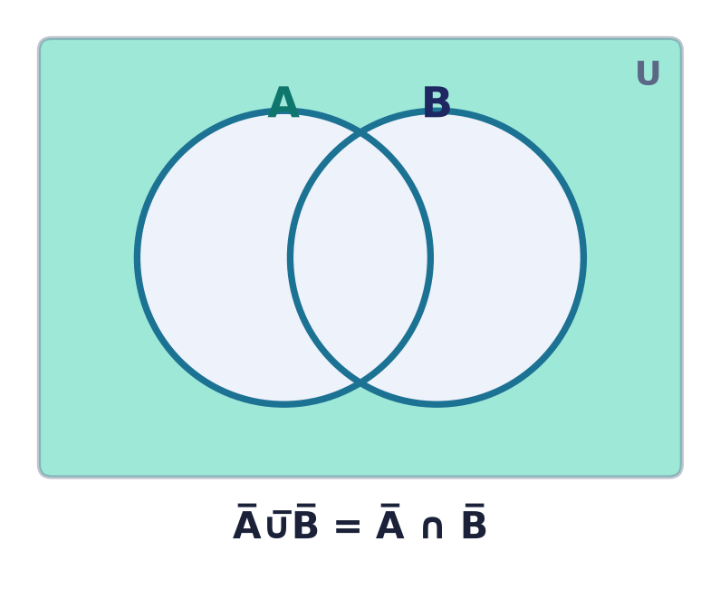
De Morgan's laws
A̅∪̅B̅ = A̅ ∩ B̅
A̅∩̅B̅ = A̅ ∪ B̅.
Complement turns ∪ into ∩ and vice-versa.
Read it straight off the shaded region.
Notes:
De Morgan's laws are the workhorse of simplification — and reappear identically in logic (¬(p∨q)=¬p∧¬q) and in bit-masking.

Slide 14
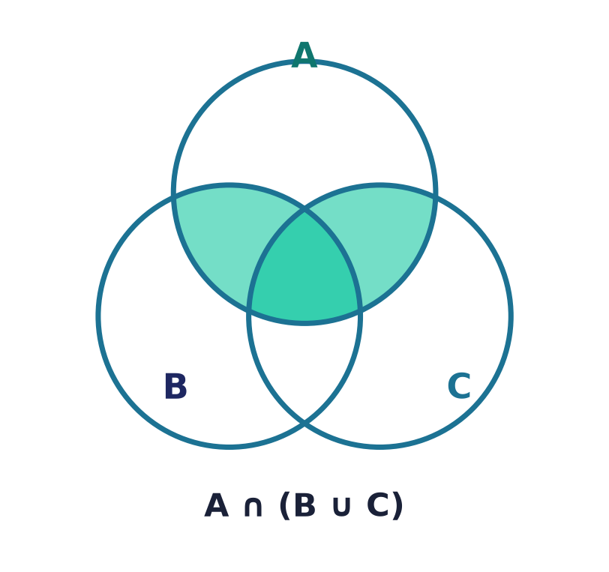
Distributivity
A ∩ (B ∪ C)
= (A ∩ B) ∪ (A ∩ C).
Intersection distributes over union — and dually,
union distributes over intersection.
Notes:
Unlike ordinary arithmetic, BOTH operations distribute over each other. The shaded region A∩(B∪C) is visibly the union of the two lens pieces.

Slide 15
The duality principle
Swap and it still holds
Exchange ∪ ↔ ∩ and U ↔ ∅ in any true identity
and you get another true identity.
Every law comes in a dual pair — prove one, get two.
A ∪ ∅ = A
⇕ dual
A ∩ U = A
Notes:
Duality halves the work: because the axioms come in dual pairs, every theorem does too. It's the same self-duality that structures Boolean algebra.

Slide 16
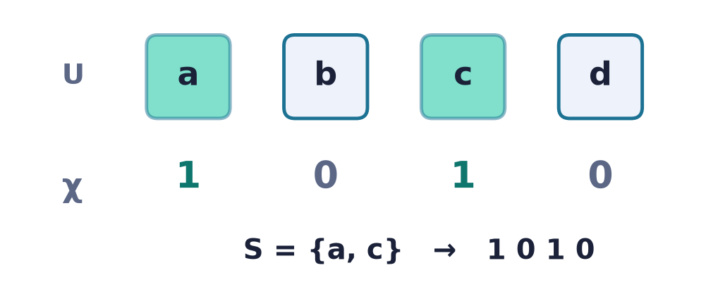
Characteristic functions
χ_A : U → {0,1}
χ_A(x) = 1 if x ∈ A, else 0.
A set becomes a bit-string over the universe.
Operations become arithmetic on 0/1.
χ(A∩B) = χ(A)·χ(B)
χ(A∪B) = χ(A)+χ(B) − χ(A)·χ(B)
χ(Ā) = 1 − χ(A) |A| = Σ χ(A)
Notes:
The characteristic function is the bridge from sets to bits: it turns 'is x in A?' into a 0/1, and set operations into arithmetic — intersection is a product, union is add-minus-product, complement is 1−χ. Summing χ over the universe even counts the set: |A| = Σ χ_A(x). This is how a computer stores a small set, and it gives a purely algebraic way to prove the set laws.

Slide 17
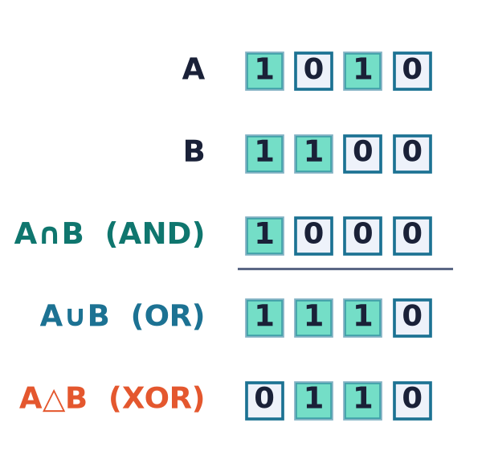
Sets as bit-vectors
One machine word, one set
Store a subset of an n-element universe as n bits.
∩ = AND, ∪ = OR, △ = XOR, complement = NOT.
Set algebra runs at hardware speed.
Notes:
Bitsets are set algebra realised in hardware — a whole subset fits in a register and the operations are single instructions. Used in schedulers, feature flags, and graph algorithms.

Slide 18
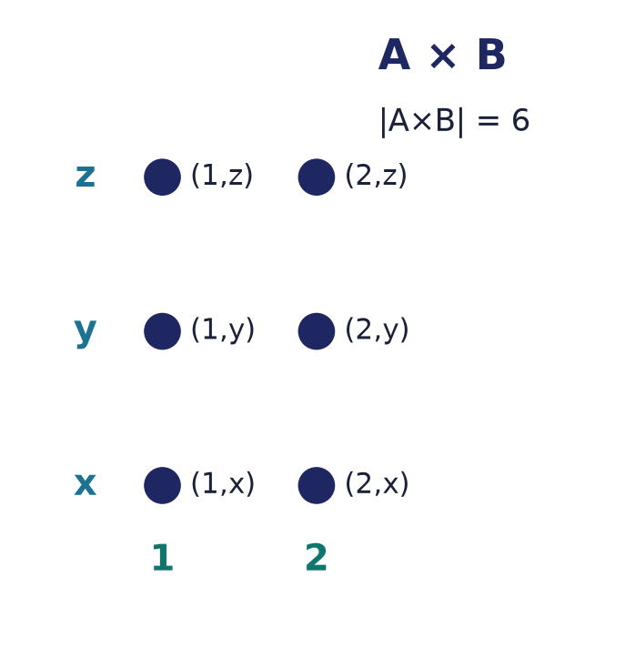
The Cartesian product A × B
A × B
All ordered pairs (a, b) with a ∈ A, b ∈ B.
|A × B| = |A| · |B|.
The set inside which every relation lives.
Notes:
Pairing each element of A with each of B gives a grid of size |A|·|B|. Relations — the whole of Lecture 3 — are subsets of this product.

Slide 19
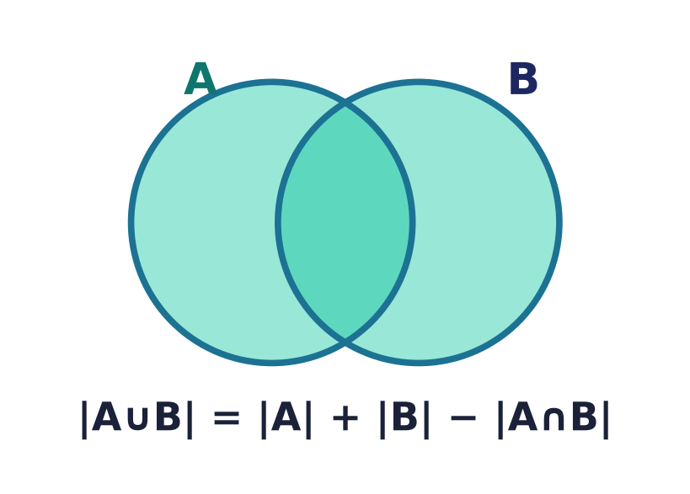
Inclusion–exclusion
|A ∪ B| = |A| + |B| − |A ∩ B|
Add the parts, subtract the double-counted overlap.
Three sets: add singles, subtract pairs, add the triple.
The counting tool behind probability's union rule.
Three sets:
|A∪B∪C| = |A|+|B|+|C|
−|A∩B|−|A∩C|−|B∩C|+|A∩B∩C|
1–100 divisible by 2, 3, or 5: 74
Notes:
Counting a union naively double-counts the overlap, so we subtract it back. For three sets: add the singles, subtract the three pairwise overlaps, add the triple. Concretely, of the numbers 1–100 the count divisible by 2, 3, or 5 is 50+33+20−16−10−6+3 = 74. The pattern generalises to any number of sets and underlies the union bound in probability.

Slide 20
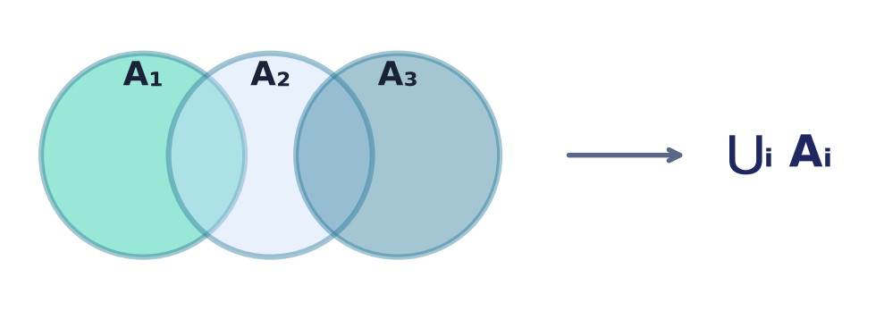
Indexed unions & intersections
⋃ᵢ Aᵢ and ⋂ᵢ Aᵢ
Combine a whole family of sets at once.
x ∈ ⋃ᵢ Aᵢ iff x is in SOME Aᵢ; ⋂ᵢ needs ALL.
Indexing sets is how we handle the infinite.
Notes:
When there are many (even infinitely many) sets, we index them and take the union or intersection over the whole family — essential in analysis and in defining limits of sets.

Slide 21
Set algebra in software
SQL
UNION, INTERSECT, EXCEPT are ∪, ∩, ∖ on result rows; DISTINCT enforces set semantics.
Bitsets
Feature flags, schedulers, and reachability use AND/OR/XOR as ∩/∪/△.
Permissions
Effective access = union of role grants minus explicit denies.
Notes:
Every operation today is a database keyword, a bitwise instruction, or an access-control computation. The algebra is not abstract — it's what the query planner and the CPU actually do.

Slide 22
Common mistakes
A ∖ B is directed
A ∖ B ≠ B ∖ A. Difference is not symmetric.
Complement needs U
Ā only makes sense against a fixed universe U.
De Morgan flips the op
A̅∩̅B̅ = A̅ ∪ B̅ — the ∩ becomes ∪.
Don't forget the overlap
|A∪B| = |A|+|B|−|A∩B|, not just |A|+|B|.
Notes:
The classic slips: treating difference as symmetric, forgetting the universe for complement, not flipping the operation in De Morgan, and double-counting in inclusion–exclusion.

Slide 23
Summary
— Four operations: ∪, ∩, ∖, complement — plus △.
— The laws form a Boolean algebra; each has a dual.
— De Morgan and distributivity read off Venn diagrams.
— χ_A turns sets into bits; operations become bitwise.
— A × B holds all ordered pairs; |A×B| = |A|·|B|.
— Inclusion–exclusion counts unions correctly.

Slide 24
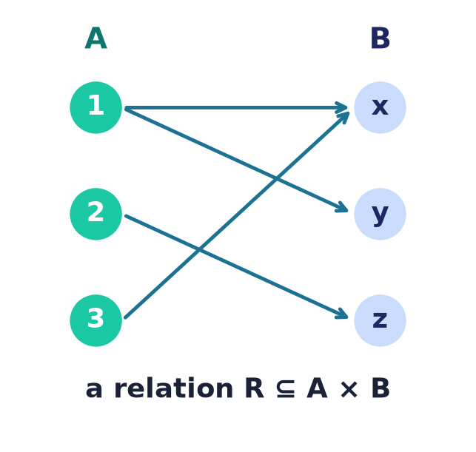
Next → Lecture 3: Relations
A relation is a subset of A × B.
It pairs elements — 'is related to' — and we'll classify them:
reflexive · symmetric · transitive · equivalence · order
Notes:
The Cartesian product we just built is the arena for relations. Next lecture we single out subsets of A×B and study their properties — the backbone of databases, orderings, and equivalence.

