Slide 1
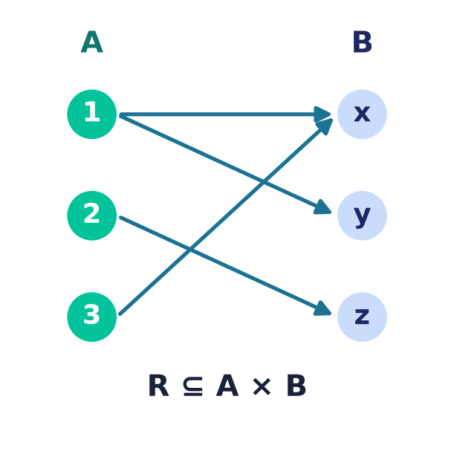
Relations
Lecture 3 · Computer Discrete Mathematics
Subsets of A × B · properties · equivalence · order · databases
Notes:
A relation records which elements are 'related'. Today: relations as subsets of a Cartesian product, their representations and properties, equivalence relations and partitions, partial orders, and the relational database model.

Slide 2
Recap — the Cartesian product
A × B
All ordered pairs (a, b), a ∈ A, b ∈ B.
Size
|A × B| = |A| · |B|.
Today
A relation singles out SOME of those pairs.
Notes:
Last lecture built A×B, the set of all pairs. A relation is any subset of it — the pairs we declare 'related'.

Slide 3
What is a relation?
R ⊆ A × B
A set of ordered pairs.
(a, b) ∈ R is written a R b — 'a is related to b'.
Any subset qualifies — from ∅ to all of A × B.
Notes:
A relation is nothing more than a chosen set of pairs. 'a R b' just means the pair (a,b) was chosen.

Slide 4
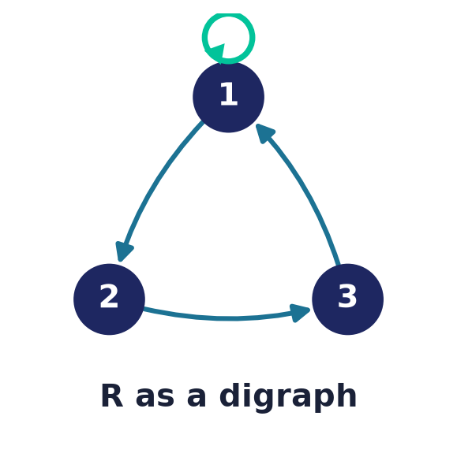
Relations on a set
R ⊆ A × A
Both coordinates come from the same set A.
Models 'less than', 'divides', 'is friends with', 'links to'.
Pictured as a directed graph on A.
Notes:
Most relations we study relate a set to itself — orderings, equivalences, graph edges. These are exactly directed graphs.

Slide 5
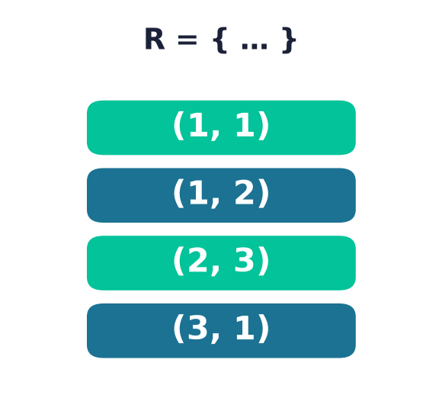
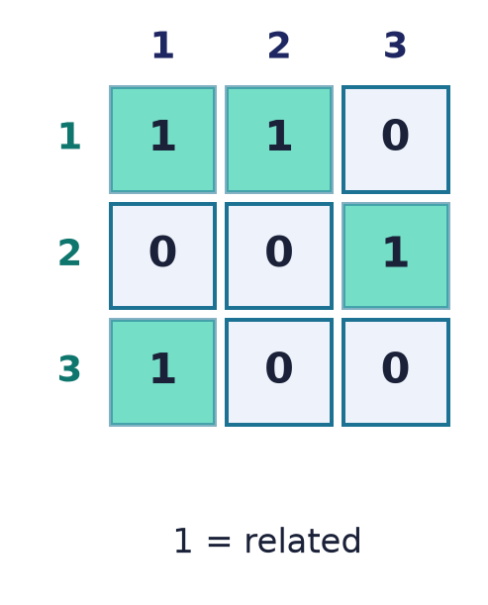
Three ways to represent a relation
Ordered pairs
the related pairs, listed
Boolean matrix
1 where i R j, else 0
Directed graph
an arrow i → j when i R j
Notes:
The SAME relation on {1,2,3}, shown three ways: the raw pair-set, a Boolean matrix (great for computation), and a digraph (great for intuition). Trace any pair — say (2,3) — and you find it as a listed pair, as a 1 in row 2 column 3, and as an arrow 2→3. We switch freely between the three.

Slide 6
The relation matrix
Mᵢⱼ = 1 ⇔ i R j
A Boolean adjacency matrix over A.
Composition of relations = Boolean matrix product.
Powers Mᵏ reveal length-k connections.
Notes:
The matrix turns relational questions into linear-algebra-style computations over Booleans — composition is a matrix product, and reachability is a matrix power.

Slide 7
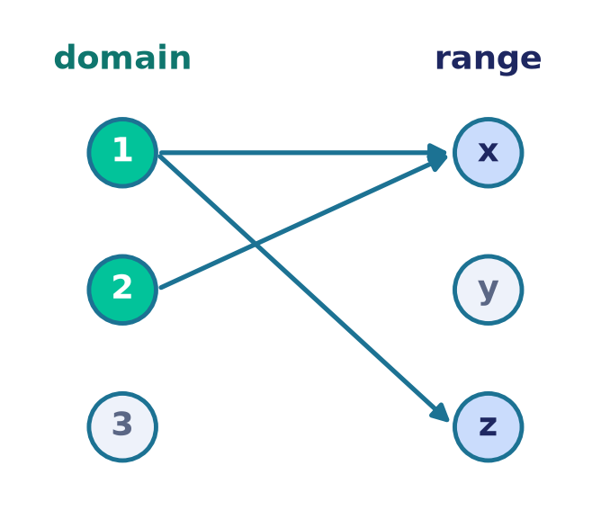
Domain & range
Which elements take part?
Domain: the a's that appear as a first coordinate.
Range: the b's that appear as a second coordinate.
Not every element of A or B need be used.
Notes:
Domain and range are the 'active' elements — the sources and targets that actually occur in the relation.

Slide 8
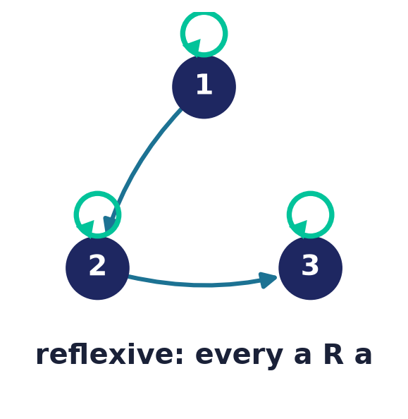
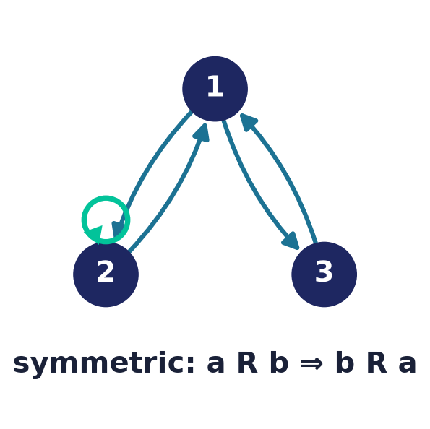
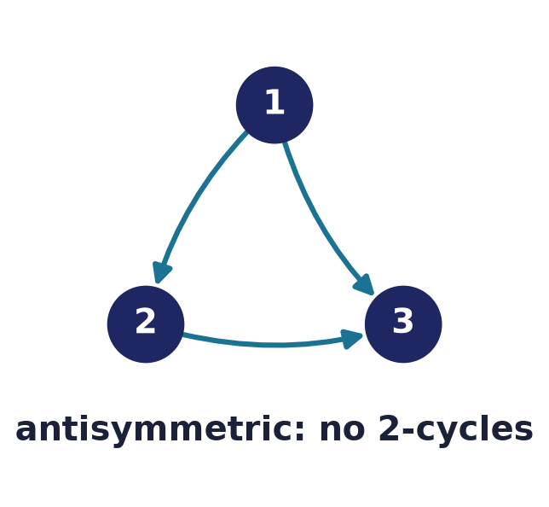
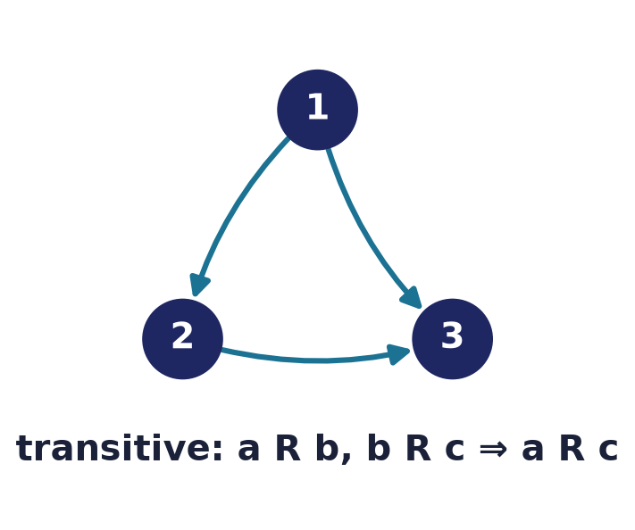
The core properties
Reflexive
Symmetric
Antisymmetric
Transitive
Notes:
These four are the most-used properties; their combinations define equivalence relations and partial orders. Three further properties — irreflexive, asymmetric, antitransitive — follow after the individual slides.

Slide 9
Reflexive
∀a: a R a
Every element relates to itself.
In the digraph: a self-loop at every vertex.
'≤', '=', 'divides' are reflexive; '<' is not.
Notes:
Reflexivity means a self-loop everywhere. Contrast irreflexive ('<'), where no element relates to itself.

Slide 10
Symmetric
a R b ⇒ b R a
If a relates to b, then b relates to a.
In the digraph: every arrow has a reverse.
'is friends with', '=' are symmetric.
Notes:
Symmetry makes the direction of arrows irrelevant — a symmetric relation is essentially an undirected graph.

Slide 11
Antisymmetric
a R b and b R a ⇒ a = b
No two distinct elements point both ways.
The hallmark of an ORDER relation.
'≤', 'divides', '⊆' are antisymmetric.
Notes:
Antisymmetry forbids 2-cycles between distinct elements — exactly what lets a relation express a consistent ordering.

Slide 12
Transitive
a R b and b R c ⇒ a R c
Chains collapse to direct links.
In the digraph: every 2-step path has a shortcut.
'≤', 'divides', 'ancestor of' are transitive.
Notes:
Transitivity is what makes reachability and ordering well-behaved — it guarantees a shortcut for every path.

Slide 13
Three more properties
Irreflexive
∀a: ¬(a R a) — no self-loop anywhere. The opposite extreme from reflexive, and NOT the same as 'not reflexive'. Example: '<'.
Asymmetric
a R b ⇒ ¬(b R a). Equivalently irreflexive + antisymmetric (Prop 3.6). A strict order '<' is the archetype.
Antitransitive
a R b and b R c ⇒ ¬(a R c) — a two-step path never has its shortcut. Example: the chain 1→2→3→4; 'beats' in rock-paper-scissors.
Notes:
Beyond the four core properties: irreflexive (no self-loops — not merely 'not reflexive'); asymmetric, which by Proposition 3.6 is exactly irreflexive plus antisymmetric — the shape of a strict order <; and antitransitive, where a two-step path never has its direct shortcut.

Slide 14
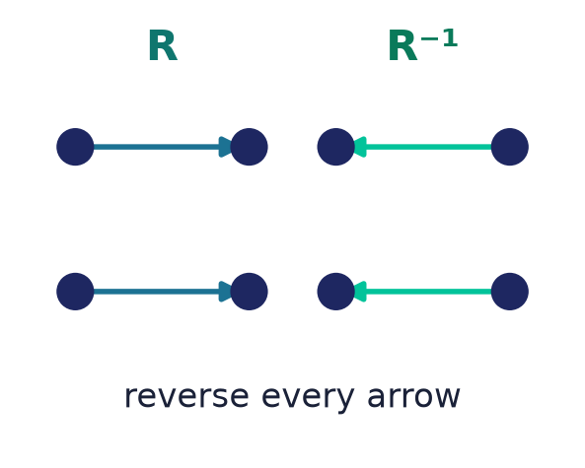
Inverse & composition
R⁻¹ and R ∘ S
Inverse R⁻¹: reverse every pair — swap (a,b) to (b,a).
Composition (R∘S): follow S then R.
Composition = Boolean product of the matrices.
Notes:
The inverse flips every arrow; composition chains two relations. Both are the relational analogues of function inverse and composition.

Slide 15
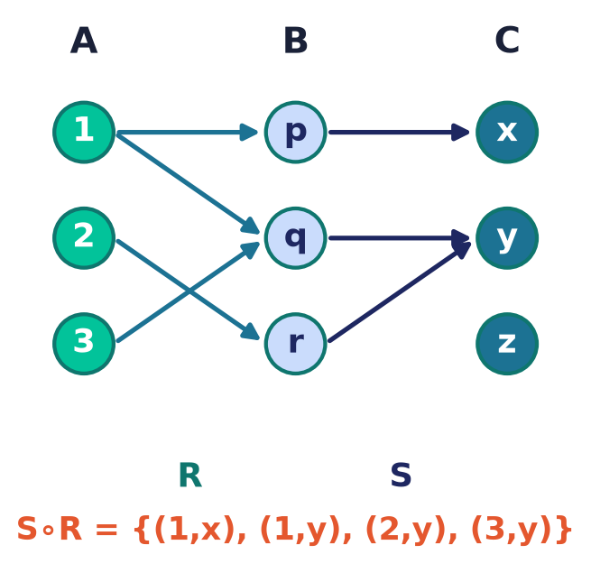
Composition — worked example
Follow R, then S
(S∘R): a → c when a R b and b S c for some b.
Trace every 2-hop path A → B → C.
Equivalently, the Boolean matrix product M_R ⊙ M_S.
Notes:
Composition chains two relations. To build S∘R, follow an R-arrow from A to B, then an S-arrow from B to C. Here 1→p→x and 1→q→y give (1,x) and (1,y); 2→r→y gives (2,y); 3→q→y gives (3,y). The very same answer drops out of the Boolean matrix product M_R ⊙ M_S — an OR-of-ANDs over the shared middle index — which is exactly why the matrix representation is so convenient.

Slide 16
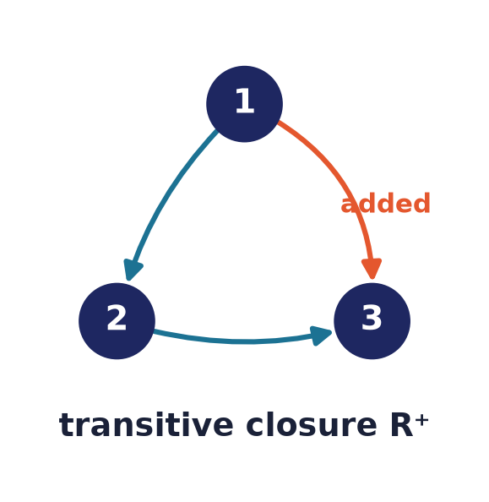
Closures
Add the least to gain a property
Reflexive closure: add all self-loops.
Symmetric closure: add all reverses.
Transitive closure R⁺: add all reachability — the connectivity relation.
Notes:
A closure is the smallest superset relation with a desired property. The transitive closure answers 'can I get from a to b at all?' — computed by Warshall's algorithm.

Slide 17
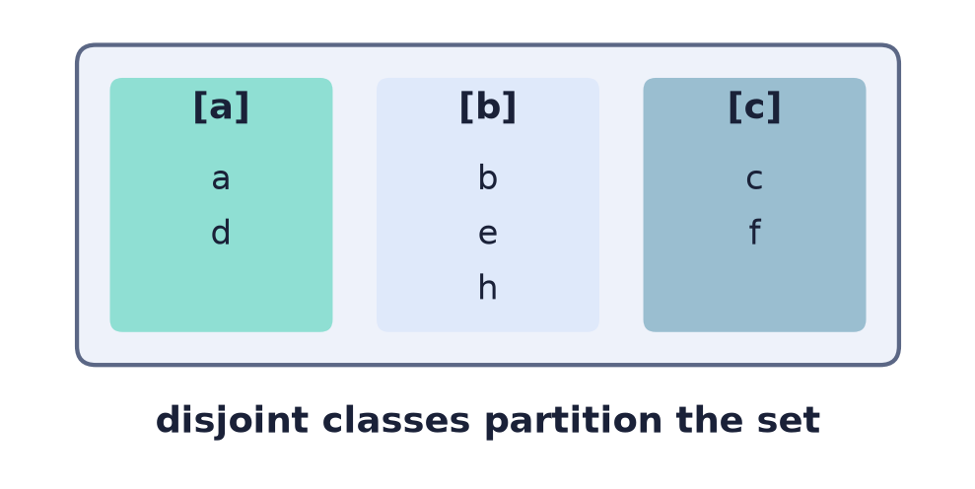
Equivalence relations
Reflexive + Symmetric + Transitive
Captures a notion of 'sameness'.
Examples: equality, congruence mod n, 'same colour'.
Every such relation carves the set into classes.
Notes:
An equivalence relation abstracts equality-up-to-some-criterion. The three properties together force the set to split into disjoint classes.

Slide 18
Classes & partitions
Classes ⇔ Partition
Equivalence class [a] = everything related to a.
Fundamental theorem: equivalence relations and partitions are the same thing.
Classes are disjoint and cover the whole set.
Notes:
The Fundamental Theorem of Equivalence Relations: giving an equivalence relation is exactly the same as giving a partition into disjoint blocks. Two views of one idea.

Slide 19
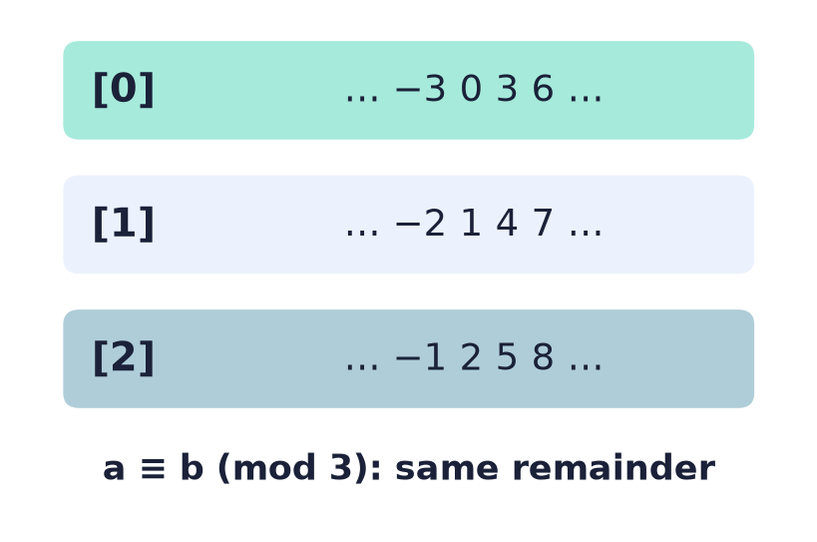
Congruence modulo n
a ≡ b (mod n)
Related when a and b leave the same remainder ÷ n.
An equivalence relation; its classes are the residues.
The arithmetic behind hashing, checksums, clocks.
Notes:
Congruence mod n is the archetypal equivalence relation — n classes [0]…[n−1], and the basis of modular arithmetic used all over computing.

Slide 20
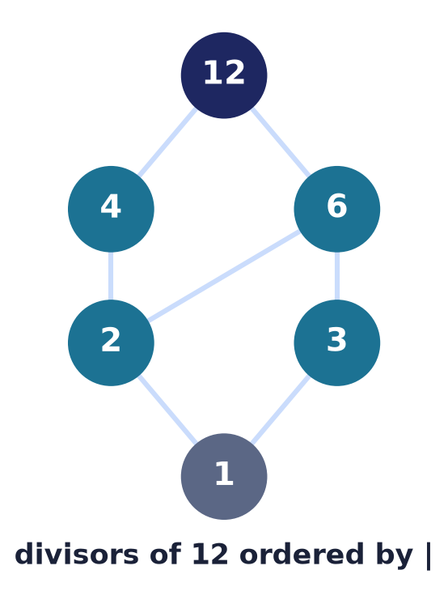
Partial orders & Hasse diagrams
Reflexive + Antisymmetric + Transitive
A consistent '≤' — but not everything need be comparable.
Hasse diagram: draw only the direct covers.
Divisibility, subset ⊆, and task dependencies are orders.
Notes:
A partial order lets some elements be incomparable. The Hasse diagram strips out loops and transitive edges, leaving a clean picture — used for dependency and scheduling graphs.

Slide 21
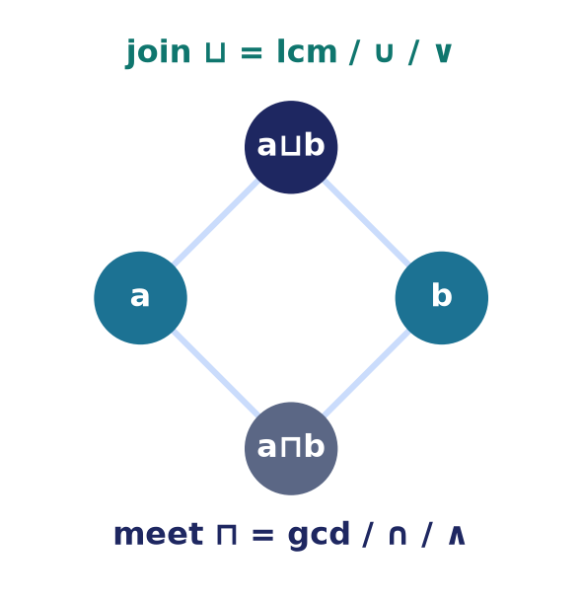
Extremes & lattices
Special elements of an order
Minimal / maximal: nothing below / above (may be several).
Least / greatest: below / above everything (unique if it exists).
Lattice: every pair has a meet ⊓ and a join ⊔.
Notes:
A minimal element has nothing strictly below it — but there can be several, so 'minimal' is weaker than 'least', which sits below everything. When every pair of elements has a greatest lower bound (meet ⊓) and a least upper bound (join ⊔), the order is a lattice. Divisibility gives gcd and lcm; the subsets of a set give ∩ and ∪ — the very same structure as the Boolean algebra of the next lecture, which is why this slide bridges into it.

Slide 22
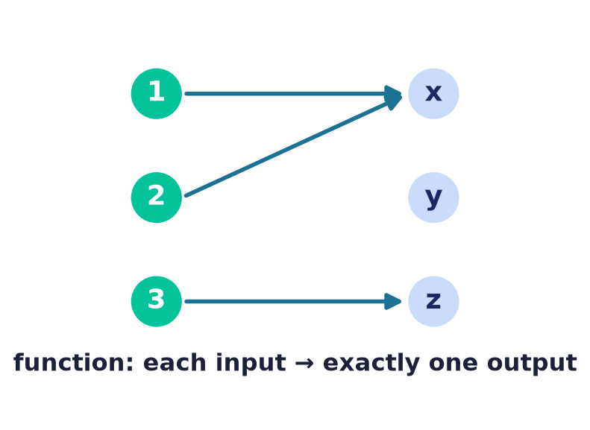
Functions are special relations
A function is a relation…
…where every input relates to exactly one output.
So functions inherit all of relation theory.
Injective / surjective / bijective describe the arrows.
Notes:
A function is just a relation with the single-valued, total constraint — one arrow out of every input. This unifies functions with everything we've built.

Slide 23
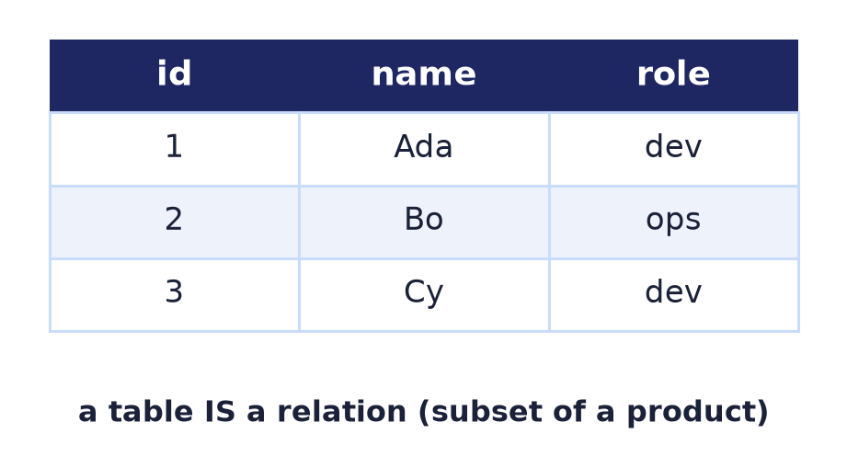
Relations run databases
The relational model
A table is a relation: a subset of a product of columns.
Relational algebra = select, project, join — set operations.
SQL is this theory made executable.
Notes:
Codd's relational model is literally this lecture: every table is an n-ary relation, and every query is relational algebra — selection, projection, and join built from set operations.

Slide 24
Common mistakes
Reflexive ≠ symmetric
Different properties — check each on its own.
Antisymmetric ≠ 'not symmetric'
'≤' is antisymmetric AND has a=a pairs.
Empty relation is transitive
Vacuously — no chains to violate it.
Classes must be disjoint
Overlapping 'classes' means it isn't an equivalence.
Notes:
Watch these: the properties are independent; antisymmetry is not the negation of symmetry; vacuous truth makes ∅ transitive; and equivalence classes never overlap.

Slide 25
Summary
— A relation is a subset of A × B — pairs, matrix, or digraph.
— Reflexive, symmetric, antisymmetric, transitive classify them.
— Equivalence = R+S+T → partition into classes.
— Partial order = R+A+T → Hasse diagram.
— Congruence mod n is the model equivalence relation.
— Functions and databases are relations in disguise.

Slide 26
Next → Lecture 4: Boolean algebra
Relations gave us TRUE/FALSE pairings. Next we study the algebra of true and false itself.
Statements · the operations ∧, ∨, ¬ · truth tables · the laws that mirror set algebra.
Notes:
A relation's matrix is a grid of true/false. Next lecture we study the algebra of true and false directly — Boolean algebra — whose laws are the exact mirror of the set laws from Lecture 2.

