Slide 1
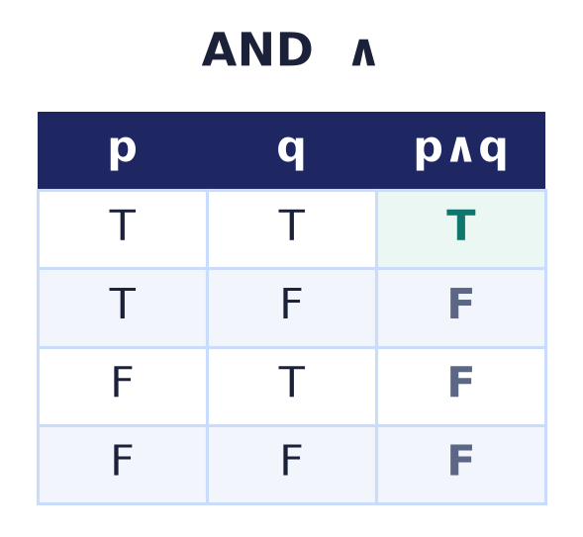
Boolean Algebra
Lecture 4 · basics
Statements · connectives · truth tables · the laws · logic = sets = bits
Notes:
Boolean algebra is the arithmetic of true and false. Today: statements and the logical connectives, truth tables, Boolean functions, the algebraic laws, and the deep isomorphism between logic, set algebra, and bits.

Slide 2
Why Boolean algebra?
It runs the machine
Every digital circuit computes a Boolean function of its input bits.
It mirrors sets
∧∨¬ obey exactly the ∩∪complement laws of Lecture 2.
It grounds logic
The foundation for propositional logic and proof.
Notes:
Two true/false values and three operations power all of digital hardware, obey the same laws as set algebra, and underpin the logic used to reason and prove.

Slide 3
Statements & truth values
A statement is true or false
A proposition: a declarative sentence with a definite truth value.
'7 is prime' (T), '2 > 3' (F).
Questions and opinions are not statements.
T = 1
true
F = 0
false
Notes:
A statement has exactly one truth value. Encoding true as 1 and false as 0 is what turns logic into an ALGEBRA — an arithmetic on {0,1} — and lets the very same operations run as bitwise instructions on a CPU. Compound statements are built from simple ones with the connectives we introduce next.

Slide 4
The connectives
¬ NOT
negation — flips the value
∧ AND
true iff both are true
∨ OR
true iff at least one
⊕ → ↔
xor · implies · iff
Notes:
Six connectives suffice for everything: negation, conjunction, disjunction, exclusive-or, implication, and equivalence. Each is defined by its truth table.

Slide 5
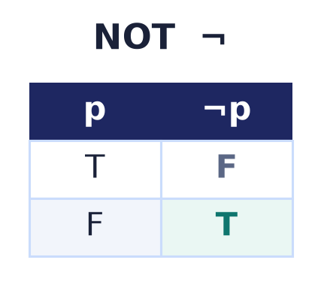
Negation ¬
¬p
True becomes false and vice-versa.
The only unary connective.

Slide 6
Conjunction ∧
p ∧ q
True only when BOTH are true.
The set-algebra analogue of ∩.

Slide 7
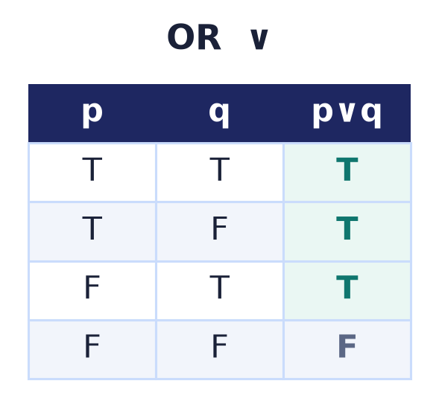
Disjunction ∨
p ∨ q
True when AT LEAST ONE is true (inclusive).
The analogue of ∪.

Slide 8
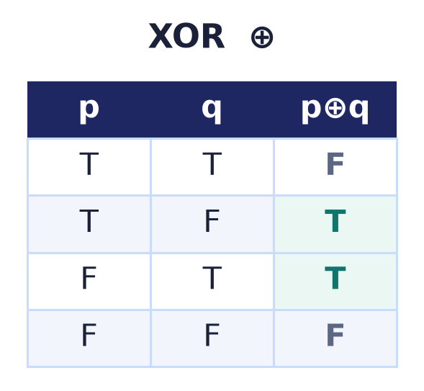
Exclusive-or ⊕
p ⊕ q
True when EXACTLY ONE is true.
= 'p or q but not both'; the analogue of △.

Slide 9
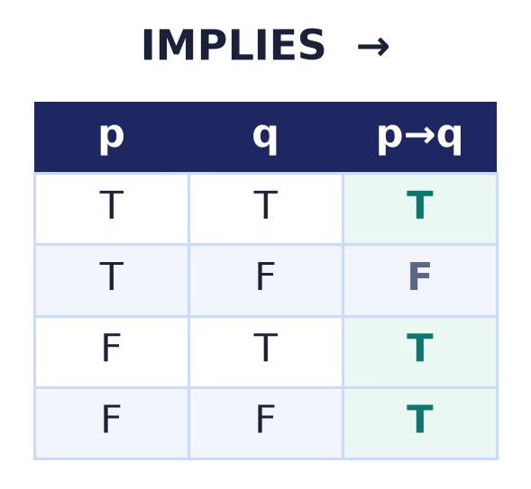
Implication →
p → q
False only when p is true and q is false.
'If p then q' — vacuously true when p is false.

Slide 10
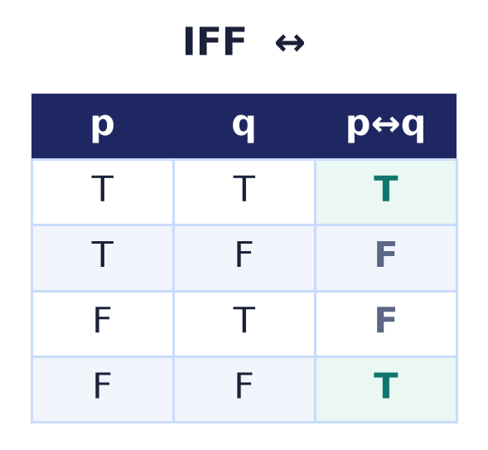
Equivalence ↔
p ↔ q
True when both sides have the SAME value.
'p if and only if q'.

Slide 11
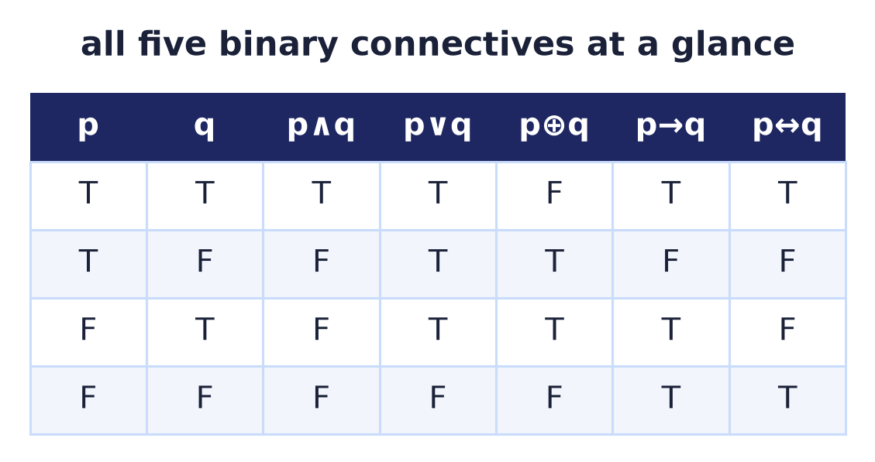
All connectives at a glance
Compare the patterns
One table, all five two-variable connectives.
∧ true once, ∨ three times, ⊕ on the 'disagree' rows.
Reading the columns side by side reveals the structure.
Notes:
Seeing every connective in one table lets you compare output patterns directly: AND is true in one row, OR in three, XOR in the two rows where the inputs disagree, implication is false only when p is true and q false, and equivalence is true on the two rows where they agree. Side by side, the family structure is obvious.

Slide 12
XOR is addition mod 2
A clean little algebra
p ⊕ q = (p + q) mod 2 — true exactly when the bits differ.
p ⊕ p = 0, p ⊕ 0 = p, p ⊕ 1 = ¬p.
Commutative, associative; ∧ distributes over ⊕.
Why it matters
({0,1}, ⊕, ∧) is a field — the basis of the algebraic normal form (Lecture 5).
And of every parity and checksum circuit.
Notes:
Exclusive-or is just addition modulo 2: p ⊕ q is 1 exactly when the two bits differ. That gives it a tidy algebra — p ⊕ p = 0, p ⊕ 0 = p, p ⊕ 1 = NOT p — and it is commutative and associative, with AND distributing over it. Together these make ({0,1}, ⊕, ∧) a field, which is the foundation of the algebraic normal form we meet in Lecture 5 and of the parity and checksum circuits used everywhere in error detection.

Slide 13
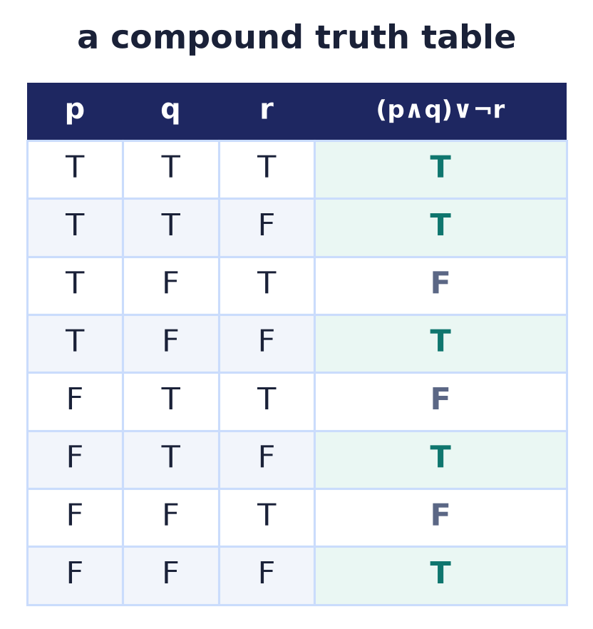
Compound expressions
Build up, then tabulate
Combine connectives into formulas like (p∧q)∨¬r.
A truth table lists the value for every assignment.
n variables ⇒ 2ⁿ rows.
Notes:
Any formula's meaning is fully captured by its truth table — one row per assignment of the variables. With n variables there are 2ⁿ rows.

Slide 14
Precedence
¬ > ∧ > ∨ > → > ↔
Negation binds tightest, then AND, then OR, …
¬p ∧ q means (¬p) ∧ q.
When in doubt, parenthesise.
p ∨ q ∧ r
reads as
p ∨ (q ∧ r)
Notes:
Precedence lets us drop parentheses, but the safe habit is to add them whenever a formula could be misread — exactly as in programming.

Slide 15
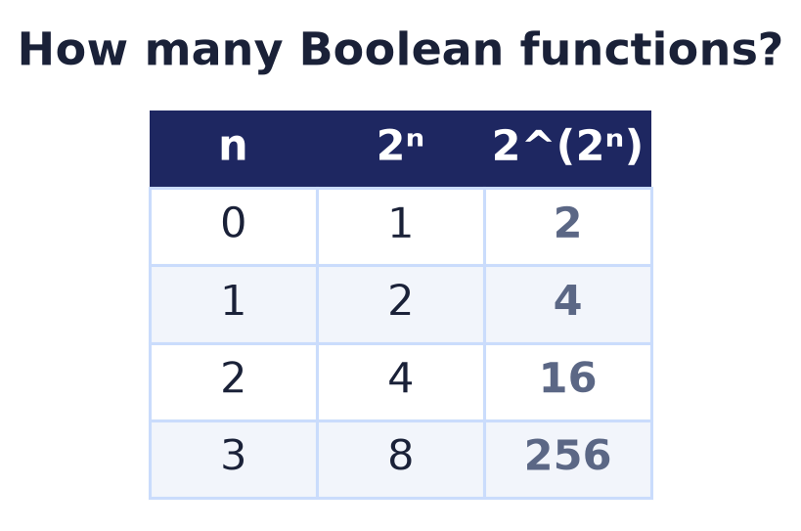
How many Boolean functions?
2^(2ⁿ)
A function of n bits fills a 2ⁿ-row truth table.
Each row's output is a free 0/1 choice.
So there are 2^(2ⁿ) functions — 16 for n = 2.
Notes:
Counting: 2ⁿ input rows, each with a binary output, gives 2^(2ⁿ) distinct functions. It explodes fast — 256 for three variables.

Slide 16
Tautology, contradiction, contingency
Tautology
Always true — e.g. p ∨ ¬p.
Contradiction
Always false — e.g. p ∧ ¬p.
Contingency
Sometimes true, sometimes false.
Notes:
Formulas fall into three classes by their truth column: always true (tautology), always false (contradiction), or mixed (contingency). This classification drives satisfiability in the logic lectures.

Slide 17
The laws of Boolean algebra
Commutative
p∧q = q∧p
Associative
(p∧q)∧r = p∧(q∧r)
Distributive
p∧(q∨r)=(p∧q)∨(p∧r)
Identity / domination
p∨F=p, p∧F=F
Complement
p∨¬p=T, p∧¬p=F
De Morgan
¬(p∧q)=¬p∨¬q
also: idempotent p∧p=p · absorption p∨(p∧q)=p · involution ¬¬p=p
Notes:
These are the same laws as set algebra with ∧,∨,¬ in place of ∩,∪,complement — because both are Boolean algebras. Beyond the six shown there are also the idempotent, absorption, and involution (double-negation) laws; the next slide but one applies them to simplify a formula.

Slide 18
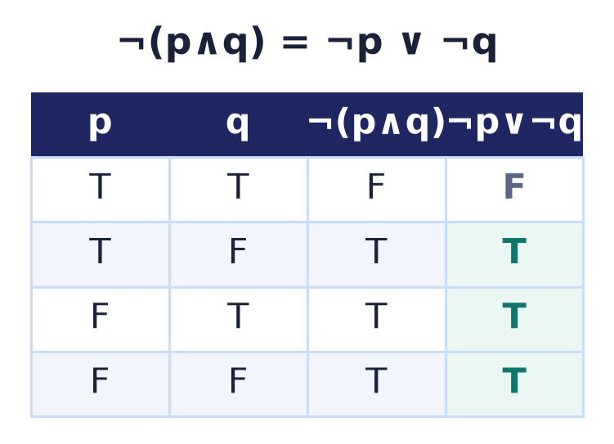
De Morgan's laws
¬(p∧q) = ¬p ∨ ¬q
¬(p∨q) = ¬p ∧ ¬q.
Negation swaps ∧ and ∨.
Proved by matching truth columns.
Notes:
De Morgan in logic is identical to De Morgan in sets. The truth table proves it: the columns for ¬(p∧q) and ¬p∨¬q agree on every row.

Slide 19
The duality principle
Swap ∧↔∨ and T↔F
Every identity has a dual obtained by the swap.
Prove one law and its dual comes free.
The same self-duality as set algebra.
p ∨ F = p
⇕ dual
p ∧ T = p
Notes:
Duality halves the theorems to prove — it follows from De Morgan together with involution (double negation). It is the structural symmetry between AND and OR, true and false.

Slide 20
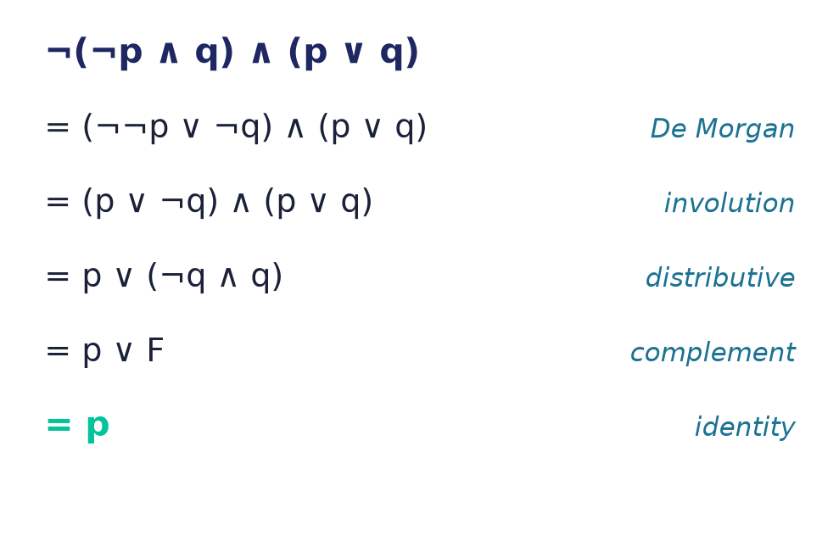
Simplifying with the laws
Laws as rewrite rules
Apply the identities left-to-right to shrink a formula.
Each step cites exactly one law.
¬(¬p∧q)∧(p∨q) collapses all the way to p.
Notes:
The laws are not just true statements — they are rewrite rules for simplification. Starting from ¬(¬p∧q)∧(p∨q): De Morgan and involution open the first factor, distributivity factors out p, the complement law kills ¬q∧q, and identity leaves just p. This algebraic minimisation is exactly what Lecture 5 automates with Karnaugh maps and Quine–McCluskey.

Slide 21
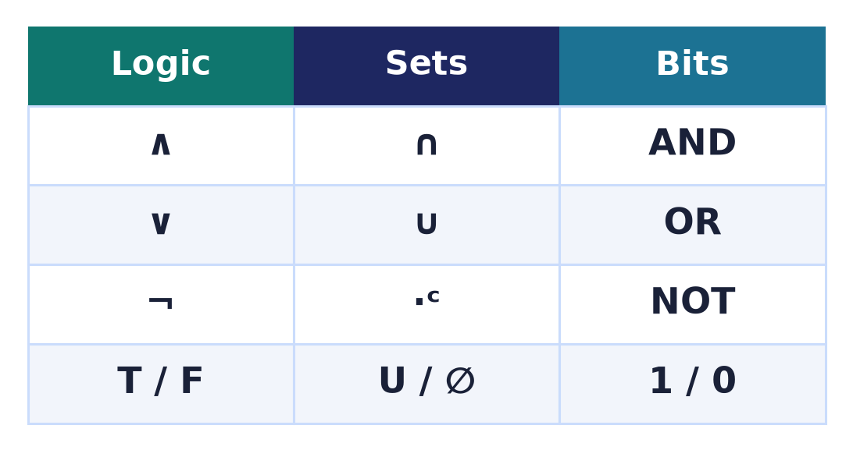
Three faces of one structure
Logic = Sets = Bits
∧ is ∩ is AND; ∨ is ∪ is OR; ¬ is complement is NOT.
The same Boolean algebra, three notations.
Learn once, apply everywhere.
Notes:
Propositional logic, the algebra of sets, and bitwise operations are three views of ONE two-element Boolean algebra — in code, the operators & | ~ ^ and the short-circuit && ||, and in SQL the AND/OR/NOT of a WHERE clause. This is why the same laws keep reappearing across logic, databases, and low-level programming.

Slide 22
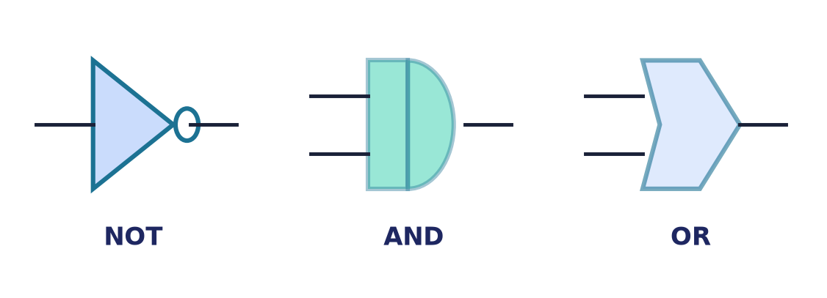
Boolean algebra is hardware
Gates compute connectives
Each connective is a logic gate; wires carry bits.
Shannon (1937): switching circuits ARE Boolean algebra.
Adders, ALUs, and memory are built from these.
Notes:
Claude Shannon's insight was that a circuit of switches computes a Boolean function. Every processor is Boolean algebra realised in silicon — which is why simplifying formulas (next lecture) saves real gates.

Slide 23
Common mistakes
∨ is inclusive
p∨q is true when BOTH hold; use ⊕ for exclusive.
Implication is not 'causes'
p→q is just ¬p∨q — true whenever p is false.
¬ binds tightest
¬p∧q = (¬p)∧q, not ¬(p∧q).
Tautology ≠ true-for-one-case
It must be true for EVERY row.
Notes:
The classic confusions: OR is inclusive, implication is material (not causal), negation binds tightest, and a tautology must hold on every row.

Slide 24
Summary
— Statements are true/false; connectives build compounds.
— A truth table (2ⁿ rows) fixes a formula's meaning.
— There are 2^(2ⁿ) Boolean functions of n variables.
— The laws mirror set algebra; each has a dual.
— Logic = sets = bits — one Boolean algebra.
— Every logic gate computes a connective.

Slide 25
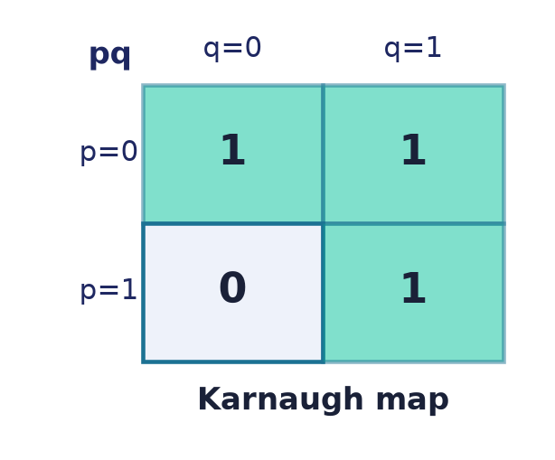
Next → Lecture 5: Boolean algebra
From tables to minimal circuits.
Canonical forms (SOP/POS) · Karnaugh maps · Quine–McCluskey · functional completeness · gates.
Notes:
Next we turn functions into the SMALLEST circuit: canonical forms give a systematic expression, and Karnaugh maps and Quine–McCluskey minimise it — the Karnaugh map previewed here.

