Slide 1
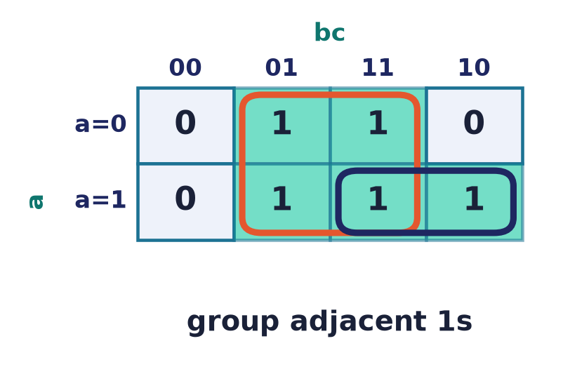
Boolean Algebra
Lecture 5 · functions, forms & minimization
Canonical forms · Karnaugh maps · Quine–McCluskey · gates · completeness
Notes:
From a truth table to the SMALLEST circuit. Today: how many functions there are, functional completeness, canonical forms, and the two minimisation methods — Karnaugh maps and Quine–McCluskey.

Slide 2
From tables to minimal circuits
We have
A function, given by its truth table.
We want
The cheapest expression / circuit computing it.
Two tools
Karnaugh maps (by eye) and Quine–McCluskey (by algorithm).
Notes:
Every truth table can be built as a circuit — but naively that circuit is huge. Minimisation finds a small equivalent, saving gates, power, and delay.

Slide 3
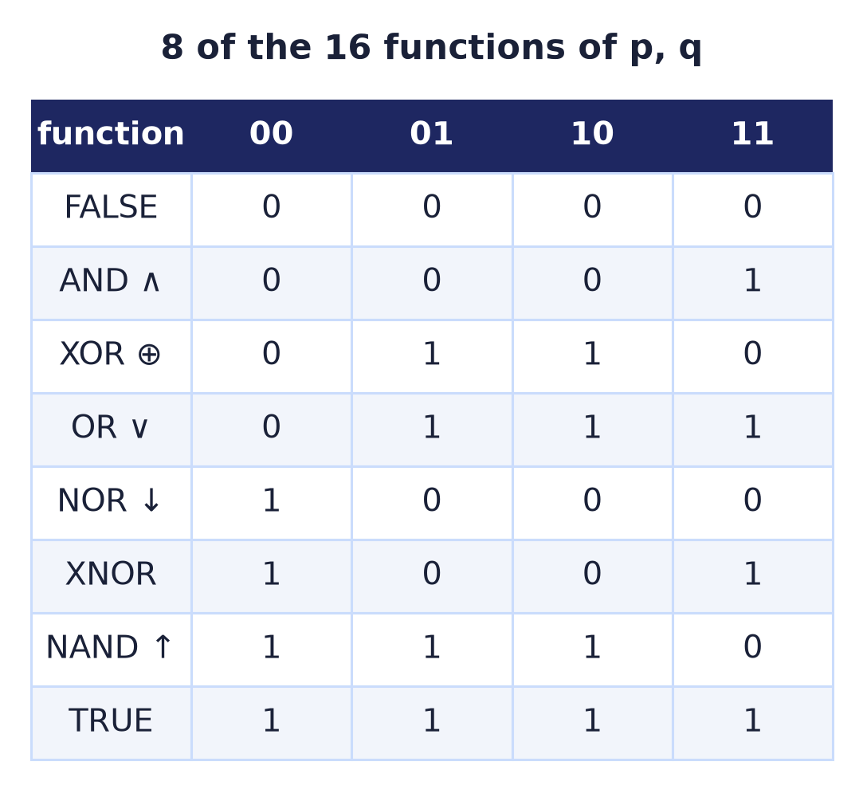
The 16 functions of two variables
2^(2²) = 16
Every 2-input function is one of sixteen.
The familiar ones: AND, OR, XOR, NAND, NOR, XNOR.
NAND and NOR turn out to be special.
Notes:
With four input rows and a free output bit each, there are exactly 16 two-variable functions. Most are named; NAND and NOR are the ones from which all others can be built.

Slide 4
Functional completeness
A basis builds everything
{¬, ∧, ∨} is complete — every function is expressible.
So is {¬, ∧} and {¬, ∨} (via De Morgan).
But {∧, ∨} alone is NOT — with no ¬ you cannot invert.
Question: can a SINGLE operator suffice?
{¬, ∧, ∨}
expresses every Boolean function
Notes:
A set of operators is functionally complete if every Boolean function can be written using only them. The standard basis is {¬,∧,∨}; De Morgan lets us drop one of ∧/∨, but negation is indispensable — {∧,∨} alone builds only monotone functions. Shannon's expansion, f = x·f(x=1) ∨ x̅·f(x=0), constructively shows why {¬,∧,∨} suffices: it splits any function on one variable and recurses.

Slide 5
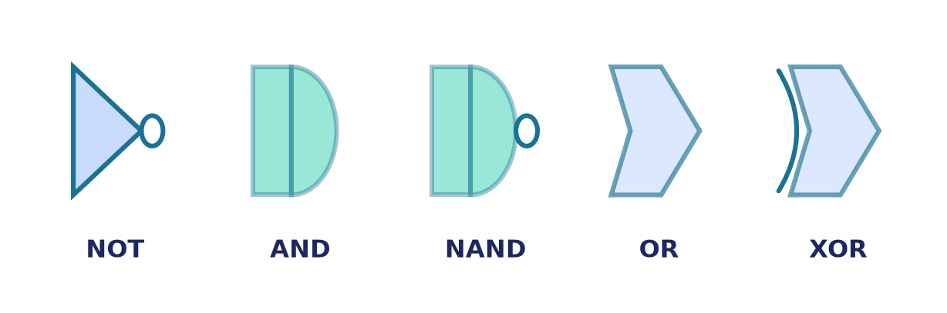
One gate rules them all: NAND
NAND (and NOR) are universal
¬p = p ↑ p
p ∧ q = (p ↑ q) ↑ (p ↑ q)
p ∨ q = (p ↑ p) ↑ (q ↑ q)
So a chip can be ALL NAND gates.
Notes:
Remarkably, the single operator NAND (or NOR) is complete on its own. Manufacturers exploit this: a fabric of identical NAND gates can realise any logic, simplifying design and production.

Slide 6
Logic gates
Symbols for the connectives
Each connective is a standard gate symbol.
A bubble on the output means negation (NAND, NOR).
Wires carry single bits between gates.
Notes:
These IEEE gate symbols are the vocabulary of circuit diagrams. The little bubble is inversion — an AND with a bubble is a NAND.

Slide 7
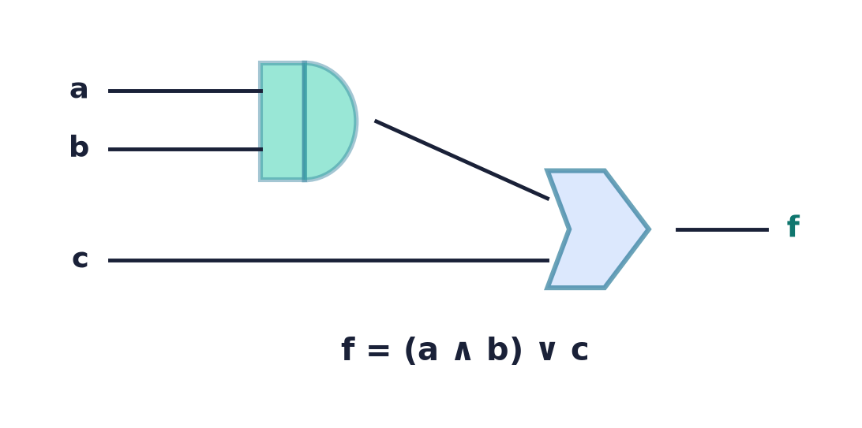
From expression to circuit
Read the formula as wiring
Each operator becomes a gate; each variable a wire.
Inner operations feed outer ones.
f = (a ∧ b) ∨ c → an AND into an OR.
Notes:
Translating a Boolean expression to hardware is mechanical: build the parse tree of the formula and replace each node with its gate. Minimising the formula first means fewer gates.

Slide 8
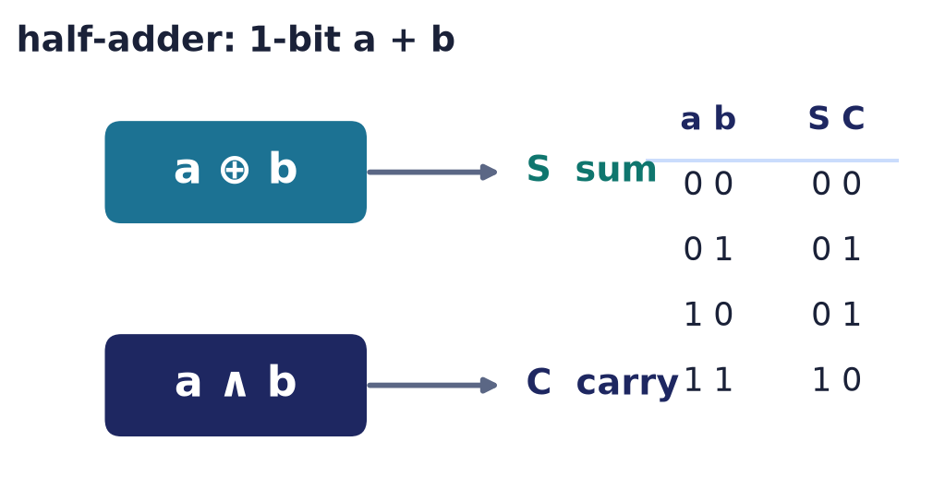
A real circuit: the half-adder
Add two bits
Sum S = a ⊕ b — 1 when the bits differ.
Carry C = a ∧ b — 1 only when both are 1.
Two gates add one bit: the atom of arithmetic.
Notes:
The half-adder is the smallest arithmetic circuit: XOR produces the sum bit and AND the carry. Chaining full-adders — which also accept a carry-in — builds the ripple-carry adder inside every ALU. This is Boolean algebra literally performing addition, and it shows why the connectives of Lecture 4 are the foundation of computer arithmetic.

Slide 9
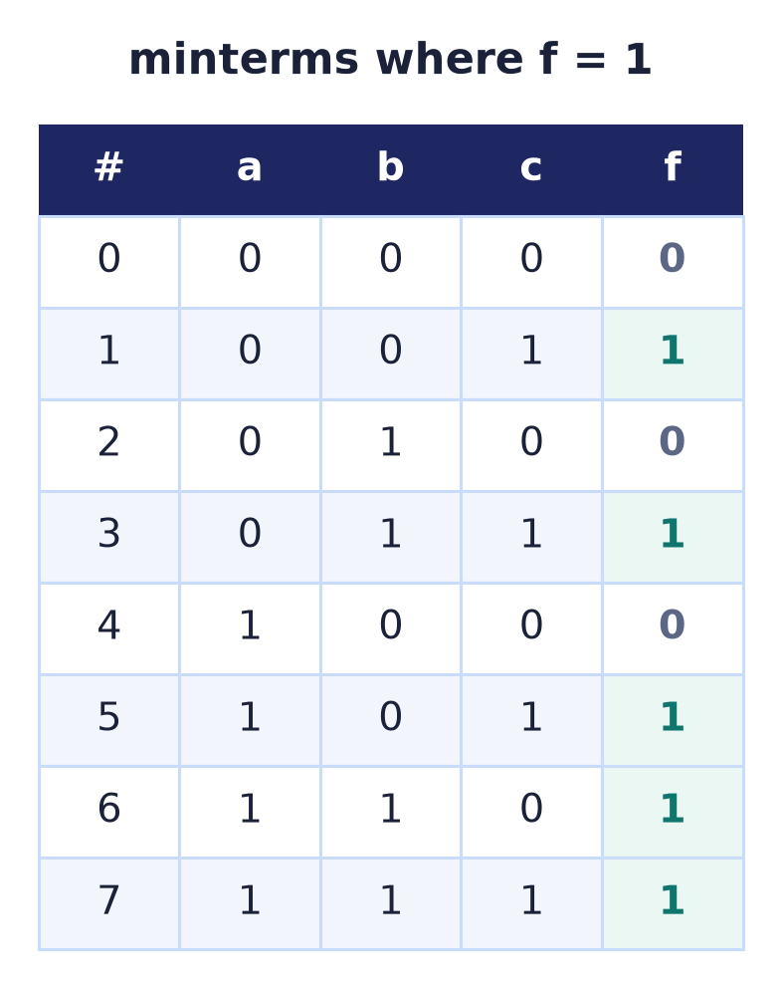
Minterms & maxterms
Name each row
Minterm: the AND of all variables making one row true.
Maxterm: the OR making one row false.
A function = the rows where it is 1.
Notes:
Each row of the truth table has a minterm (a product true only there) and a maxterm. Listing the rows where f=1 gives its minterms — the raw material for canonical forms.

Slide 10
Canonical DNF — SOP (sum of products)
f = ⋁ (minterms where f=1)
OR together the minterm for every 1-row.
f is 1 on rows 1,3,5,6,7 — five minterms:
f = a̅b̅c ∨ a̅bc ∨ ab̅c ∨ abc̅ ∨ abc.
Correct, but rarely minimal.
Notes:
The canonical disjunctive normal form ORs one product per 1-row. Here f equals 1 on rows 1, 3, 5, 6, and 7, so five minterms are ORed together. It always works and is unique, but it uses the maximum number of literals — the Karnaugh map will shrink it to F = ab ∨ c.

Slide 11
Canonical CNF — POS (product of sums)
f = ⋀ (maxterms where f=0)
AND together the maxterm for every 0-row.
The dual of SOP — group the zeros instead.
Choose whichever is cheaper for your function.
SOP ⋁∧
POS ⋀∨
Notes:
POS is the dual canonical form, built from the 0-rows. SOP suits functions with few 1s; POS suits functions with few 0s.

Slide 12
A third form: ANF (Zhegalkin)
XOR instead of OR
Every function has a UNIQUE algebraic normal form: a XOR of distinct AND-terms (plus maybe 1).
Works because {∧, ⊕, 1} is functionally complete.
The natural form for parity and checksums.
How to get it
Rewrite a̅ = a ⊕ 1 and x∨y = x ⊕ y ⊕ xy, expand, then simplify with a ⊕ a = 0 and aa = a.
Degree ≤ 1 ⇒ the function is affine (linear).
Notes:
Beyond DNF and CNF there is a third, XOR-based canonical form. Since the set {AND, XOR, 1} is functionally complete, every Boolean function has a unique algebraic normal form — a XOR of distinct AND-terms, optionally including the constant 1 — called its Zhegalkin polynomial. You reach it by substituting NOT-a = a XOR 1 and OR expressed through XOR, expanding, and simplifying with a XOR a = 0 and a AND a = a. It is the natural language of parity and checksums, and a function is affine, or linear, exactly when its ANF has degree at most one.

Slide 13
Algebraic minimization
Apply the laws
Use complement (x ∨ x̅ = 1), absorption, distributivity.
ab ∨ ab̅ = a(b ∨ b̅) = a.
Powerful, but easy to miss simplifications.
a b̅ c ∨ a b c
= a c (b̅ ∨ b)
= a c
Notes:
Minimising by the laws is fully general but unsystematic — you can always find one more step, or miss one. Karnaugh maps make the adjacencies visual instead.

Slide 14
Karnaugh maps — the idea
Adjacency = simplification
Lay the truth table on a grid where neighbours differ in one bit.
Adjacent 1s combine and drop that variable.
Rows/columns are in Gray-code order.
Notes:
A Karnaugh map arranges minterms so that physically adjacent cells differ in exactly one variable. Then a block of adjacent 1s is a single product term — minimisation becomes 'draw the biggest rectangles'.

Slide 15
Grouping the 1s
Bigger groups, fewer literals
Group 1s into rectangles of size 1, 2, 4, 8…
Each group of 2ᵏ cells removes k variables.
Cover every 1 with as few, as large groups as possible.
RED → c NAVY → ab
⇒ F = ab ∨ c
Notes:
The rules: groups must be powers of two, as large as possible, and together cover all the 1s. Each doubling of a group eliminates one more variable. Here the c-block (red, four cells) and the ab-block (navy, two cells) cover all five 1s, giving the minimal F = ab ∨ c — down from five product terms.

Slide 16
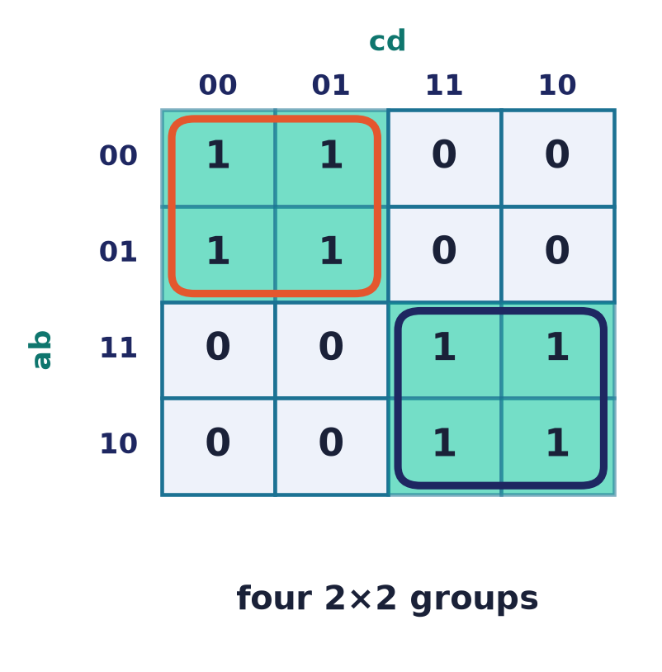
Four variables & wrap-around
16 cells, edges wrap
A 4×4 map handles four variables.
The map is a torus — left/right and top/bottom edges are adjacent.
Corners can form a single group.
Notes:
Four-variable maps add wrap-around adjacency: the grid is really a torus, so opposite edges — and all four corners — are neighbours and may group together.

Slide 17
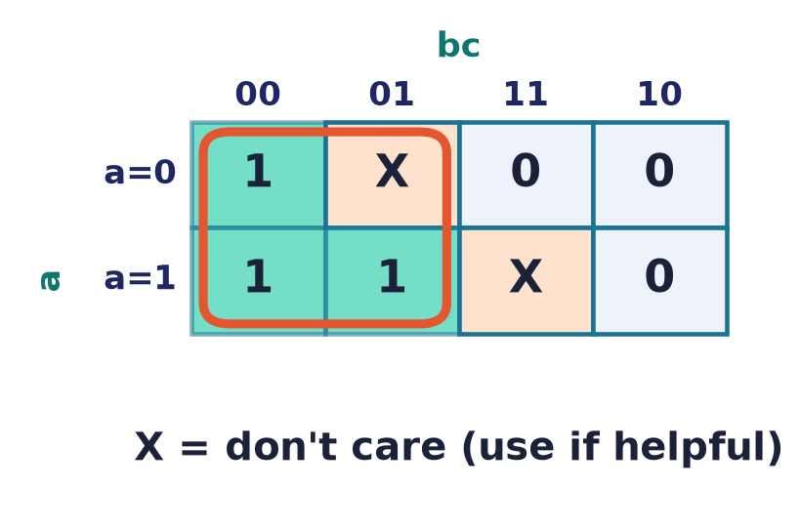
Don't-care conditions
X = free choice
Some input combinations never occur (or the output is unused).
Mark them X and treat as 0 OR 1 — whichever enlarges a group.
Don't-cares often shrink the circuit dramatically.
Notes:
Don't-cares are gifts: you may set each to 0 or 1 to make groups bigger. Exploiting them is one of the biggest real-world savings in logic design.

Slide 18
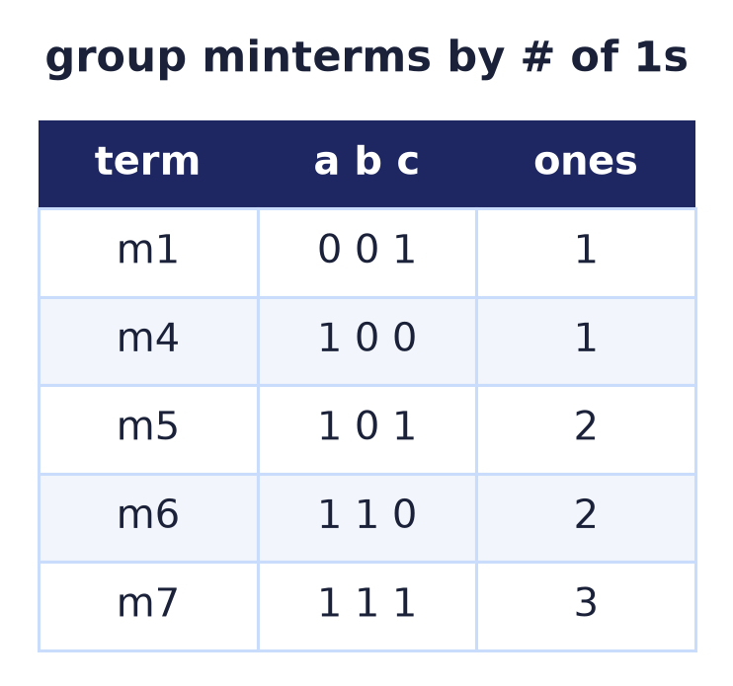
The Quine–McCluskey algorithm
Minimisation you can program
Karnaugh maps stop working past ~5 variables.
Q–M groups minterms by their number of 1s, then merges.
Prime implicant: a group that can't grow — essential ones must be chosen.
Systematic, exact, and automatable.
Notes:
Quine–McCluskey is the tabular, algorithmic version of the K-map, suitable for a computer and any number of variables. It finds prime implicants, then selects a minimal cover.

Slide 19
Cost: before vs after
Canonical SOP
6 gates
After F = ab ∨ c
2 gates
Notes:
Minimisation is not cosmetic: fewer literals mean fewer gates, less silicon area, lower power, and shorter propagation delay. The same function, a third of the hardware.

Slide 20
Common mistakes
Groups must be 2ᵏ
Sizes 1,2,4,8… only — never a group of 3.
Use the wrap-around
Edges and corners of a K-map are adjacent.
Cover every 1
Overlap is fine; leaving a 1 uncovered is wrong.
Don't-cares are optional
Set each to 0 or 1 — only if it helps.
Notes:
The classic K-map slips: illegal group sizes, forgetting wrap-around adjacency, leaving a 1 uncovered, and mishandling don't-cares.

Slide 21
Summary
— There are 2^(2ⁿ) Boolean functions of n variables.
— {¬,∧,∨} is complete; NAND (or NOR) alone is universal.
— Canonical SOP/POS build any function from its rows.
— Karnaugh maps minimise by grouping adjacent cells.
— Quine–McCluskey does the same, algorithmically.
— Minimisation saves real gates, power, and delay.

Slide 22
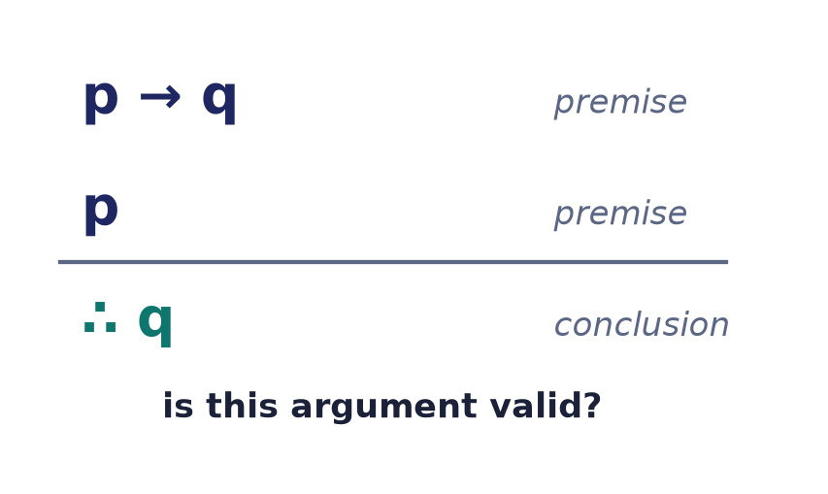
Next → Lecture 6: Propositional logic
Same connectives — now used to REASON.
Arguments, validity, satisfiability (SAT), entailment, CNF/DNF — deciding when a conclusion truly follows.
Notes:
We've used ∧,∨,¬ to compute. Next we use them to REASON: when does a conclusion follow from premises? That's propositional logic — validity, entailment, and the satisfiability problem.

