Slide 1
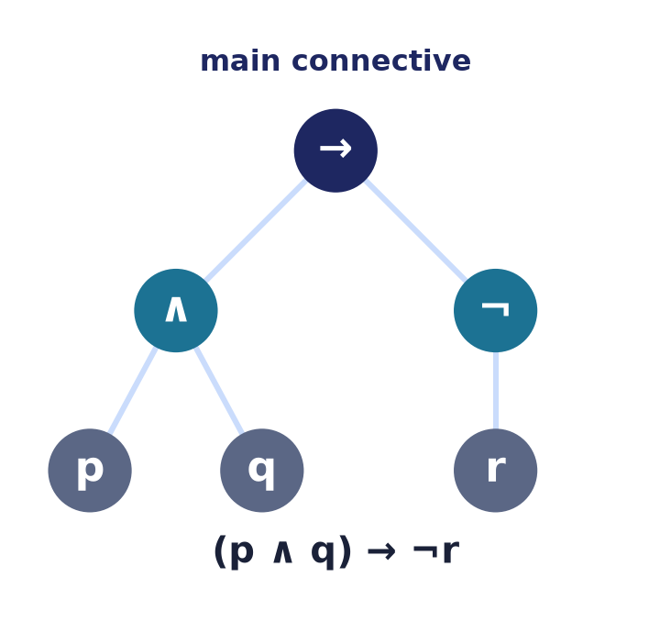
Propositional Logic
Lecture 6 · Computer Discrete Mathematics
Syntax · semantics · SAT · equivalence · entailment · validity
Notes:
We now use the connectives to REASON. Today: the syntax and semantics of formulas, classifying them, satisfiability and SAT, logical equivalence and normal forms, and when a conclusion truly follows from premises.

Slide 2
From computing to reasoning
Lecture 4–5
Compute a Boolean value; minimise a circuit.
Now
Decide whether an ARGUMENT is valid.
The question
Does the conclusion follow from the premises?
Notes:
Same connectives, new purpose. Instead of computing outputs we ask a reasoning question: is a conclusion guaranteed whenever the premises hold?

Slide 3
Atomic & compound propositions
Build from atoms
A proposition: a declarative sentence, exactly one of true/false.
Atomic: an indivisible proposition — p, q, r.
Compound: atoms joined by connectives.
p, q
(p ∧ q) → ¬r
Notes:
A proposition is a declarative sentence with a definite truth value. Questions, commands, and 'open sentences' with a free variable (like 'x > 3') are NOT propositions until the variable is fixed — handling those needs the predicate logic hinted at later. Atomic propositions are the leaves; compounds are built with ¬,∧,∨,→,↔, and propositional logic treats each atom as an opaque true/false.

Slide 4
The connectives, in reasoning
¬ ∧ ∨ ⊕
not, and, or, xor
→ implication
the heart of inference — 'if…then'
↔ equivalence
'if and only if' — two-way
Notes:
Implication is the connective that carries reasoning: an argument is a chain of implications. Recall p→q is false only when p is true and q is false, and that exclusive-or ⊕ is true exactly when the two sides differ.

Slide 5
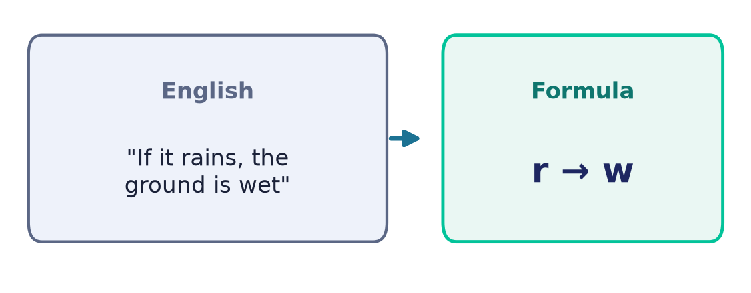
Formalization: English → formula
Strip away the words
Identify the atoms, then the connectives.
'If it rains, the ground is wet' → r → w.
'not both' ¬(p∧q) ≠ 'both not' ¬p∧¬q.
Ambiguity in English becomes explicit here.
Notes:
Formalization is the crucial modelling step: name the atomic statements, then translate the logical words. It forces the ambiguity of natural language to be resolved.

Slide 6
Syntax: well-formed formulas
The grammar of formulas
An atom is a formula.
If φ, ψ are formulas, so are ¬φ, (φ∧ψ), (φ∨ψ), (φ→ψ), (φ↔ψ).
Nothing else is a formula.
(p ∧ q) → ¬r
p ∧ ) q ¬
not well-formed
Notes:
A recursive grammar defines exactly which strings are formulas. Well-formedness is what lets us parse and evaluate unambiguously.

Slide 7
Parse trees & the main connective
Structure decides meaning
Every formula parses to a unique tree.
The root is the MAIN connective — evaluated last.
Unique readability: no ambiguity.
Precedence: ¬ > ∧ > ∨ > → > ↔
→ is right-associative:
p→q→r = p→(q→r)
≠ (p→q)→r
Notes:
The parse tree exposes structure: the main connective at the root determines the formula's overall shape and is applied last when evaluating. Precedence (¬ binds tightest, ↔ loosest) and the right-associativity of → let us drop parentheses — but beware that (p→q)→r and p→(q→r) are genuinely different formulas, a common trap. Unique readability guarantees exactly one tree per formula.

Slide 8
Semantics: truth under an interpretation
Meaning = truth value
An interpretation assigns T/F to each atom.
The truth of a compound follows recursively.
A truth table lists all 2ⁿ interpretations.
n atoms
2ⁿ rows
Notes:
Semantics assigns meaning: given the atoms' values, the connectives' truth tables fix the whole formula's value. Enumerating all assignments is the truth table.

Slide 9
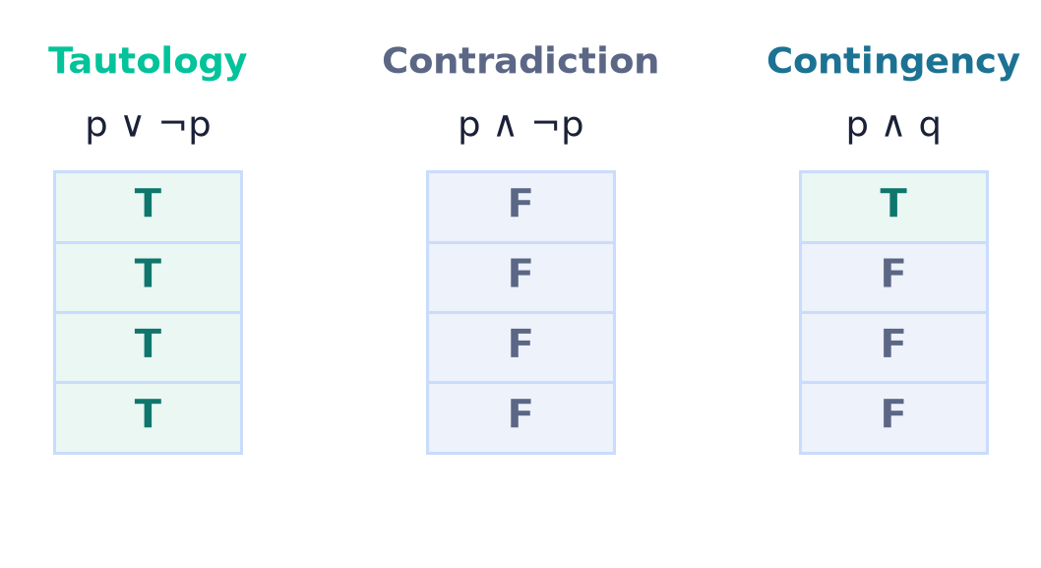
Classifying formulas
Three kinds
Tautology: true under EVERY interpretation.
Contradiction: false under every interpretation.
Contingency: sometimes true, sometimes false.
Notes:
The truth column classifies a formula: all-true (tautology), all-false (contradiction), or mixed (contingency). Tautologies are the logical laws; contradictions are unsatisfiable.

Slide 10
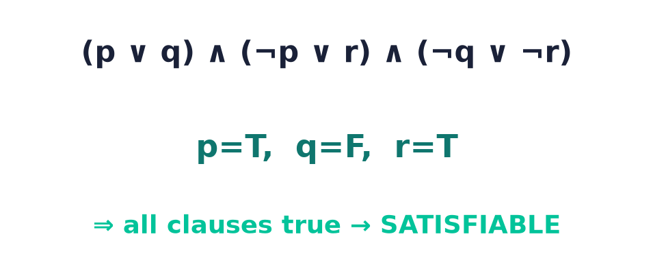
Satisfiability
Is there ANY true row?
A formula is satisfiable if some interpretation makes it true.
Contradictions are the only unsatisfiable formulas.
Finding the row is the practical problem.
Notes:
Satisfiability asks merely whether one true row exists. It is weaker than tautology but far more useful in practice — it is the question solvers answer.

Slide 11
The SAT problem
The problem
Given a formula, is it satisfiable?
Hard
SAT is NP-complete — the first proven such problem.
Yet practical
Modern SAT solvers handle millions of variables.
Notes:
SAT is the canonical NP-complete problem — worst-case exponential — yet engineered SAT solvers routinely crack industrial instances, powering verification, planning, and configuration. Validity is its mirror image: φ is a tautology exactly when ¬φ is UNSATISFIABLE, so a solver can prove a theorem by failing to refute it.

Slide 12
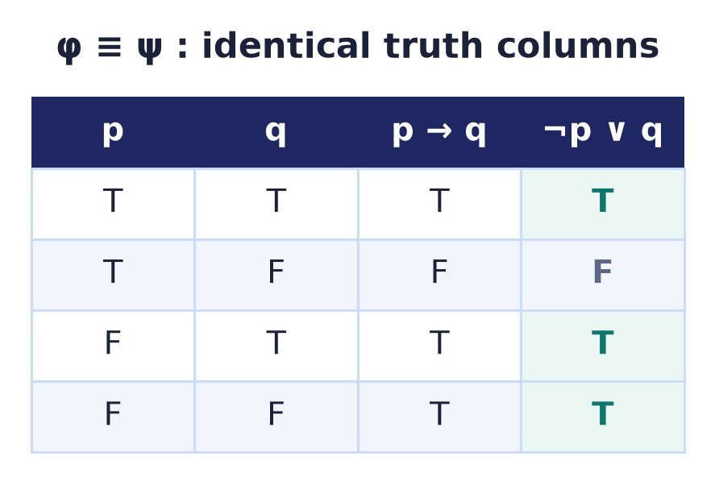
Logical equivalence
φ ≡ ψ
Same truth value under every interpretation.
Equivalently: φ ↔ ψ is a tautology.
Lets us rewrite formulas while preserving meaning.
Notes:
Two formulas are logically equivalent when their truth columns match on every row — here p→q and ¬p∨q agree throughout, so p→q ≡ ¬p∨q. Note the level distinction: ≡ is a meta-level claim ABOUT two formulas (their columns coincide), whereas ↔ is an object-level connective INSIDE a formula; the two are linked because φ≡ψ holds exactly when φ↔ψ is a tautology. Equivalence is the licence to simplify — replace a formula by any equivalent one.

Slide 13
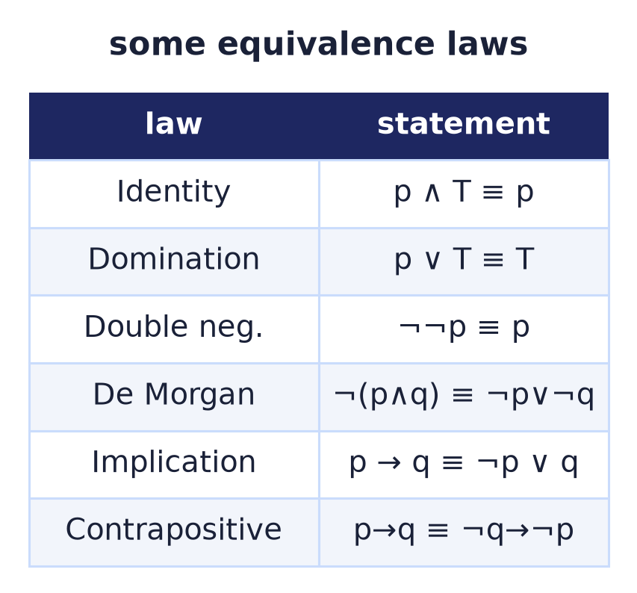
The equivalence laws
An algebra for formulas
The set/Boolean laws, now on propositions.
Implication: p→q ≡ ¬p ∨ q.
Contrapositive: p→q ≡ ¬q→¬p.
Notes:
The same commutativity, distributivity, and De Morgan laws hold, plus implication and contrapositive rewrites. Together they let us transform formulas algebraically.

Slide 14
Reasoning algebraically
Prove without a table
Chain equivalences to show a formula is a tautology.
Or simplify it to a normal form.
Scales where 2ⁿ truth tables do not.
p → (p ∨ q)
≡ ¬p ∨ (p ∨ q)
≡ (¬p ∨ p) ∨ q ≡ T
Notes:
Algebraic reasoning proves tautologies by rewriting, avoiding the exponential blow-up of truth tables — the method that scales to large formulas.

Slide 15
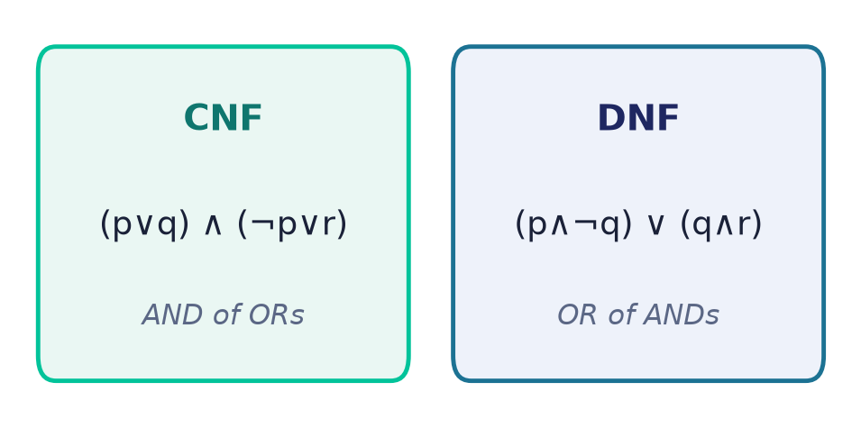
Normal forms: CNF & DNF
Standard shapes
CNF: an AND of OR-clauses.
DNF: an OR of AND-terms.
SAT solvers expect CNF; DNF makes satisfiability obvious.
Notes:
Every formula can be rewritten into CNF or DNF. CNF is the input format for SAT solvers; DNF makes satisfiability trivial to read but can be exponentially large.

Slide 16
Converting to a normal form
Rewrite in steps
1 · Rewrite → as ¬p∨q, and ↔ as (p→q)∧(q→p).
2 · Push ¬ inward (De Morgan, double negation).
3 · Distribute to reach AND-of-ORs (CNF).
→,↔ ⇒ ¬,∧,∨
¬ inward ⇒ literals
distribute ⇒ CNF
Notes:
A fixed three-step recipe converts any formula to CNF: remove implications, drive negations to the atoms, then distribute. The same steps in the other order give DNF.

Slide 17
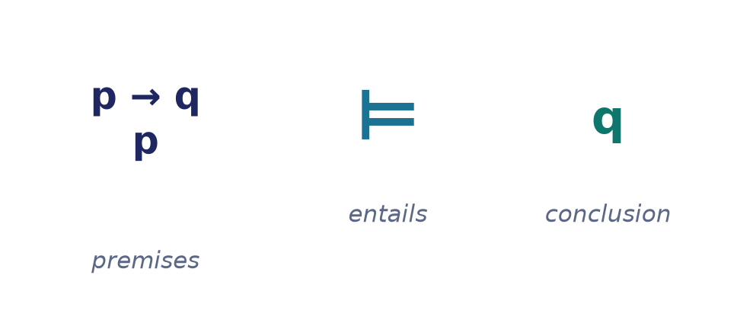
Logical consequence
Premises ⊨ conclusion
Every interpretation making all premises true makes the conclusion true.
⊨ is entailment — the meaning of 'follows from'.
The core of a valid argument.
Notes:
Entailment (⊨) is the semantic notion of 'follows': in every model of the premises, the conclusion holds. It is exactly what makes an argument valid.

Slide 18
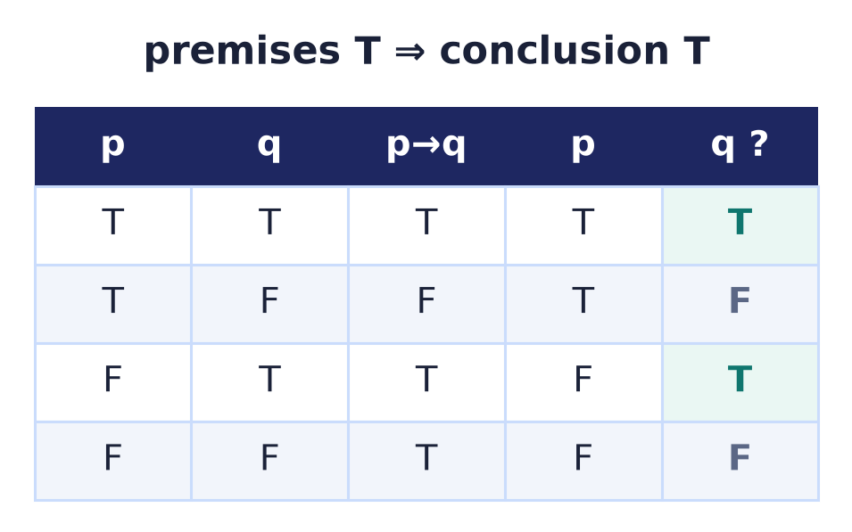
Validity of arguments
Check every premise-true row
Modus ponens: p→q, p ⊨ q.
In each row where both premises are true, q is true.
Equivalently: (premises → conclusion) is a tautology.
Invalid — affirming the consequent:
p→q, q ⊭ p
the row p=F, q=T makes both premises true but the conclusion false.
Notes:
To test validity, restrict to rows where all premises hold and check the conclusion. Modus ponens passes — and equivalently, the implication from premises to conclusion is a tautology.

Slide 19
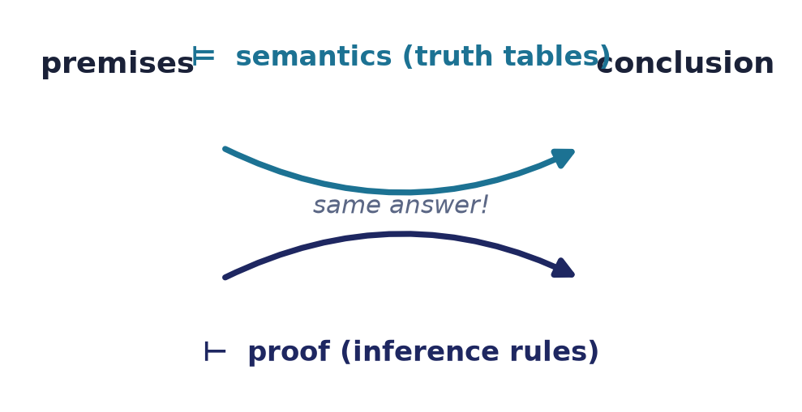
Semantics vs proof
⊨ and ⊢
⊨ : truth in every model (semantics).
⊢ : derivable by inference rules (syntax).
Soundness & completeness: they agree — the bridge to proofs.
Notes:
Two routes to 'valid': checking all models (⊨) or deriving with rules (⊢). Soundness and completeness theorems guarantee they coincide — the reason proof works, and the bridge to Lecture 7.

Slide 20
Propositional logic in software
SAT solvers
Verification, planning, configuration, and cryptanalysis run on SAT.
Type checking
Constraint solving for types reduces to logical satisfiability.
Hardware/model checking
Prove a circuit or protocol can never reach a bad state.
Notes:
Propositional reasoning is industrial: equivalence checking of circuits, bounded model checking of protocols, type inference, and planning are all encoded as SAT and discharged automatically.

Slide 21
Common mistakes
Implication ≠ causation
p→q is ¬p∨q; it holds whenever p is false.
Satisfiable ≠ tautology
One true row is not every true row.
Converse is not equivalent
p→q ≢ q→p; only the contrapositive is.
Valid ≠ true premises
Validity is about the LINK, not the facts.
Notes:
The recurring errors: reading implication as cause, confusing satisfiable with tautology, assuming the converse, and thinking validity requires true premises.

Slide 22
Summary
— A formula parses to a unique tree; the root is the main connective.
— Semantics = truth over all 2ⁿ interpretations.
— Tautology / contradiction / contingency; SAT is NP-complete.
— Equivalence laws rewrite formulas; CNF/DNF standardise them.
— ⊨ (entailment) defines a valid argument.
— Semantics (⊨) and proof (⊢) agree.

Slide 23
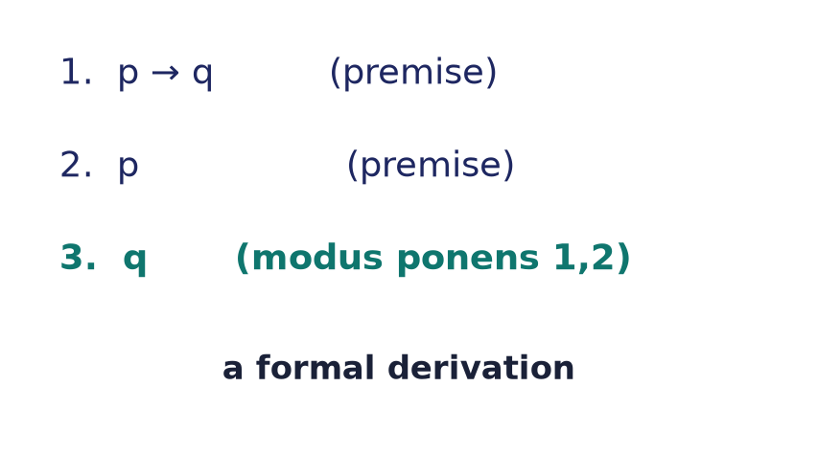
Next → Lecture 7: Methods of proof
From checking to DERIVING.
Direct · contrapositive · contradiction · cases · induction — building conclusions with inference rules (⊢).
Notes:
Truth tables check validity by brute force. Next we DERIVE conclusions with inference rules — direct proof, contradiction, cases, and induction — the syntactic (⊢) side that soundness and completeness tie back to semantics.

