Slide 1
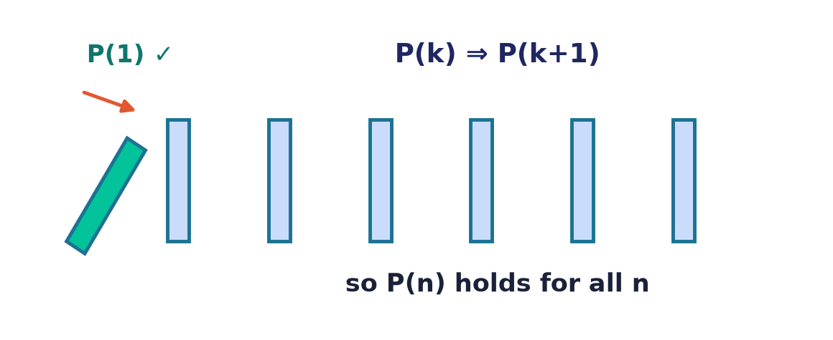
Methods of Proof
Lecture 7 · Computer Discrete Mathematics
Inference · direct · contradiction · cases · induction
Notes:
Logic told us WHEN a conclusion follows; now we learn HOW to derive it convincingly. Today: inference rules, the standard proof techniques, and mathematical induction — the engine of correctness proofs.

Slide 2
What is a proof?
A proof
A finite chain of steps from premises to conclusion.
Each step
Justified by a definition, axiom, or inference rule.
Why rigor
It rules out plausible-but-false claims for good.
Notes:
A proof is an unbroken, checkable argument — every step justified. Rigor is what separates certainty from persuasion, and lets a result be trusted forever. The vocabulary of results: an axiom is assumed without proof; a theorem is a significant proved statement; a lemma is a helper proved along the way; a corollary follows quickly from a theorem; and a conjecture is a plausible claim not yet proved.

Slide 3
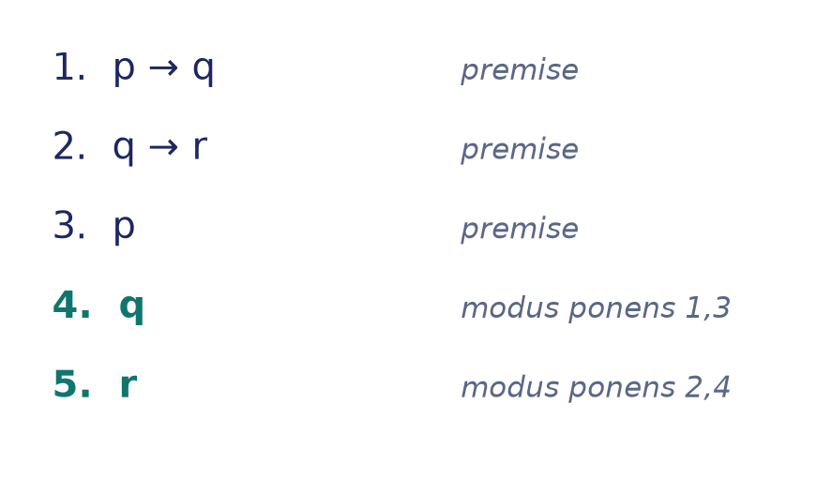
From semantics to syntax
⊨ becomes ⊢
Lecture 6: ⊨ checks all models (semantics).
A proof DERIVES the conclusion with rules (⊢, syntax).
Soundness & completeness make them equivalent.
Notes:
Truth tables decide validity by exhausting models (⊨). A proof reaches the same verdict symbolically, step by step (⊢). That the two always agree is no accident: the soundness theorem says everything provable is true, and the completeness theorem says everything true is provable — together they weld syntax to semantics.

Slide 4
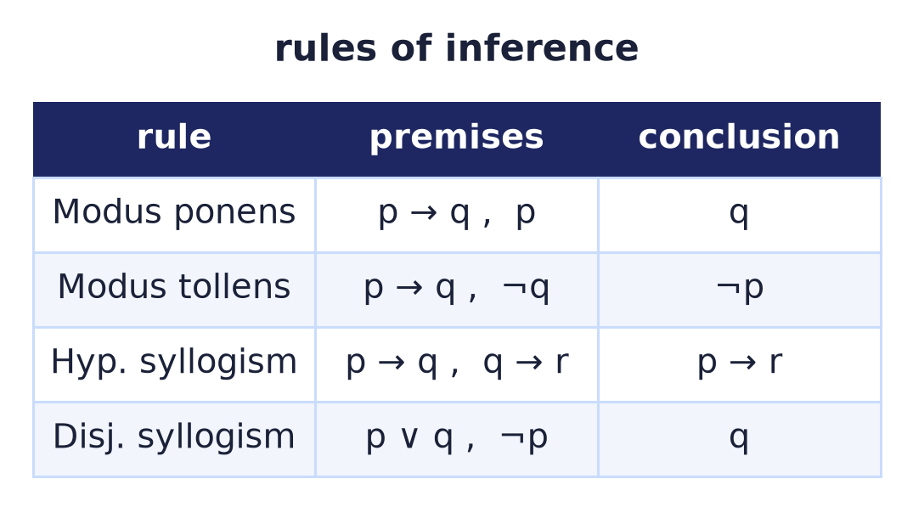
Rules of inference
Valid step patterns
Each rule is a tautology, licensed to be applied.
Modus ponens is the workhorse: from p→q and p, infer q.
Chain them into derivations.
Notes:
Inference rules are pre-approved moves — each a valid argument form. Modus ponens, modus tollens, and the syllogisms are the building blocks of every formal proof. To reason about 'for all' and 'there exists' we add the quantifier rules — universal and existential instantiation and generalization — whose one pitfall is that you may generalize only over a genuinely arbitrary element, never a specific one.

Slide 5
Formal derivations
A numbered argument
List premises, then derive new lines by rules.
Each line cites its justification.
The last line is the theorem.
Notes:
A formal derivation is a numbered sequence: premises first, then each new statement justified by earlier lines and a rule. It is a proof a machine can check.

Slide 6
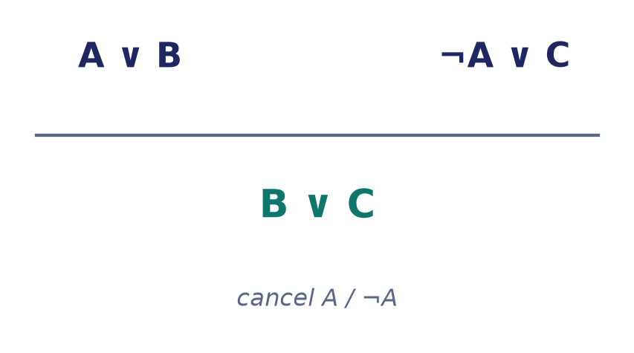
Resolution & refutation
One rule to decide all
Resolution cancels a literal between two clauses.
To prove φ, refute ¬φ: derive the empty clause ⊥.
The basis of automated theorem proving.
Notes:
Resolution works on clauses — disjunctions of literals, the CNF form from Lecture 6. It is a single, complete rule: assume the negation of the goal and repeatedly cancel a variable between two clauses until the empty clause (a contradiction) appears. This refutation procedure is exactly what powers SAT-based theorem provers.

Slide 7
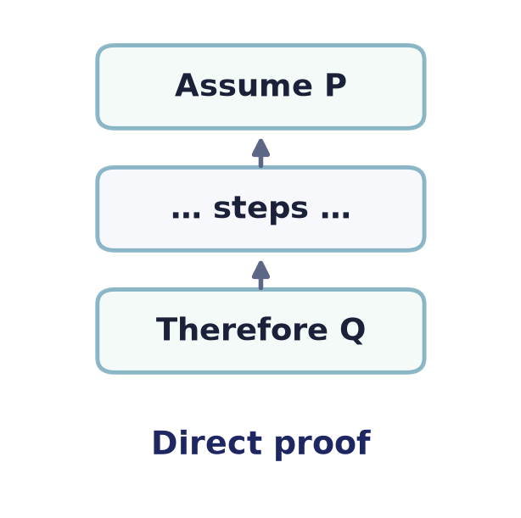
Direct proof
Assume, then deduce
To prove P → Q: assume P, derive Q by valid steps.
The default strategy — try it first.
Example: n even ⇒ n² even.
Notes:
The direct proof assumes the hypothesis and marches to the conclusion using definitions and known results. Most theorems yield to it — reach for it first.

Slide 8
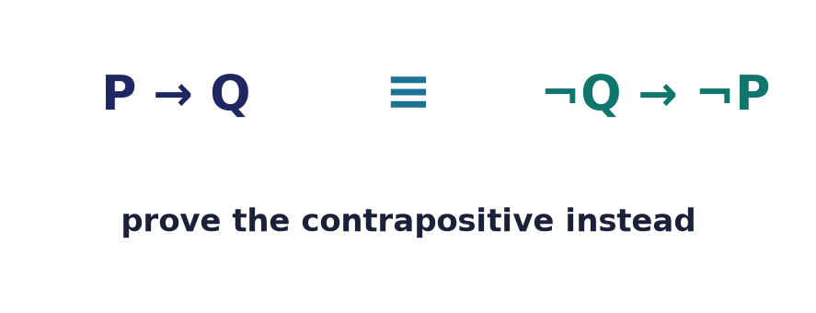
Proof by contraposition
Flip and negate
P → Q is equivalent to ¬Q → ¬P.
Prove the contrapositive when it's easier.
But the CONVERSE Q → P is NOT equivalent.
Example: n² even ⇒ n even.
Notes:
When the direct route is awkward, prove the logically equivalent contrapositive instead. It often turns a hard 'if' into an easy one.

Slide 9
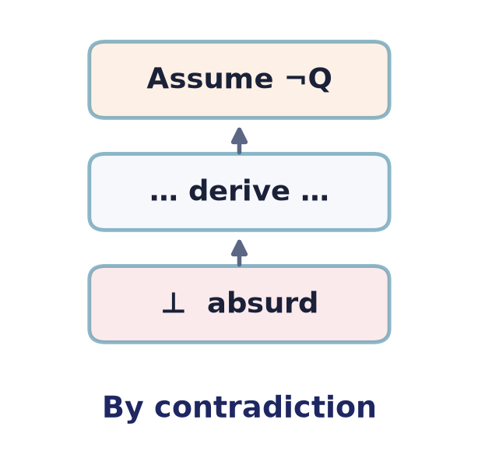
Proof by contradiction
Assume the opposite
Suppose the claim is false, derive an absurdity ⊥.
The contradiction forces the claim to be true.
Example: √2 is irrational.
A second classic: infinitely many primes
Suppose p₁, …, p_k were all the primes.
Then N = p₁·p₂···p_k + 1 has a prime factor not in the list — contradiction.
Notes:
Reductio ad absurdum assumes the negation and derives a contradiction, so the assumption must be false. Two of the most elegant proofs in mathematics are of this form: the irrationality of √2, and Euclid's proof that the primes never run out — if they did, one plus the product of the finite list would demand a prime outside it.

Slide 10
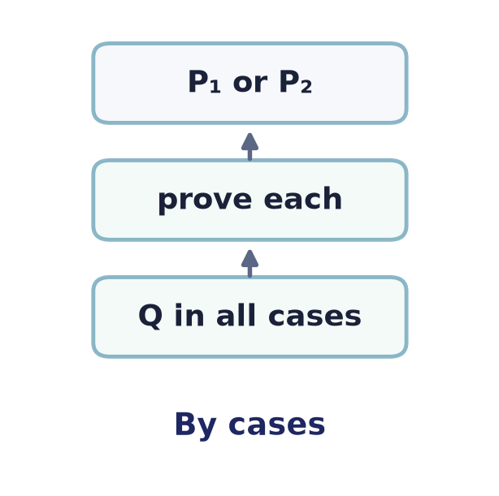
Proof by cases
Cover every possibility
Split into exhaustive cases; prove the claim in each.
The cases must together cover all inputs.
Example: |x| behaviour for x ≥ 0 and x < 0.
Notes:
When no single argument fits, partition into finitely many exhaustive cases and prove each. The key correctness check: the cases must leave nothing out.

Slide 11
Mathematical induction
The domino principle
Base case: P(1) holds.
Inductive step: P(k) ⇒ P(k+1).
Then P(n) holds for every n — like toppling dominoes.
Notes:
Induction proves a statement for all naturals: knock over the first domino (base case) and guarantee each topples the next (inductive step). Both parts are essential — skip the base case and you could 'prove' P(n)=P(n+1) with nothing anchoring it, and a subtly wrong inductive step gives the notorious false proof that 'all horses are the same colour'. Together, a true base and a valid step topple the whole line.

Slide 12
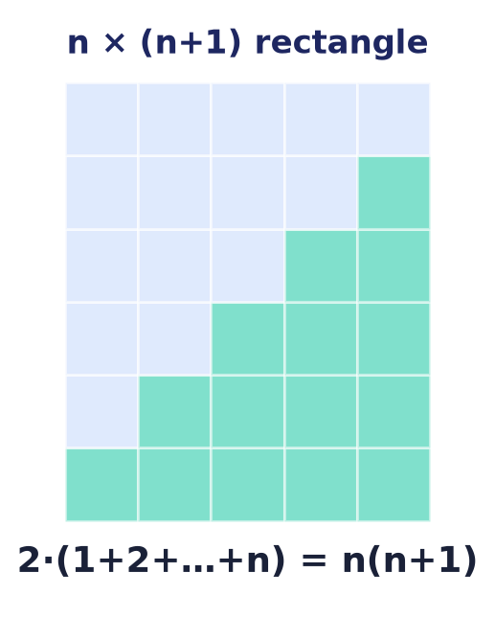
Induction, worked
1 + 2 + … + n = n(n+1)/2
Base: n=1 gives 1 = 1·2/2. ✓
Step: add (k+1) to both sides and simplify.
A picture proves it too — two staircases tile a rectangle.
Notes:
The classic first induction: the sum of the first n integers. The algebra follows the base/step recipe; the picture shows two copies of the staircase forming an n×(n+1) rectangle.

Slide 13
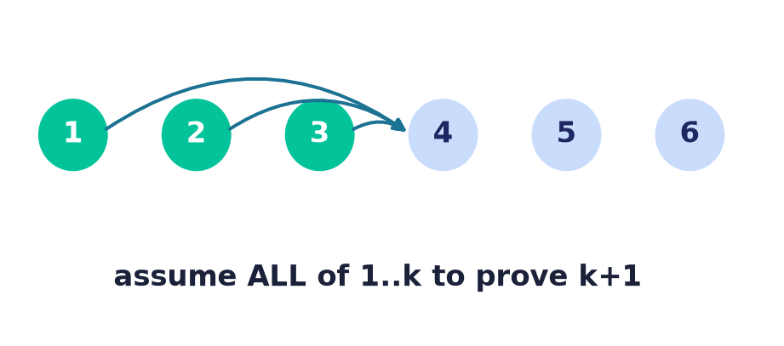
Strong induction
Assume ALL previous
Inductive step may use P(1), …, P(k) — not just P(k).
Needed when a case depends on several earlier ones.
Example: every n > 1 has a prime factor.
Notes:
Strong induction strengthens the hypothesis to all previous cases — essential when P(k+1) rests on several earlier values, as in prime factorisation or Fibonacci arguments.

Slide 14
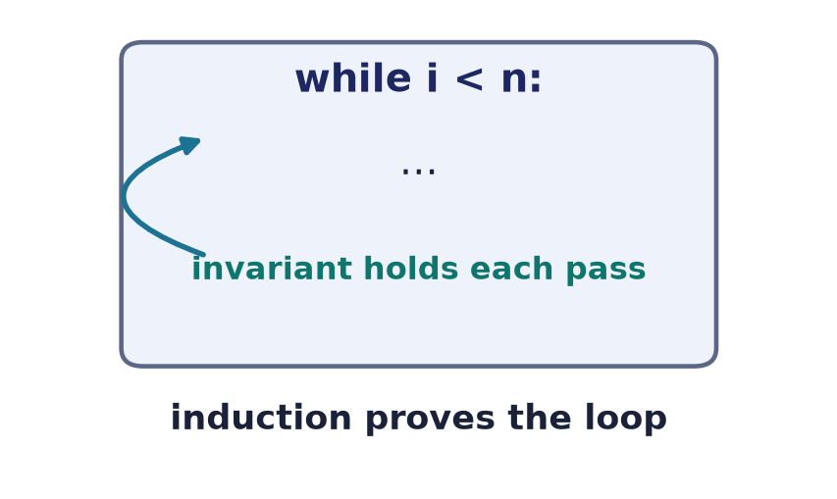
Induction runs computer science
Loop invariants & recursion
A loop invariant is an induction over iterations.
Recursion's correctness is induction on input size.
Structural induction proves properties of trees and lists.
Notes:
Program correctness IS induction: a loop invariant is the inductive hypothesis over iterations, and recursive algorithms are verified by induction on their input. Structural induction extends this to data types.

Slide 15
Existence & uniqueness
Existence
Exhibit one object, or prove one must exist.
Uniqueness
Assume two, show they must be equal.
Constructive vs not
A construction gives more than a mere existence proof.
Notes:
Existence proofs either build an example or argue one must exist; uniqueness shows any two candidates coincide. Constructive proofs are prized because they yield an algorithm.

Slide 16
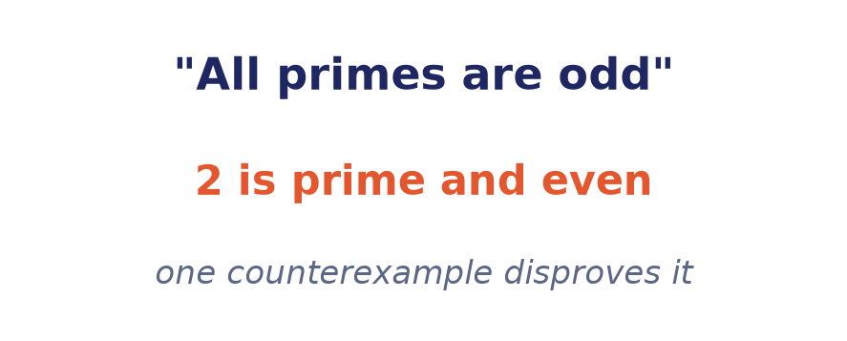
Counterexamples & disproof
One is enough
To DISPROVE a universal claim, exhibit a single counterexample.
No amount of examples PROVES a universal — but one kills it.
Test conjectures by hunting counterexamples first.
Patterns can lie:
n² + n + 41 is prime for n = 0…39 — then fails at n = 40.
Fermat guessed 2^(2ⁿ)+1 is always prime; F₅ = 4294967297 = 641 × 6700417.
Notes:
Asymmetry: a universal statement needs a general proof, but a single counterexample refutes it. History warns us — Euler's n²+n+41 yields primes for the first forty inputs before breaking, and Fermat's conjecture that 2^(2ⁿ)+1 is always prime died at n=5, which Euler factored as 641×6700417. Always probe a conjecture for counterexamples before attempting a proof.

Slide 17
Common fallacies
Affirming the consequent
From p→q and q, you CANNOT infer p.
Denying the antecedent
From p→q and ¬p, you cannot infer ¬q.
Circular reasoning
Assuming what you set out to prove.
Examples ≠ proof
A pattern in cases does not prove the general claim.
Notes:
These invalid moves masquerade as proofs: affirming the consequent, denying the antecedent, begging the question, and mistaking a handful of examples for a general argument.

Slide 18
Proof in software
Formal verification
Machine-checked proofs that code meets its spec (seL4, CompCert).
Proof assistants
Coq, Lean, Isabelle check every inference step.
Type = proof
The Curry–Howard correspondence: programs ARE proofs.
Notes:
Proof is now executable: verified kernels and compilers ship with machine-checked correctness, proof assistants guarantee every step, and Curry–Howard reveals that well-typed programs are proofs.

Slide 19
Summary
— A proof is a rule-justified chain from premises to conclusion.
— Inference rules (modus ponens) license each step.
— Direct, contrapositive, contradiction, cases — pick the fit.
— Induction proves ∀n via base + step (dominoes).
— Strong induction and invariants extend it to CS.
— One counterexample disproves a universal claim.

Slide 20
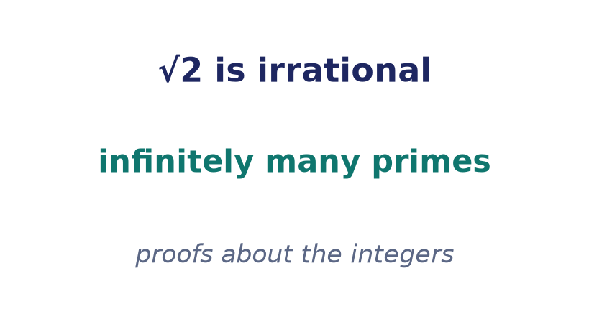
Next → Lecture 8: Number theory
Proofs need a playground — the integers.
Divisibility · primes & Euclid · unique factorization · congruences · Euler's totient — every result proved with today's methods.
Notes:
The integers are where proof techniques come alive: infinitely many primes (contradiction), unique factorization (strong induction), and divisibility results all use the methods from today.

