Slide 1
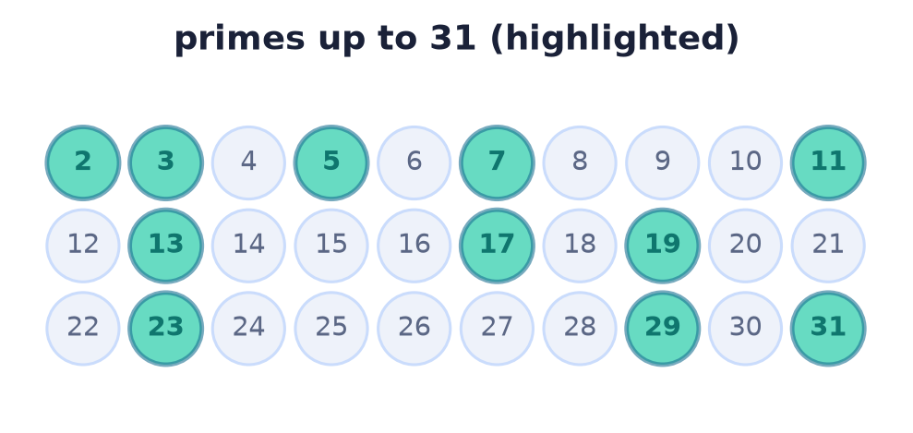
Number Theory
Lecture 8 · Computer Discrete Mathematics
Divisibility · primes · Euclid · factorization · congruences · totient
Notes:
The integers — the oldest object of mathematics and the natural home for the proof methods of Lecture 7. Today: divisibility, primes, the Euclidean algorithm, unique factorization, and modular arithmetic.

Slide 2
Why number theory?
Proof made concrete
Every result here is a direct, contradiction, or induction proof.
It secures the internet
RSA, Diffie–Hellman, and hashing are modular arithmetic.
Ties back to relations
Congruence mod n is an equivalence relation (Lecture 3).
Notes:
Number theory is where proofs come alive, the mathematics behind modern cryptography, and a direct application of equivalence relations — three threads of the course meeting.

Slide 3
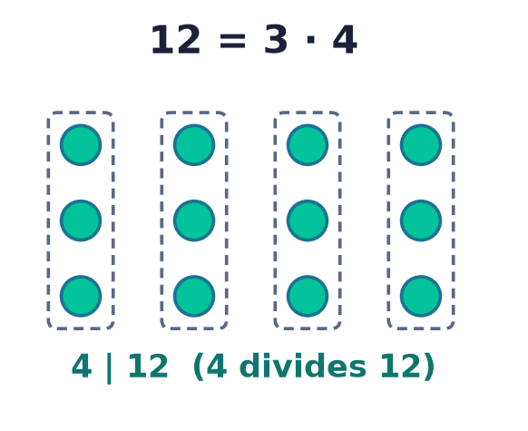
Divisibility & parity
b | a
b divides a when a = b·k for some integer k.
Transitive: a | b and b | c ⇒ a | c.
Even means 2 | n; parity is n mod 2.
Common divisors survive linear combinations.
Notes:
Divisibility is the single relation everything rests on. A key fact used constantly: any common divisor of a and b also divides every combination ax+by.

Slide 4
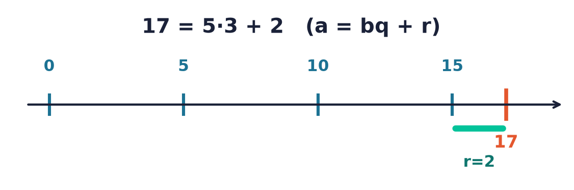
The division algorithm
a = bq + r, 0 ≤ r < b
Unique quotient q and remainder r.
The remainder is a mod b.
The foundation of gcd and modular arithmetic.
Notes:
Dividing a by b leaves a unique quotient and a remainder strictly smaller than b. That remainder is the whole basis of modular arithmetic and the Euclidean algorithm.

Slide 5
Primes
The multiplicative atoms
A prime p > 1 has only 1 and p as divisors; otherwise n is composite.
Every integer n > 1 has a prime divisor.
Primes are where all structure begins.
Notes:
Primes are the indivisible building blocks. A short strong-induction argument shows every integer above 1 has a prime factor — the seed of unique factorization.

Slide 6
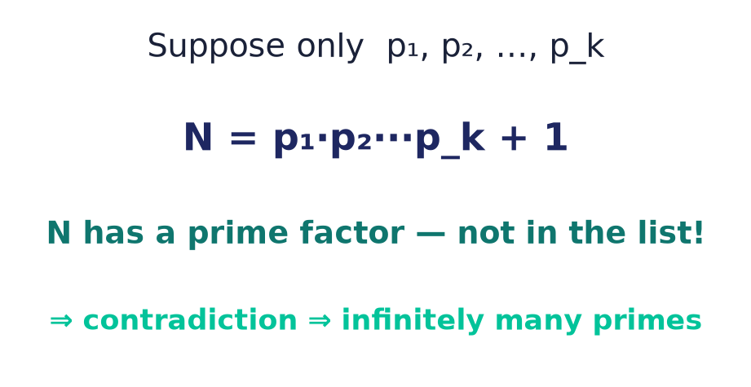
Infinitely many primes
Euclid's proof
Assume finitely many; multiply them and add 1.
The result has a prime factor outside the list.
Contradiction — so there are infinitely many.
Notes:
One of the most beautiful proofs by contradiction: no finite list of primes can be complete, because their product plus one always demands a new prime.

Slide 7
Primality testing
Trial division to √n
A composite n = ab has a factor a ≤ √n.
So test divisors only up to √n.
Runs in O(√n) — the check used in Lab 5.
test d = 2, 3, …, √n
no divisor ⇒ prime
Notes:
If n factors, one factor is at most √n, so we only need to test divisors up to the square root — turning an O(n) scan into O(√n).

Slide 8
Greatest common divisor
gcd(a, b)
The largest integer dividing both a and b.
gcd(a,b) = 1 means a and b are coprime.
Computed fast by the Euclidean algorithm.
gcd(48, 18) = 6
coprime: gcd = 1
Notes:
The gcd is the largest shared divisor. When it equals 1 the numbers are coprime — a condition central to modular inverses and the totient.

Slide 9
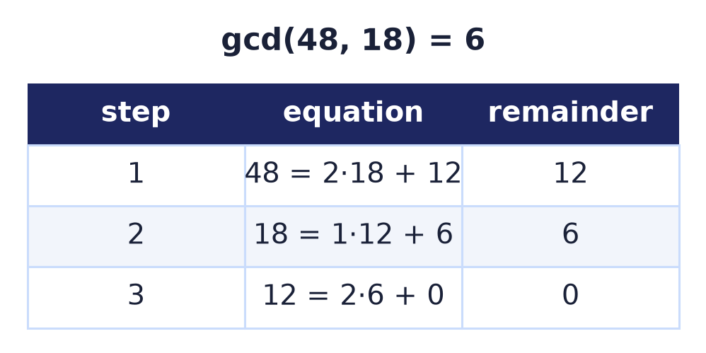
The Euclidean algorithm
gcd(a,b) = gcd(b, a mod b)
Replace the larger by the remainder; repeat.
The last nonzero remainder is the gcd.
O(log) steps — extremely fast.
Notes:
Euclid's algorithm is over two thousand years old and still optimal: swapping in remainders shrinks the numbers logarithmically to reach the gcd in a handful of steps.

Slide 10
Bézout's identity
gcd(a,b) = ax + by
The gcd is an integer combination of a and b.
Found by running Euclid backwards (extended).
Gives modular inverses — the key to RSA decryption.
6 = 48·(−1) + 18·3
extended Euclid finds x, y
Notes:
Bézout: the gcd is always expressible as ax+by. The extended Euclidean algorithm computes x and y — and when gcd=1 this yields the modular inverse used to decrypt.

Slide 11
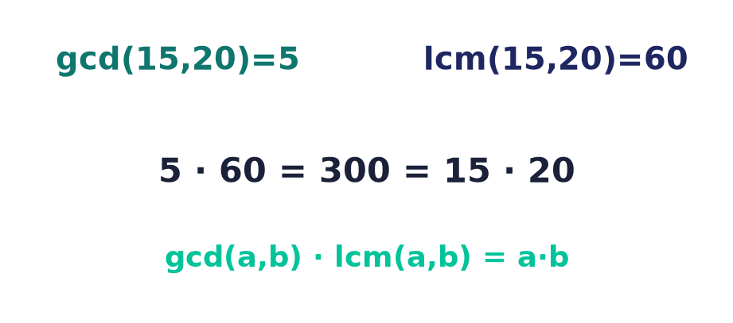
Least common multiple
gcd · lcm = a·b
The smallest positive common multiple.
lcm(a,b) = a·b / gcd(a,b).
So the lcm is a free by-product of the gcd.
Notes:
gcd and lcm are two sides of a coin: their product is ab, so once you have the gcd the lcm costs one division.

Slide 12
Euclid's lemma
p | ab ⇒ p | a or p | b
True precisely because p is PRIME.
Fails for composites: 6 | (4·9) but 6 ∤ 4 and 6 ∤ 9.
The engine behind uniqueness of factorization.
prime p
divides a product ⇒ divides a factor
Notes:
Euclid's lemma singles primes out: only a prime dividing a product must divide one of the factors. It follows from Bézout — if p ∤ a then gcd(p,a)=1, so 1 = px + ay; multiplying through by b shows p | b. This is exactly what forces factorizations to be unique, which the next slide states.

Slide 13
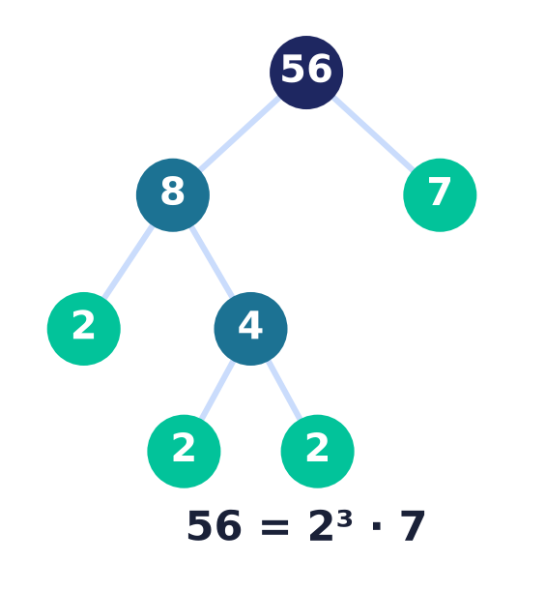
Fundamental theorem of arithmetic
Unique prime factorization
Every n > 1 factors into primes — uniquely, up to order.
56 = 2³ · 7, and no other way.
Existence by induction; uniqueness by Euclid's lemma.
Notes:
The FTA is why the integers are so rigid: every number has exactly one prime signature. Existence is a strong-induction argument; uniqueness rests on Euclid's lemma from the previous slide.

Slide 14
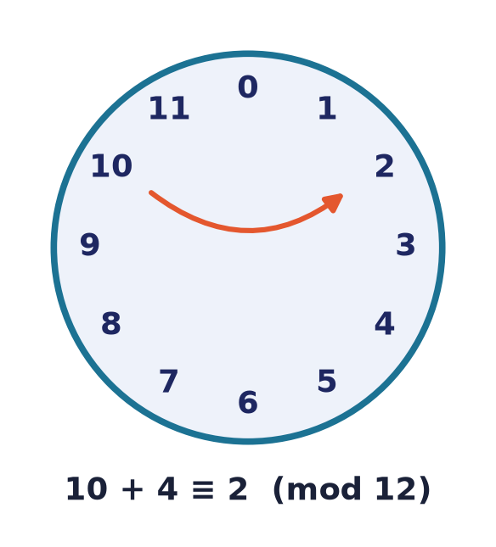
Modular arithmetic
a ≡ b (mod n)
a and b leave the same remainder on division by n.
Equivalently, n divides (a − b).
Add and multiply freely, then reduce mod n.
Arithmetic on a clock face.
Notes:
Modular arithmetic wraps the number line into a circle of size n. You may reduce at any point in a calculation — the property that makes big computations tractable in cryptography.

Slide 15
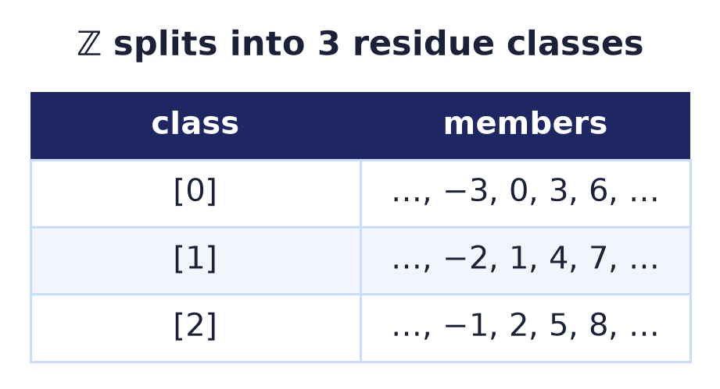
Congruence is an equivalence relation
Back to Lecture 3
≡ mod n is reflexive, symmetric, transitive.
Its classes are the n residue classes.
They partition ℤ — the Fundamental Theorem in action.
Notes:
Congruence mod n is the archetypal equivalence relation, and its equivalence classes — the residues — partition the integers, exactly as the theory of Lecture 3 predicts.

Slide 16
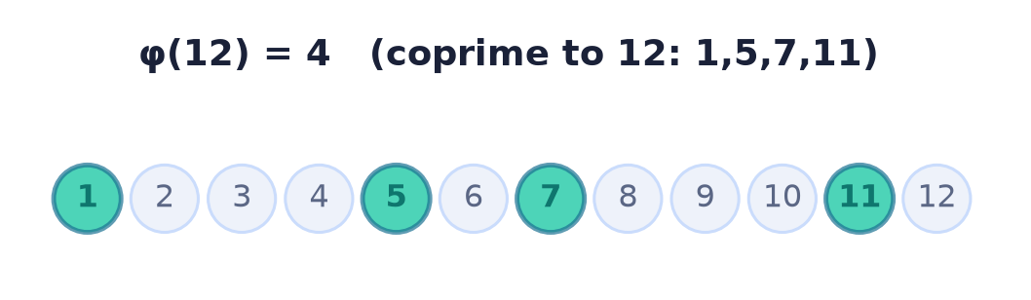
Euler's totient φ(n)
Count the coprimes
φ(n) = how many of 1..n are coprime to n.
φ(n) = n · ∏(1 − 1/p) over its prime factors.
φ(12) = 4 — the numbers 1, 5, 7, 11.
Notes:
The totient counts numbers coprime to n and drives Euler's theorem, the generalisation of Fermat's little theorem that underpins RSA key generation. The product formula is built from two facts: for a prime power φ(pᵏ)=pᵏ−pᵏ⁻¹, and φ is multiplicative — φ(mn)=φ(m)φ(n) whenever gcd(m,n)=1.

Slide 17
Euler & Fermat — and RSA
Powers wrap around mod n
Euler: gcd(a,n)=1 ⇒ a^φ(n) ≡ 1 (mod n).
Fermat (p prime): a^(p−1) ≡ 1 (mod p).
Inverse: gcd(a,n)=1 ⇒ a⁻¹ exists, from Bézout ax+ny=1.
Why it matters
RSA decrypts with d ≡ e⁻¹ (mod φ(n)) — a modular inverse — and Euler's theorem guarantees the round trip.
CRT: pairwise-coprime moduli combine to a unique solution modulo their product.
Notes:
Euler's theorem: if a is coprime to n, then a to the power φ(n) is 1 mod n; Fermat's little theorem is the prime case, a^(p−1)≡1 mod p. The modular inverse a⁻¹ exists exactly when gcd(a,n)=1 and is read off Bézout's ax+ny=1. Together they power RSA: the decryption exponent d is the inverse of e modulo φ(n), and Euler's theorem guarantees encrypt-then-decrypt returns the message. The Chinese Remainder Theorem combines congruences with pairwise-coprime moduli into a unique answer modulo their product.

Slide 18
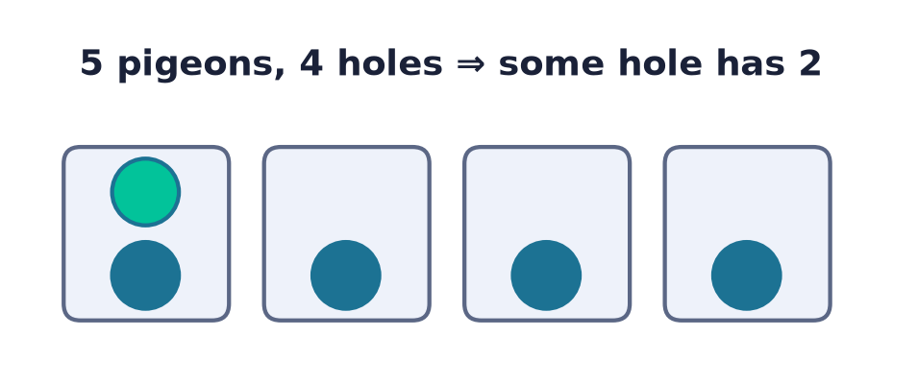
The pigeonhole principle
n+1 into n ⇒ a repeat
Put n+1 objects in n boxes: some box holds two.
Among any n+1 integers, two are congruent mod n.
A tiny principle with surprising force.
Notes:
Deceptively simple, the pigeonhole principle forces repetition — used here for congruences and later for the pumping lemma in automata theory.

Slide 19
Number theory secures computing
Public-key crypto
RSA multiplies primes; security rests on factoring being hard.
Hashing
Modular arithmetic spreads keys across buckets.
Checksums & codes
Congruences detect and correct transmission errors.
Notes:
The integers protect the internet: RSA exploits the gap between easy multiplication and hard factoring, hash tables use mod to place keys, and check digits use congruences to catch errors.

Slide 20
Common mistakes
Divisibility is directed
b | a is not a | b; mind which divides which.
1 is not prime
A prime needs exactly two divisors; 1 has one.
gcd·lcm = ab, not gcd+lcm
It's the product that equals a·b.
Mod keeps remainders non-negative
−1 mod 5 = 4, not −1.
Notes:
Watch these: divisibility has a direction, 1 is not prime, the gcd–lcm relation is a product, and remainders are taken non-negative.

Slide 21
Summary
— b | a and the division algorithm a = bq + r are the base.
— Infinitely many primes; trial-divide to √n to test.
— Euclid's algorithm gives gcd (and, extended, Bézout).
— Unique factorization (FTA) rests on Euclid's lemma.
— Congruence mod n is an equivalence relation; φ(n) counts coprimes.
— Pigeonhole forces repetition — a proof tool.

Slide 22
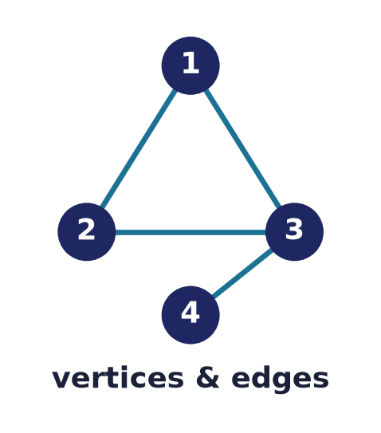
Module 1 complete → Lecture 9 test
That closes the foundations.
Lecture 9 is the module test. Then Module 2 opens with structures you can draw:
Lecture 10 — Graph theory: vertices, edges, and the networks they model.
Notes:
Sets, logic, proof, and number theory complete the first module. After the module test, Module 2 turns to graphs — vertices and edges — the mathematics of networks, dependencies, and connections.

