Slide 1
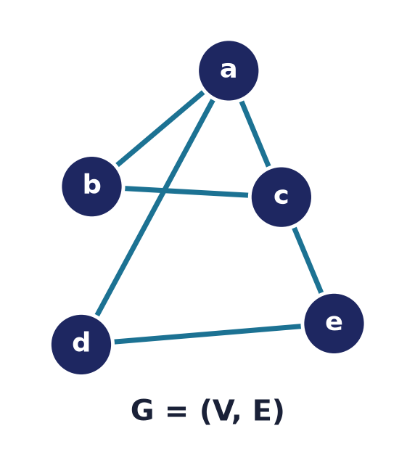
Graph Theory — Basics
Lecture 10 · Computer Discrete Mathematics
Vertices & edges · degree · matrices · paths · connectivity · colouring
Notes:
Graphs model anything with connections — networks, dependencies, maps, molecules. Today: the vocabulary, the handshaking lemma, matrix representations, walks and connectivity, isomorphism, planarity, and colouring.

Slide 2
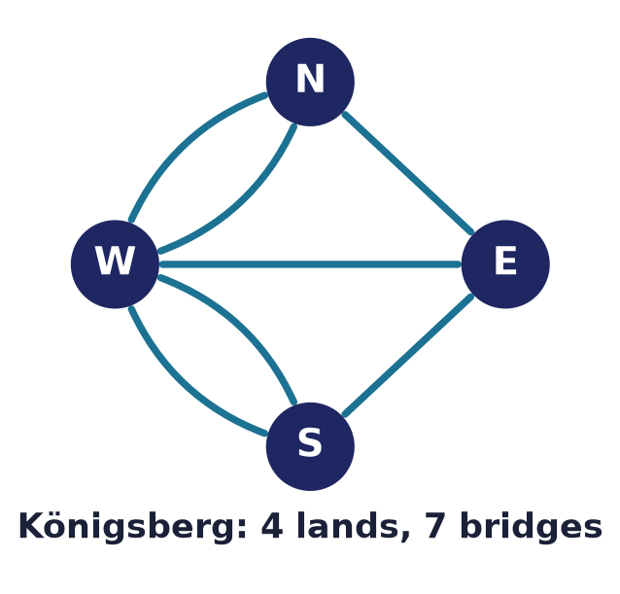
The bridges of Königsberg
Graph theory's birthday
1736: can one cross all 7 bridges exactly once?
Euler abstracted lands to vertices, bridges to edges.
The answer turns on vertex degrees — no such walk exists.
Notes:
Euler founded the subject by throwing away geometry: only the pattern of connections matters. The walk is impossible because too many landmasses have an odd number of bridges.

Slide 3
What is a graph?
G = (V, E)
A set of vertices V and a set of edges E joining them.
Edges are unordered pairs {u, v}.
Simple graph: no loops, no repeated edges.
Notes:
A graph is just vertices and the edges between them. We usually assume simple graphs — no self-loops and at most one edge per pair.

Slide 4
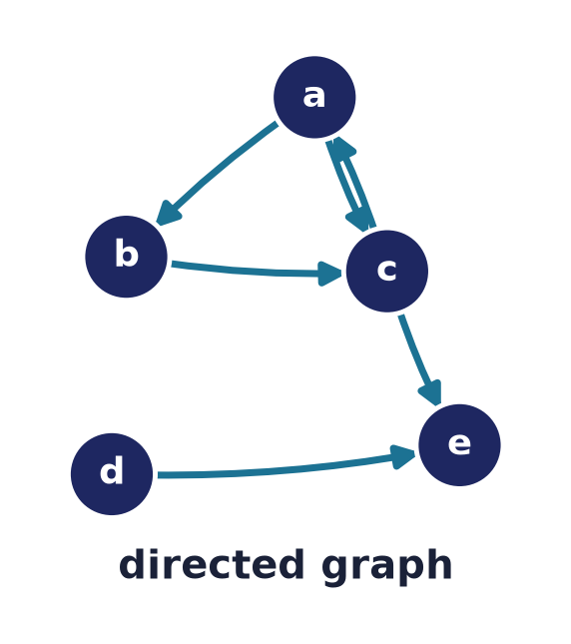
Directed vs undirected
Do edges have a direction?
Undirected: {u, v} — a two-way link.
Directed (digraph): (u → v) — one-way.
Each vertex splits into in-degree and out-degree.
Digraphs model dependencies, links, and flows.
Notes:
Direction matters for one-way relationships: web links, task prerequisites, state transitions. A digraph's edges are ordered pairs — exactly the relations of Lecture 3. Degree now splits in two: the directed handshaking lemma says the sum of in-degrees equals the sum of out-degrees, both equal to the number of edges.

Slide 5
Core terminology
Speak the language
Adjacent: joined by an edge. Incident: edge meets vertex.
Degree deg(v): number of edges at v.
Neighbourhood: the vertices adjacent to v.
Notes:
A small vocabulary carries the whole subject: adjacency between vertices, incidence between an edge and its endpoints, and degree — the count of edges at a vertex.

Slide 6
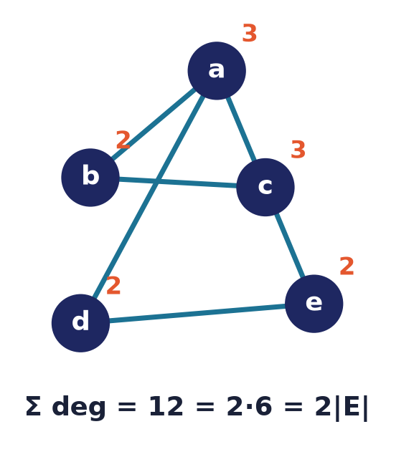
The handshaking lemma
Σ deg(v) = 2·|E|
Each edge contributes 2 to the total degree.
So the sum of degrees is always even.
Corollary: the number of odd-degree vertices is even.
Notes:
Because every edge has two ends, summing degrees double-counts the edges. Hence the total is even — and Königsberg fails precisely because it has four odd-degree vertices.

Slide 7
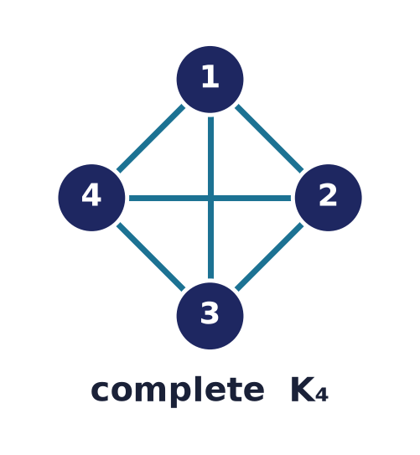
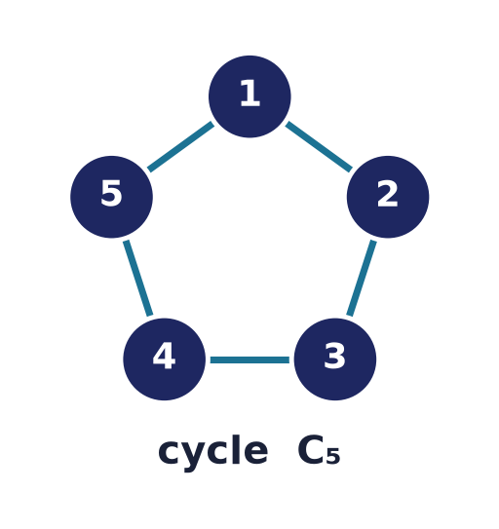
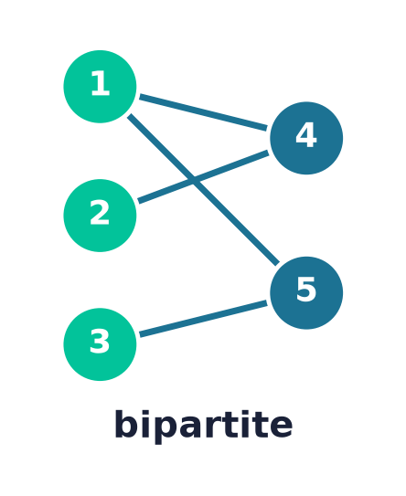
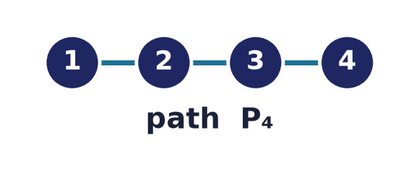
Special families of graphs
Complete Kₙ
n(n−1)/2 edges
Cycle Cₙ
n edges
Path Pₙ
n−1 edges
Bipartite Kₘ,ₙ
m·n edges
Notes:
Named families recur everywhere, each with its own edge count: the complete graph Kₙ joins all pairs (n(n−1)/2 edges), the cycle Cₙ and path Pₙ are the obvious rings and chains, and the complete bipartite Kₘ,ₙ splits vertices into two sides with every cross-edge present (m·n edges).

Slide 8
Bipartite graphs
Two sides, edges across
Vertices split into two sets; every edge crosses.
Model matchings, assignments, and preferences.
Bipartite ⇔ no odd cycle.
Notes:
Bipartite graphs capture two-sided relationships — jobs and applicants, students and courses. The elegant characterisation: a graph is bipartite exactly when it has no odd-length cycle.

Slide 9
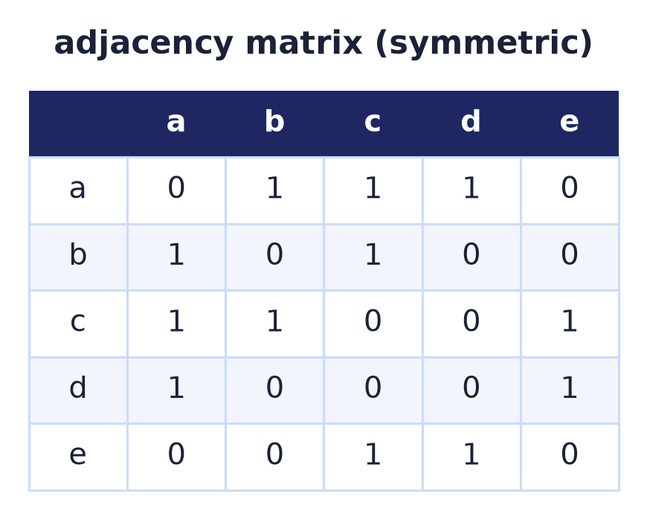
Adjacency matrix
Aᵢⱼ = 1 if i ~ j
An n×n matrix, symmetric for undirected graphs.
Fast edge lookup; O(n²) space.
The bridge from graphs to linear algebra.
Notes:
The adjacency matrix encodes edges as 1s. It is symmetric for undirected graphs and turns graph questions into matrix computations.

Slide 10
Powers count walks
(Aᵏ)ᵢⱼ = # of k-walks i→j
Matrix multiplication chains edges into walks.
A² counts length-2 walks; Aᵏ counts length-k.
Reachability drops out of the matrix.
A² ⇒ 2-step walks
Aᵏ ⇒ k-step walks
(a walk = any sequence of edges; defined in full shortly)
Notes:
A beautiful fact: entry (i,j) of the k-th power of the adjacency matrix counts walks of length k from i to j — connecting graph structure to matrix algebra.

Slide 11
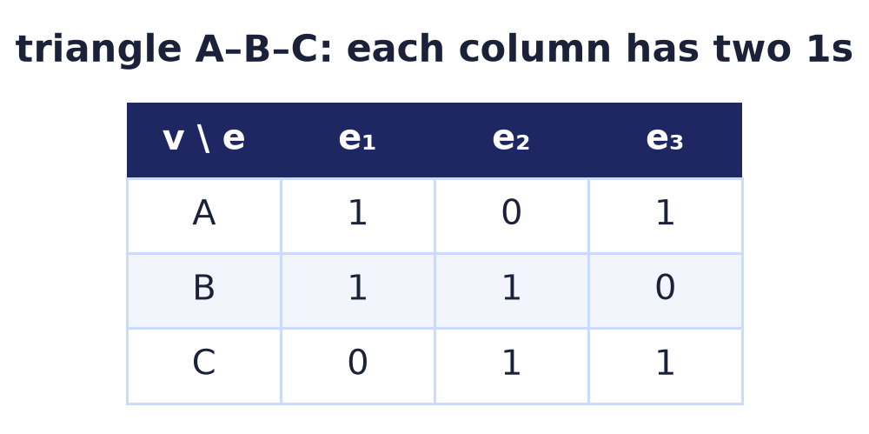
Incidence matrix
Vertices × edges
Mᵥₑ = 1 when vertex v is an endpoint of edge e.
Each column has exactly two 1s.
Useful for flows and cycle spaces.
Notes:
The incidence matrix records which vertices each edge touches. Every column has exactly two ones — the edge's endpoints — reflecting the handshaking lemma.

Slide 12
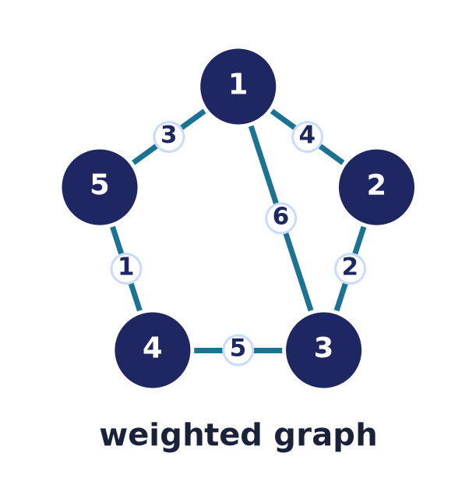
Weighted graphs
Edges carry a cost
A weight (distance, time, capacity) on each edge.
Shortest paths minimise total weight.
The setting for maps, routing, and networks.
Notes:
Adding weights turns graphs into models of cost: road distances, network latencies, pipe capacities. Optimisation over these weights is the subject of the next lecture.

Slide 13
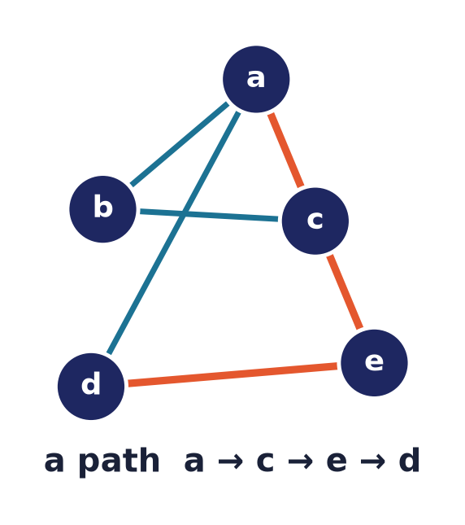
Walks, trails, paths
Ways to traverse
Walk: any sequence of edges.
Trail: no repeated EDGE.
Path: no repeated VERTEX.
Notes:
A hierarchy of traversals: walks may reuse anything, trails avoid repeating edges, and paths avoid repeating vertices — the cleanest route between two points.

Slide 14
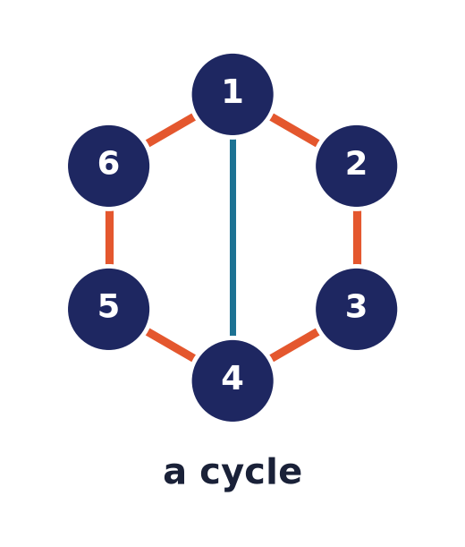
Circuits & cycles
Closed traversals
Circuit: a closed trail (start = end, no repeated edge).
Cycle: a closed path (no repeated vertex).
Euler circuits use every edge; Hamilton every vertex — Lecture 12.
Notes:
Closed walks that don't repeat give circuits and cycles. Two famous kinds — Euler (every edge once) and Hamilton (every vertex once) — are studied with special graphs.

Slide 15
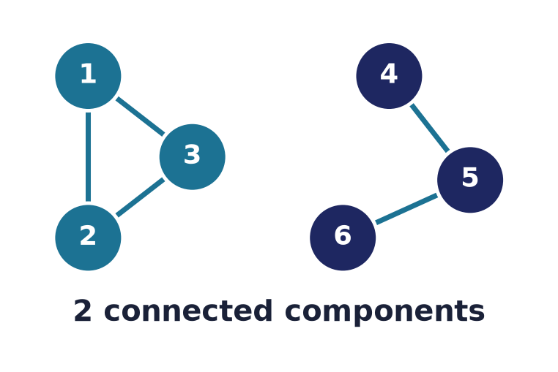
Connectivity
Can you get there?
Connected: a path exists between every pair.
Otherwise the graph splits into components.
Cut vertices and bridges are single points of failure.
Notes:
Connectivity asks whether the graph is one piece. Disconnected graphs fall into components; the vertices and edges whose removal disconnects a graph are its vulnerabilities.

Slide 16
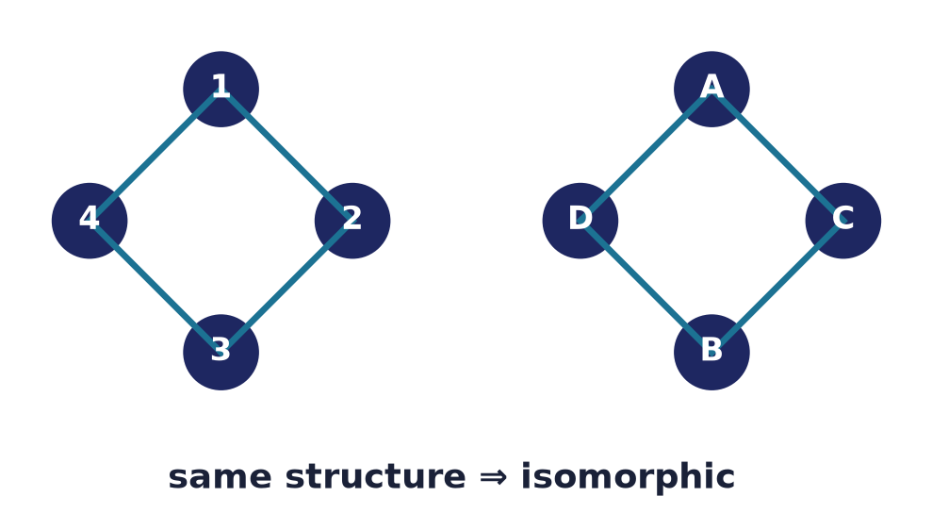
Graph isomorphism
Same graph, relabelled
A bijection of vertices preserving adjacency.
Different drawings can be the SAME graph.
No known efficient general algorithm.
Notes:
Two graphs are isomorphic if one is just a relabelling of the other. Deciding isomorphism in general is famously neither known to be easy nor proven hard.

Slide 17
Invariants
Degree sequence
The sorted list of degrees must match.
Counts
Same |V|, |E|, triangles, components.
Use
Different invariants ⇒ NOT isomorphic (a quick reject).
Notes:
Invariants are properties preserved by isomorphism — degree sequence, edge count, cycle counts. They can't confirm isomorphism, but a single mismatch instantly refutes it.

Slide 18
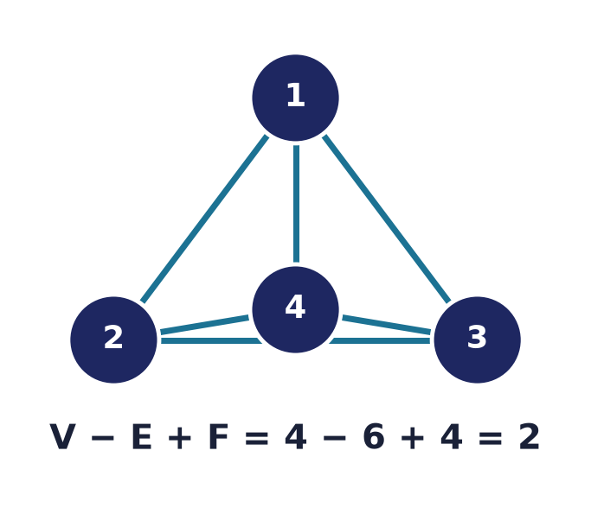
Planar graphs & Euler's formula
V − E + F = 2
Planar: drawable with no edge crossings.
A face is a region the drawing encloses — plus the outer one.
Vertices − edges + faces = 2 for connected planar graphs.
K₅ and K₃,₃ are the forbidden non-planar cores.
Notes:
Euler's formula relates the parts of any planar drawing: V−E+F=2, where a face is a connected region the edges cut the plane into, counting the unbounded outer region. It bounds how many edges a planar graph can have (E ≤ 3V−6), and Kuratowski's theorem names the two obstructions — K₅ and K₃,₃.

Slide 19
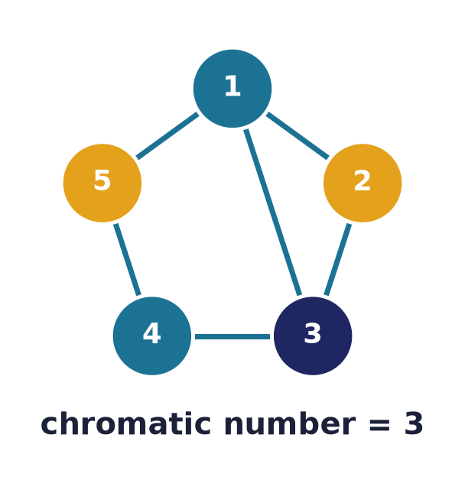
Graph colouring
Colour so neighbours differ
Vertex χ(G): fewest colours; bounds ω(G) ≤ χ(G) ≤ Δ+1.
Edge colouring χ′(G) — Vizing: always just Δ or Δ+1.
Models scheduling, registers, frequencies.
Four-colour theorem: any map needs ≤ 4.
Notes:
Vertex colouring assigns labels so adjacent vertices differ; the chromatic number χ is squeezed between the clique number ω (a clique forces distinct colours) and Δ+1 (greedy's guarantee). Colouring the EDGES instead so that edges meeting at a vertex differ gives χ′, and Vizing's theorem pins it to a razor-thin window — every simple graph needs only Δ or Δ+1 edge-colours. These abstractions drive exam scheduling, register allocation, and frequency assignment, and famously four colours suffice for any map.

Slide 20
The chromatic polynomial
Count the colourings
P(G,k): the number of proper colourings using at most k colours.
χ(G) = the smallest k with P(G,k) > 0.
Deletion–contraction: P(G,k) = P(G−e,k) − P(G/e,k).
Handy base cases
Tree on n vertices: k(k−1)^(n−1)
Complete graph Kn: k(k−1)⋯(k−n+1)
Cycle Cn: (k−1)^n + (−1)^n (k−1)
Notes:
The chromatic polynomial P(G,k) counts the proper colourings of G with at most k colours, so the chromatic number is simply the smallest k making it positive. It obeys deletion-contraction: P(G,k) = P(G-e,k) - P(G/e,k), because the colourings of G-e that give an edge's endpoints the same colour are exactly the colourings of the contraction G/e. Standard base cases — an edgeless graph gives k^n, a tree k(k-1)^(n-1), the complete graph the falling factorial, and a cycle (k-1)^n+(-1)^n(k-1) — let you unwind any P by the recurrence, and the result is always a polynomial in k.

Slide 21
Graphs are everywhere in software
Networks
The internet, social graphs, and road maps are graphs.
Dependencies
Build systems and package managers are DAGs.
Data structures
Trees, tries, and state machines are special graphs.
Notes:
Graphs underlie routing and social networks, dependency resolution in build tools and package managers, and the very data structures — trees and state machines — that programs run on.

Slide 22
Common mistakes
Degree counts edges, not neighbours
A multi-edge or loop changes the count.
Trail ≠ path
A trail may revisit a vertex; a path may not.
Isomorphic ≠ identical drawing
Layout is irrelevant; adjacency is all.
Bipartite ⇔ no odd cycle
Not 'looks like two rows'.
Notes:
Common slips: conflating degree with neighbour count, mixing up trails and paths, thinking isomorphism depends on the drawing, and misjudging bipartiteness.

Slide 23
Summary
— A graph G = (V, E): vertices joined by edges.
— Handshaking: Σ deg = 2|E|; odd-degree vertices come in pairs.
— Adjacency & incidence matrices; Aᵏ counts k-walks.
— Walks ⊃ trails ⊃ paths; connectivity = reachability.
— Isomorphism compares structure; invariants reject quickly.
— Planarity (V−E+F=2) and colouring (χ) close the basics.

Slide 24
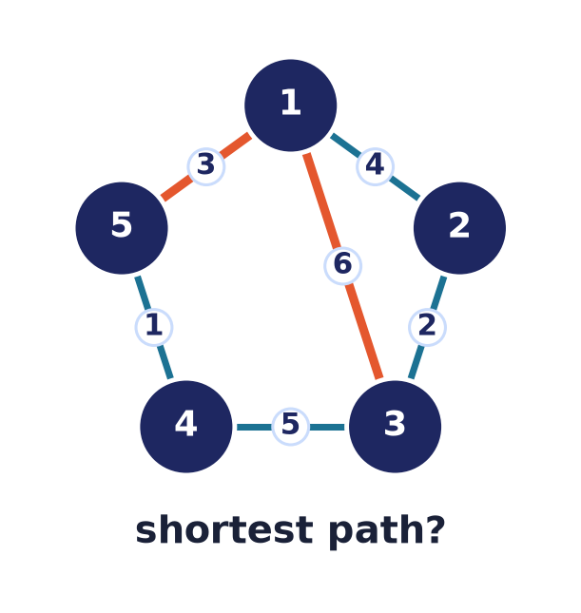
Next → Lecture 11: Graph algorithms
From structure to computation.
Traversal (BFS/DFS) · shortest paths (Dijkstra) · minimum spanning trees (Prim, Kruskal) · union–find — with correctness proofs.
Notes:
We now have the language; next we compute with it — traversing graphs, finding shortest paths and minimum spanning trees, and proving the greedy algorithms correct.

