Slide 1
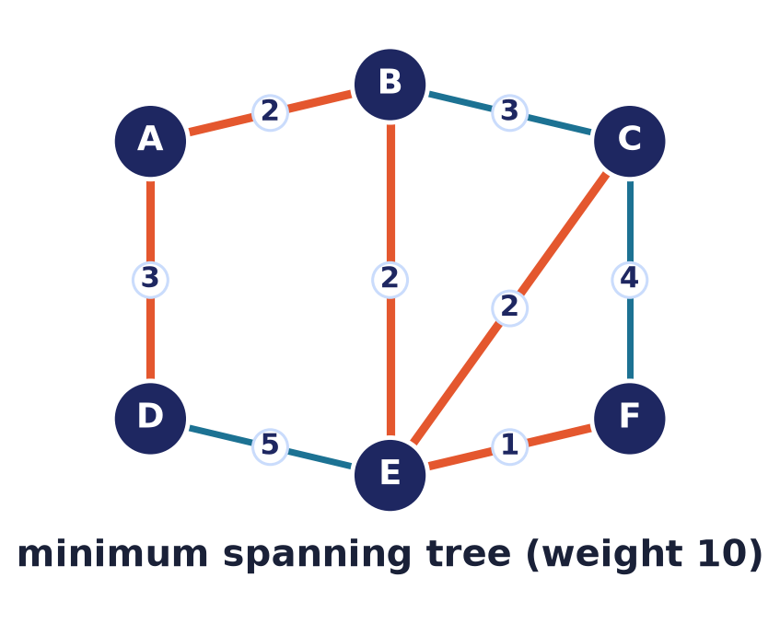
Graph Theory — Algorithms
Lecture 11 · Computer Discrete Mathematics
Colouring · Dijkstra · minimum spanning trees · greedy correctness
Notes:
Last lecture gave us graphs; now we compute with them. A single idea — be greedy, take the best local choice — powers colouring, shortest paths, and minimum spanning trees. Sometimes it is provably optimal; sometimes only a heuristic. Knowing which is the lecture.

Slide 2
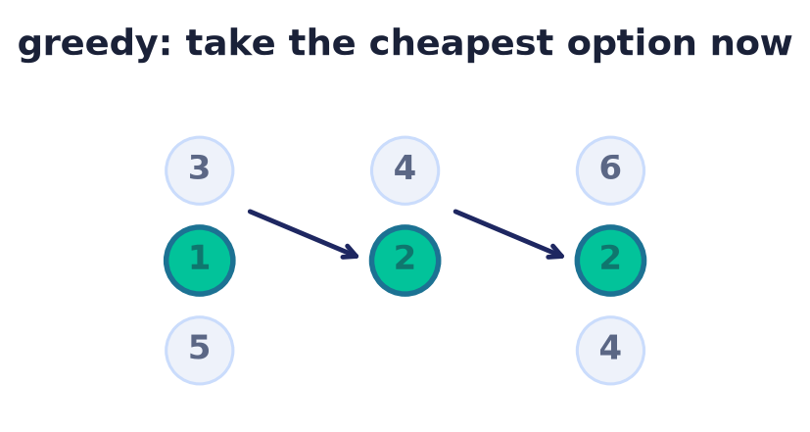
The greedy paradigm
Take the best choice now
At each step, grab the locally optimal option.
Never look back, never revise.
Provably optimal iff greedy-choice property + optimal substructure.
Otherwise only a heuristic.
Notes:
A greedy algorithm commits to the best-looking choice at each step and never reconsiders. It is fast and easy to state. It reaches the GLOBAL optimum exactly when the problem has two properties: the greedy-choice property (a locally optimal choice is part of some global optimum) and optimal substructure (an optimal solution contains optimal solutions to subproblems). Shortest paths and MSTs have both; graph colouring does not, so there greed is only a heuristic.

Slide 3
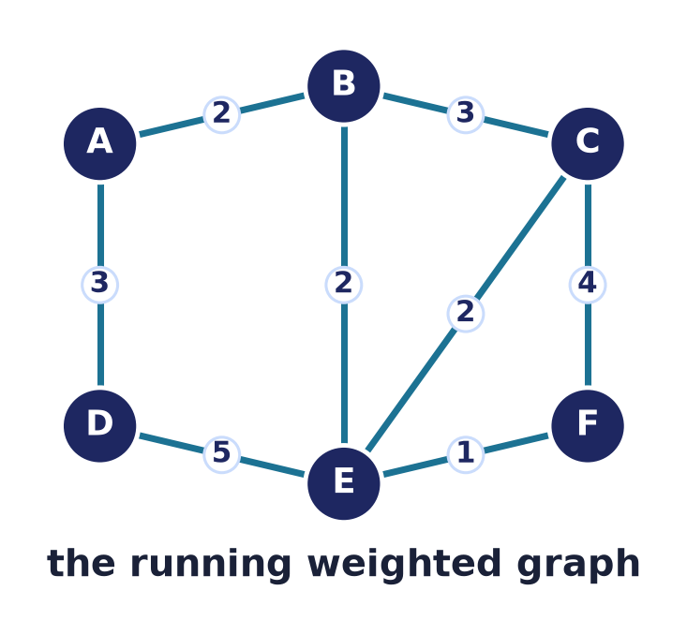
Our running example
One weighted graph
Six vertices, weighted edges.
We will colour it, find shortest paths, and build its MST.
Same graph throughout — watch each algorithm act.
Notes:
To compare the algorithms fairly, we run them all on one small weighted graph. Keeping the example fixed lets you see exactly how each strategy differs on identical input.

Slide 4
Graph traversal: BFS & DFS
Visit every vertex
Frontier in a QUEUE → breadth-first search (BFS).
Frontier in a STACK / recursion → depth-first search (DFS).
Both run in O(V + E) with adjacency lists.
On our graph, from A:
BFS A · B C · D E · F
(rings = fewest-edges distance)
DFS A → B → C → D → E → F
(plunge deep, backtrack at dead ends)
Uses: connectivity & components; BFS = unweighted shortest path; DFS for paths & cycles.
Notes:
Before optimising we must visit a graph. BFS uses a queue and fans out in rings of increasing distance — its ring number is the fewest-edges distance, the unweighted cousin of Dijkstra. DFS uses a stack (or recursion) and plunges deep, backtracking at dead ends. Both are linear, O(V+E), and underpin connectivity, component counting, and path/cycle routines — in fact Dijkstra and Prim are just BFS with a priority queue.

Slide 5
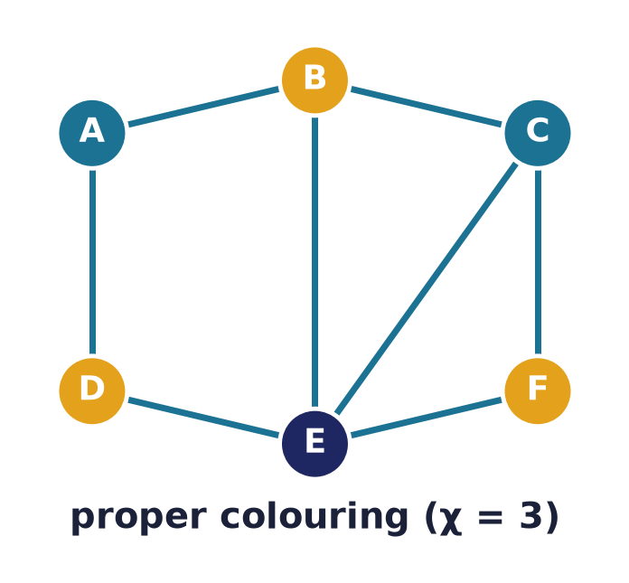
Greedy vertex colouring
First free colour
Process vertices in order; give each the lowest colour
not used by an already-coloured neighbour.
Always yields a proper colouring.
Notes:
The greedy colouring rule: walk the vertices in some order and assign each the smallest colour none of its coloured neighbours already has. The result is always proper — no two adjacent vertices clash — by construction.

Slide 6
The Δ + 1 guarantee
Never more than Δ + 1
Δ = the maximum degree in the graph.
A vertex has ≤ Δ neighbours, so some colour in 1…Δ+1 is free.
Greedy therefore uses at most Δ + 1 colours — always.
Notes:
Here is the first correctness proof. Any vertex has at most Δ neighbours, so among Δ+1 candidate colours at least one is unused — greedy can always proceed and never exceeds Δ+1 colours. This bound holds regardless of the ordering.

Slide 7
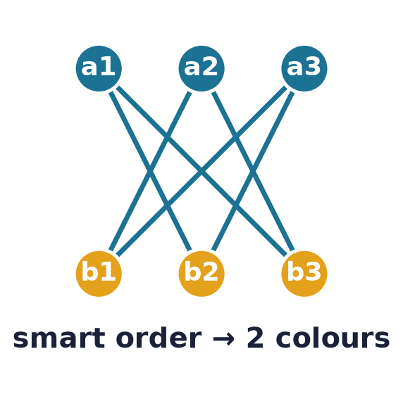
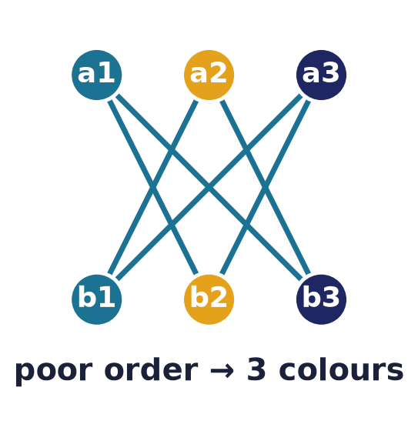
But the order matters
Same graph, same rule — a clever order uses 3 colours, a poor one uses 4.
Notes:
Δ+1 is only an upper bound. On this 3-chromatic graph (it has triangles) a good ordering achieves the optimum three, while a bad ordering wastes a fourth colour. Greedy's quality depends entirely on the order — which is why we need better orderings.

Slide 8
The Welsh–Powell ordering
The heuristic
Sort vertices by DECREASING degree, then colour greedily.
Intuition
Handle the most-constrained vertices first.
Reality
Often near-optimal — but optimal colouring is NP-hard.
Notes:
Welsh–Powell is a simple, effective rule: colour high-degree vertices first, since they are the hardest to satisfy. It usually gives excellent results, but finding the true chromatic number remains NP-hard — no greedy order is optimal for every graph.

Slide 9
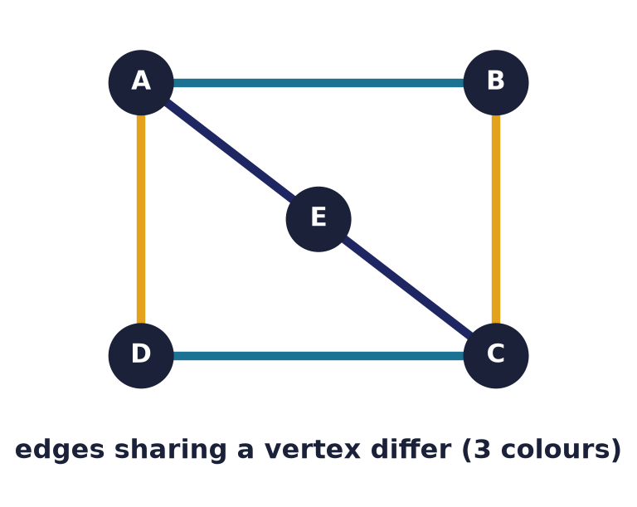
Greedy edge colouring
Colours on edges
Edges sharing a vertex must differ.
Naive greedy uses at most 2Δ − 1 colours.
Vizing's optimum: only Δ or Δ+1 are ever needed.
Notes:
Edge colouring is the same idea one level up: edges meeting at a vertex get different colours, modelling conflict-free scheduling. Colouring edges greedily guarantees only the loose bound of 2Δ−1 colours; the deep result is Vizing's theorem, which says the true optimum χ′ is always just Δ or Δ+1 — a razor-thin window, though reaching it takes more than naive greed.

Slide 10
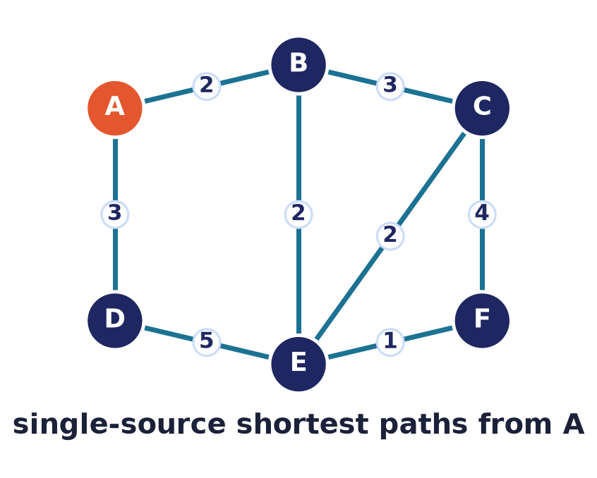
Dijkstra: shortest paths
Cheapest route from a source
Find the minimum-weight path from A to every vertex.
Weights must be non-negative.
The greedy choice: expand the nearest unfinished vertex.
Notes:
Dijkstra's algorithm solves single-source shortest paths on non-negative weights. It grows a set of finalised vertices, always finalising the closest one still outside — the greedy heart of the method.

Slide 11
Dijkstra: the idea
Relax and settle
Keep a tentative distance to every vertex.
Repeatedly settle the nearest unsettled vertex…
…and relax its edges to improve neighbours.
1. dist[A]=0, others=∞
2. pick nearest unsettled u
3. for each edge u→v:
relax dist[v]
4. repeat until all settled
Notes:
The mechanics: every vertex holds a tentative distance, starting at zero for the source and infinity elsewhere. We settle the nearest unsettled vertex, then relax its outgoing edges — updating any neighbour we can now reach more cheaply — and repeat.

Slide 12
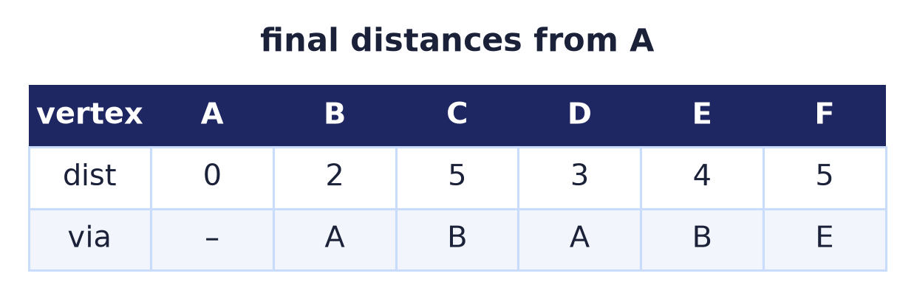
Dijkstra: worked trace
Distances from A
Each vertex settles once, in increasing distance.
'via' records the predecessor on the best path.
Backtracking 'via' reconstructs every route.
Notes:
Running it on our graph settles vertices in order of distance: A at 0, then C at 2, then B at 3, then D at 8, then E at 11, then F at 14. The predecessor column lets us rebuild the actual shortest path to any vertex by walking backwards to the source.

Slide 13
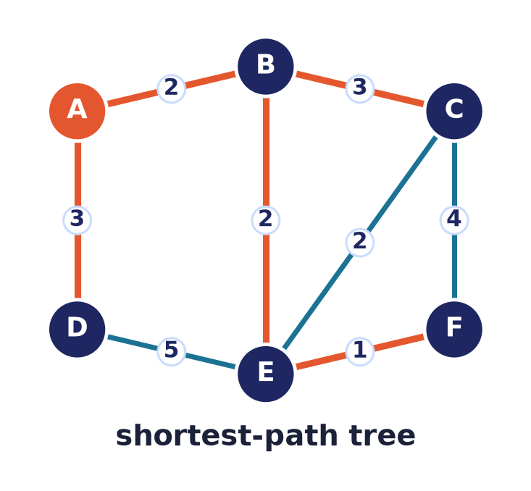
Dijkstra: why it's correct
Greedy stays ahead
When a vertex is settled, its distance is final.
Any later path would be longer (weights ≥ 0).
The settled edges form a shortest-path tree.
Notes:
Correctness rests on non-negative weights: the nearest unsettled vertex cannot be reached more cheaply through any vertex still farther away, so its tentative distance is already optimal when settled. The predecessor edges assemble into a shortest-path tree.

Slide 14
Dijkstra: complexity
Binary heap
O((V + E) log V) — the standard choice.
Array
O(V²) — better only for dense graphs.
Fibonacci heap
O(E + V log V) — optimal in theory, rare in practice.
Notes:
The running time depends on the priority queue. A binary heap gives the familiar O(E log V) and is what you will implement. Denser structures trade constant factors; the Fibonacci heap is asymptotically best but seldom worth its overhead.

Slide 15
Minimum spanning trees
Connect all, cheaply
A spanning tree touches every vertex with V − 1 edges.
The MST minimises total edge weight.
Model: cheapest network linking every node.
Notes:
A minimum spanning tree connects all vertices with no cycle and the least possible total weight — the cheapest way to wire a network, lay cable, or cluster data. Two greedy algorithms find it, both justified by one lemma.

Slide 16
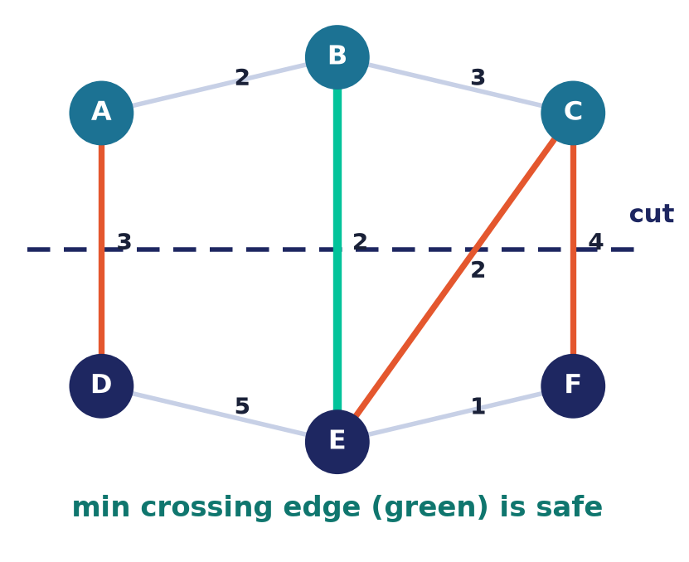
The cut property
The safe-edge lemma
Split the vertices into any two sides (a cut).
The cheapest edge crossing the cut is in SOME MST.
This single fact proves both Prim and Kruskal.
Notes:
The cut property is the engine of MST algorithms: for any partition of the vertices, the minimum-weight edge crossing it can always be included in a minimum spanning tree. Prim and Kruskal are just two ways of repeatedly applying this safe-edge rule.

Slide 17
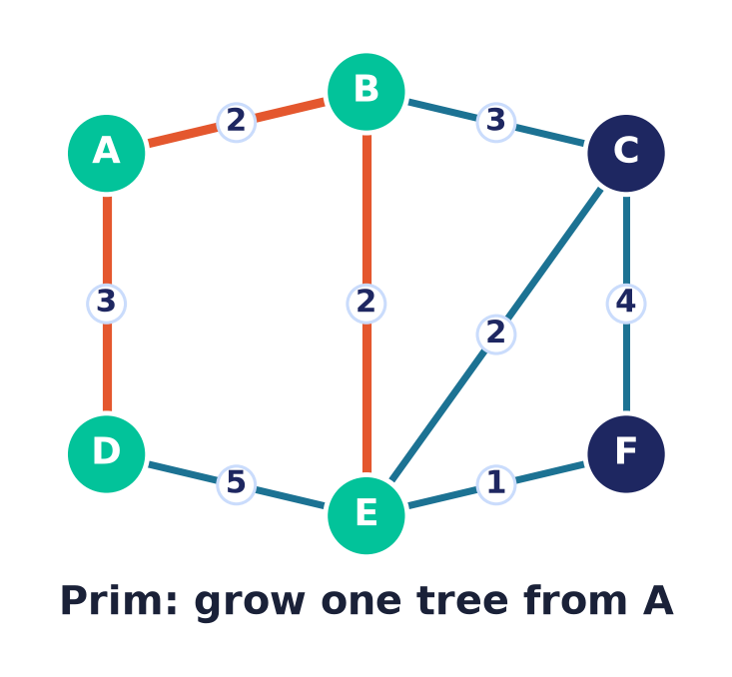
Prim's algorithm
Grow one tree
Start from any vertex; the tree is a growing blob.
Repeatedly add the cheapest edge leaving the tree.
Each addition is the cut property in action.
Notes:
Prim grows a single tree outward from a start vertex, each step adding the cheapest edge that connects a new vertex. The cut here separates the tree from the rest — so every edge Prim adds is safe by the cut property.

Slide 18
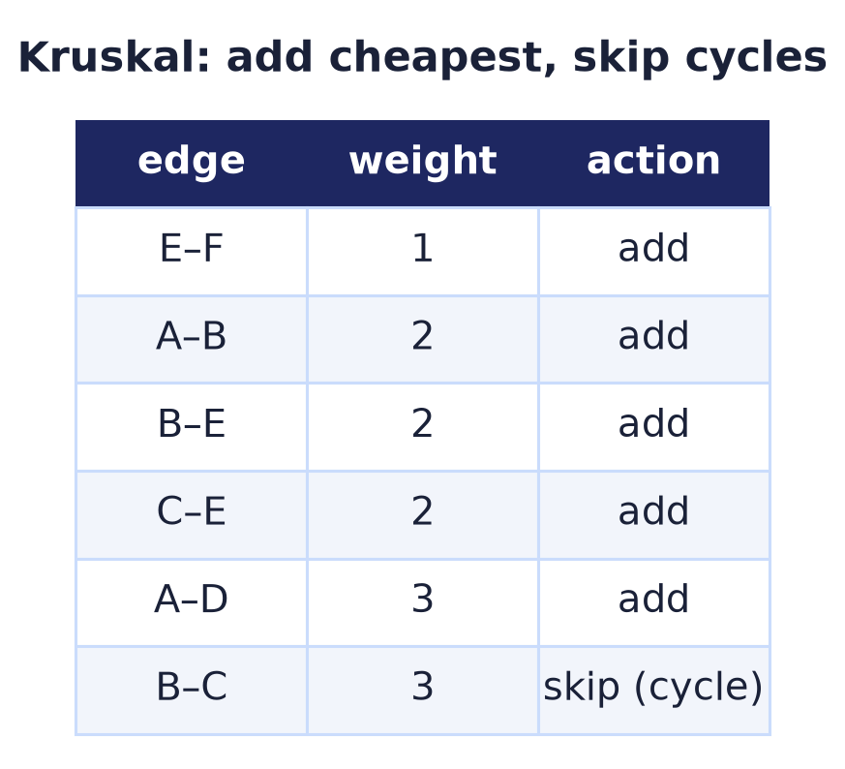
Kruskal's algorithm
Cheapest edge first
Sort all edges by weight.
Add each edge unless it forms a cycle.
A forest of trees merges into one.
Notes:
Kruskal takes a global view: consider edges cheapest-first and accept any that joins two different components, skipping those that would close a cycle. It builds many small trees that gradually merge — again, each accepted edge is a safe crossing edge.

Slide 19
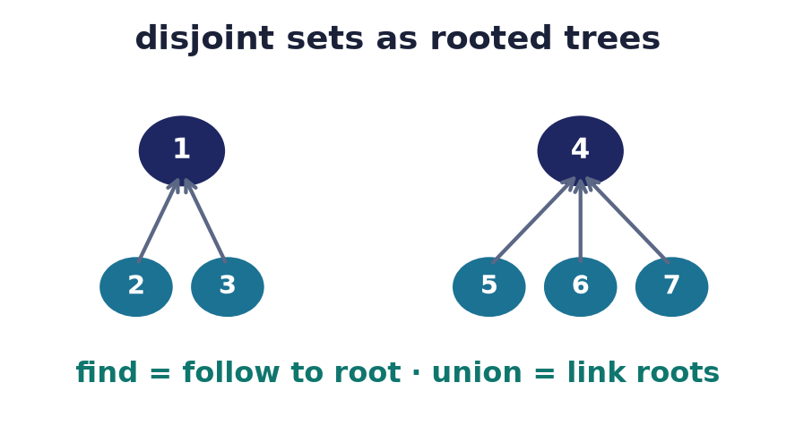
Union–find
Which tree am I in?
Kruskal must test: are u and v already connected?
Disjoint-set forest answers find & union near-instantly.
Path compression + union by rank ≈ O(1) amortised.
Notes:
Kruskal's cycle test needs a fast 'same component?' query. The union–find structure keeps each component as a rooted tree: find follows parents to the root, union links two roots. With path compression and union by rank, both run in nearly constant amortised time.

Slide 20
Prim vs Kruskal
Prim
Grows one tree; loves dense graphs and heaps.
Kruskal
Sorts edges; loves sparse graphs and union–find.
Same result
Both yield an MST — identical weight, maybe different edges.
Notes:
Both find a minimum spanning tree, but by different bookkeeping: Prim maintains one growing tree with a priority queue, ideal when edges are plentiful; Kruskal sorts edges and uses union–find, ideal when they are few. On ties they may pick different edges of equal total weight.

Slide 21
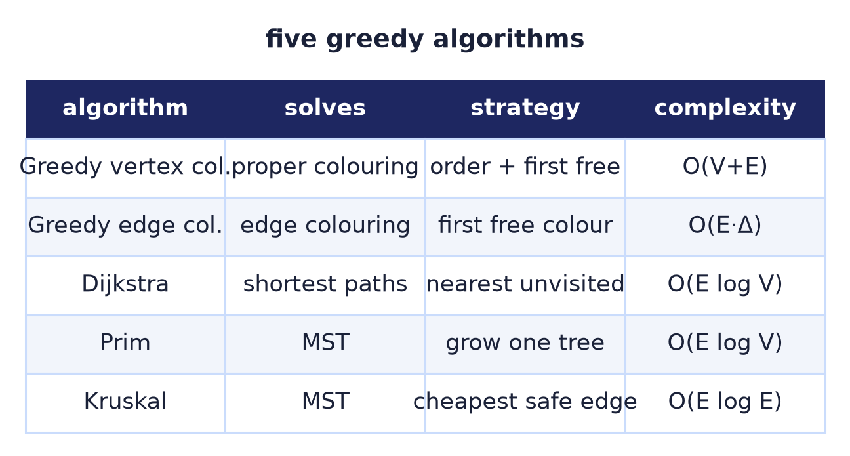
Five algorithms, one idea
Every one is greedy — but only Dijkstra, Prim, and Kruskal are provably optimal.
Notes:
Side by side, the pattern is clear: all five make greedy local choices. For shortest paths and MSTs the greedy choice is provably optimal; for colouring it is only a heuristic. Recognising that difference is the real lesson of the lecture.

Slide 22
Where these run in software
Dijkstra
GPS routing, network protocols (OSPF), games.
MST
Network design, clustering, image segmentation.
Colouring
Register allocation, scheduling, frequency assignment.
Notes:
These are not textbook curiosities. Dijkstra routes your GPS and internet packets; MST algorithms design networks and cluster data; graph colouring assigns CPU registers and radio frequencies. The greedy toolkit is everywhere in production systems.

Slide 23
Common mistakes
Dijkstra with negative edges
A→B=2, A→C=3, C→B=−2 gives 1, not 2 — greedy breaks; use Bellman–Ford.
Greedy colouring is optimal
No — order matters; χ is NP-hard.
MST = shortest-path tree
Different objectives, different trees.
Forgetting the cycle test
Kruskal without union–find builds cycles.
Notes:
The classic traps: Dijkstra silently fails on negative weights; greedy colouring is not optimal and its quality hinges on ordering; a minimum spanning tree is not a shortest-path tree; and Kruskal without a cycle check produces cycles instead of a tree.

Slide 24
Summary
— Greedy = best local choice, never revised.
— Greedy colouring ≤ Δ+1 colours, but order matters.
— Dijkstra: nearest-first shortest paths (weights ≥ 0).
— The cut property: cheapest crossing edge is safe.
— Prim grows a tree; Kruskal sorts + union–find.
— Greedy is optimal for paths & MSTs — a heuristic for colouring.

Slide 25
Next → Lecture 12: Special graphs
Structure unlocks stronger results.
Trees & spanning trees · Euler and Hamilton circuits · bipartite graphs & matching · regular graphs — where special structure makes hard problems easy.
Notes:
General graphs are hard; special families are tractable. Next we study trees, Euler and Hamilton circuits, and matchings — cases where extra structure turns intractable problems into elegant, solvable ones.

