Slide 1
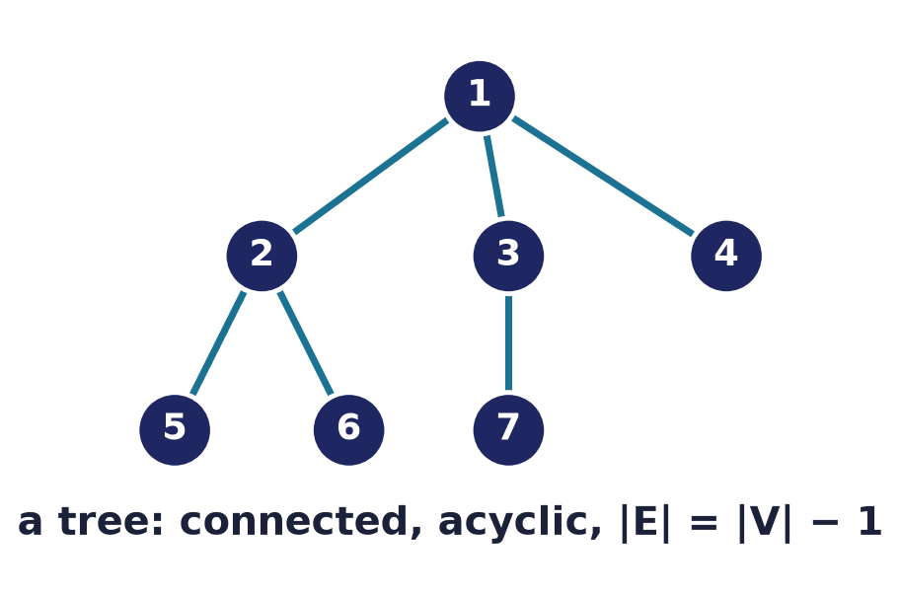
Special Graphs
Lecture 12 · Computer Discrete Mathematics
Trees · spanning trees · bipartite · Euler & Hamilton
Notes:
General graphs are hard. But impose a little structure — no cycles, two colour classes, every degree even — and beautiful, powerful theorems appear. This lecture is a tour of the graph families that matter most in computer science, each with its own signature theorem.

Slide 2
Why 'special' graphs?
Structure = power
Extra constraints unlock theorems general graphs lack.
They're everywhere
Trees, DAGs, bipartite matchings run real systems.
Hard becomes easy
Problems intractable in general are simple here.
Notes:
Special families earn their own chapter because structure buys strength: a tree's acyclicity, a bipartite graph's two sides, an Eulerian graph's even degrees each yield clean results. And these are the graphs you actually meet — file systems, dependency graphs, scheduling.

Slide 3
Trees
Connected & acyclic
A tree is a connected graph with no cycles.
Exactly one path between any two vertices.
Always |E| = |V| − 1.
Notes:
A tree is the leanest possible connected graph: remove any edge and it falls apart, add any edge and it forms a cycle. Between every pair of vertices there is exactly one path — the property that makes trees so useful for hierarchy and search.

Slide 4
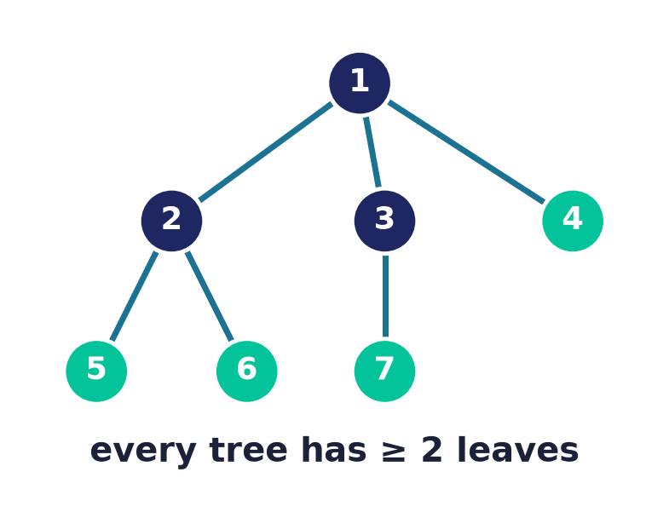
Every tree has ≥ 2 leaves
A leaf = degree-1 vertex
Follow a longest path — both ends must be leaves.
If an end had degree ≥ 2 the path could extend.
So every finite tree with ≥ 2 vertices has two leaves.
Notes:
A quick, elegant proof: take a longest path in the tree. Neither endpoint can have another neighbour — that would either extend the path or create a cycle — so both endpoints are leaves. Hence at least two leaves always exist.

Slide 5
The tree characterization
Five ways to say 'tree'
Connected + acyclic.
Connected + |E| = |V| − 1.
Acyclic + |E| = |V| − 1. · Unique path between all pairs.
Adding any edge makes exactly one cycle.
Notes:
These conditions are all equivalent — any two of {connected, acyclic, |E|=|V|−1} force the third, and each implies unique paths and the minimal-connected / maximal-acyclic properties. Knowing they coincide lets you pick whichever is easiest to check.

Slide 6
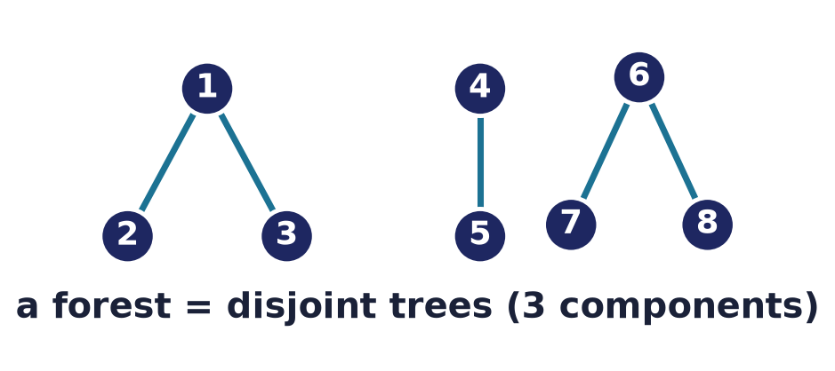
Forests
Trees, plural
A forest is a disjoint union of trees.
With c components: |E| = |V| − c.
Every acyclic graph is a forest.
Notes:
Drop the connectivity requirement and you get a forest — several trees side by side. The edge count generalises neatly: a forest with c components on n vertices has exactly n−c edges, reducing to n−1 when it is a single tree.

Slide 7
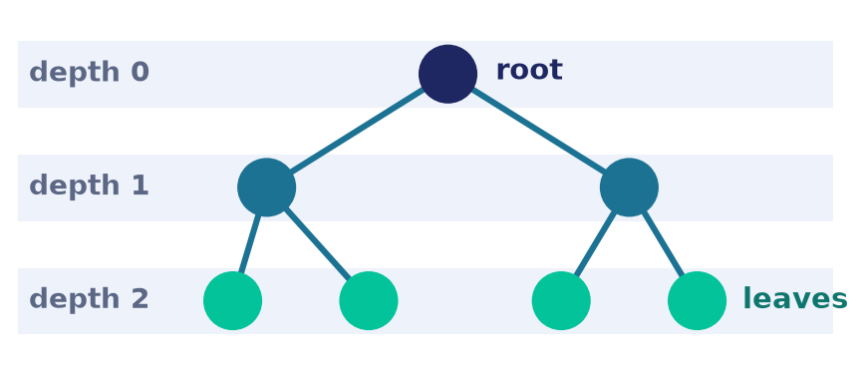
Rooted trees
Pick a root, gain hierarchy
Choosing a root orients every edge downward.
Parent, child, sibling, ancestor, descendant.
Depth = distance from root; height = deepest leaf.
Notes:
Designating one vertex as the root turns an undirected tree into a hierarchy — the structure behind file systems, org charts, and parse trees. Every non-root vertex has a unique parent, and the family vocabulary of children, ancestors, and descendants follows.

Slide 8
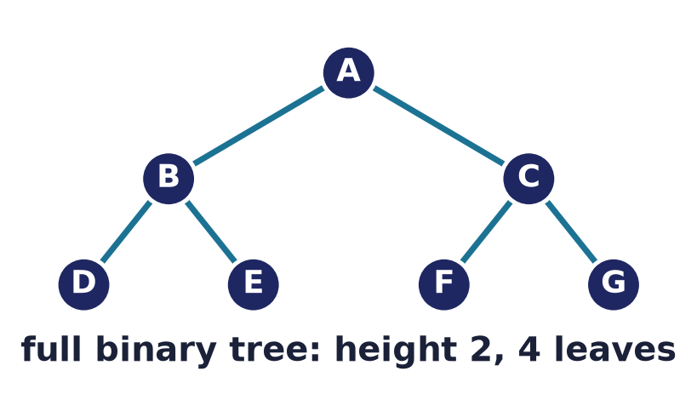
m-ary & binary trees
Bounded branching
m-ary: each node has ≤ m children (binary = 2).
Full = every internal node has exactly m children: mi + 1 vertices.
Balanced trees keep operations fast.
Notes:
Limiting the number of children gives m-ary trees; the binary case dominates computer science. Clean counting identities relate internal nodes, leaves, and total vertices — the arithmetic behind heaps, tries, and binary search trees.

Slide 9
Height bounds branching
Height controls leaves
A binary tree of height h has at most 2ʰ leaves.
So h ≥ log₂(leaves): balanced ⇒ logarithmic depth.
This is why search trees give O(log n) operations.
Notes:
Because each level at most doubles the nodes, a height-h binary tree holds at most 2^h leaves — equivalently, n leaves force height at least log₂ n. That single inequality is the reason balanced search trees and heaps achieve logarithmic time.

Slide 10
Tree traversals
Visit every node
Breadth-first: level by level (a queue).
Depth-first: pre-, in-, post-order (a stack / recursion).
Each order suits different tasks.
BFS: A B C D E F G
pre: A B D E C F G
in: D B E A F C G
post: D E B F G C A
Notes:
Traversal orders are how we linearise a tree. Breadth-first sweeps level by level with a queue; the three depth-first orders — pre, in, post — differ only in when a node is visited relative to its subtrees. Reading the sequences against the tree on the right makes the difference concrete, and each order matches a different computation.

Slide 11
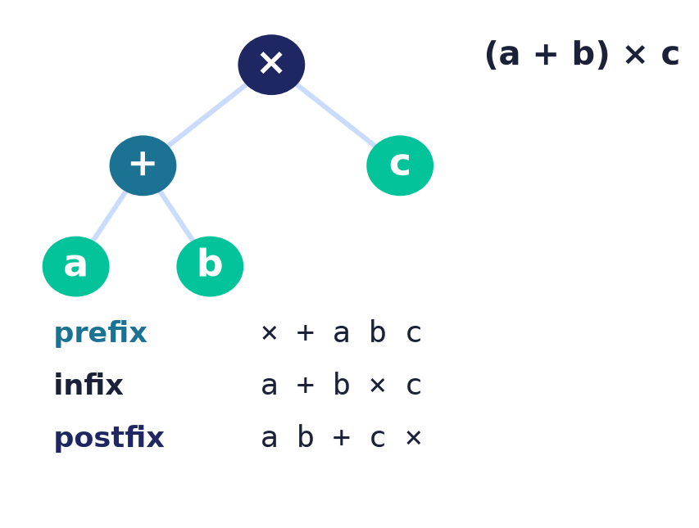
Expression trees
Traversal = notation
A binary tree stores an arithmetic expression.
Inorder gives the usual infix a + b × c.
Preorder = prefix (Polish); postorder = postfix (RPN).
Notes:
The marquee application of traversals: an expression tree holds operators at its internal nodes and operands at its leaves. Its three depth-first traversals ARE the three notations — inorder reproduces ordinary infix, preorder gives Polish prefix, and postorder gives reverse-Polish postfix, the stack-friendly form that calculators and compilers actually evaluate.

Slide 12
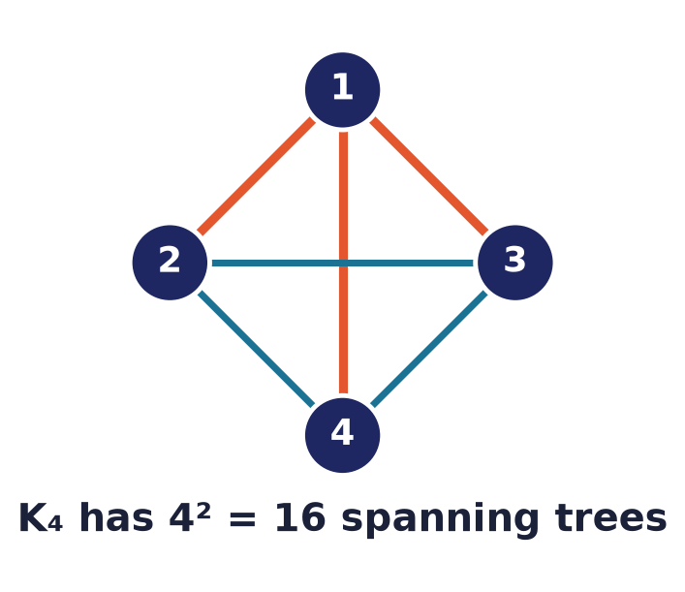
Spanning trees & Cayley
Trees inside graphs
A spanning tree connects all vertices, no cycle.
Cayley's formula: Kₙ has nⁿ⁻² spanning trees.
K₄ → 4² = 16 different spanning trees.
Notes:
Every connected graph contains spanning trees — minimal skeletons touching all vertices. Cayley's beautiful formula counts them for the complete graph: n to the power n minus two. For K4 that is sixteen, a number you can verify by hand.

Slide 13
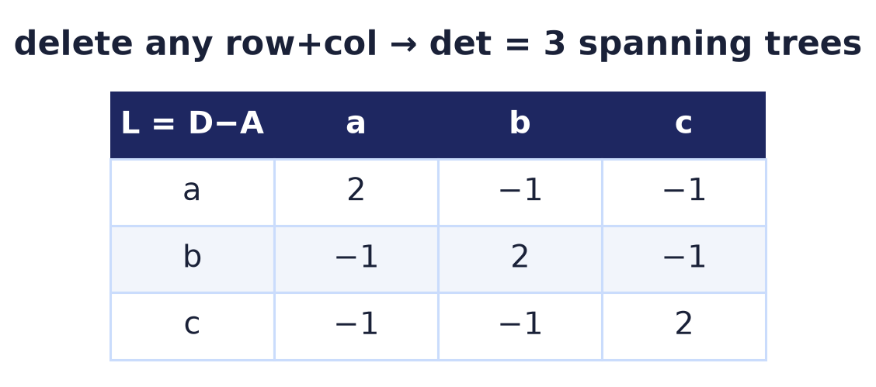
The Matrix–Tree theorem
Counting by determinant
Build the Laplacian L = D − A.
Delete any one row and column; take the determinant.
That value = the number of spanning trees.
Notes:
For any graph, Kirchhoff's Matrix–Tree theorem counts spanning trees as a determinant: form the Laplacian, strike out one row and column, and evaluate. For the triangle this gives three — and it generalises Cayley's formula to every graph.

Slide 14
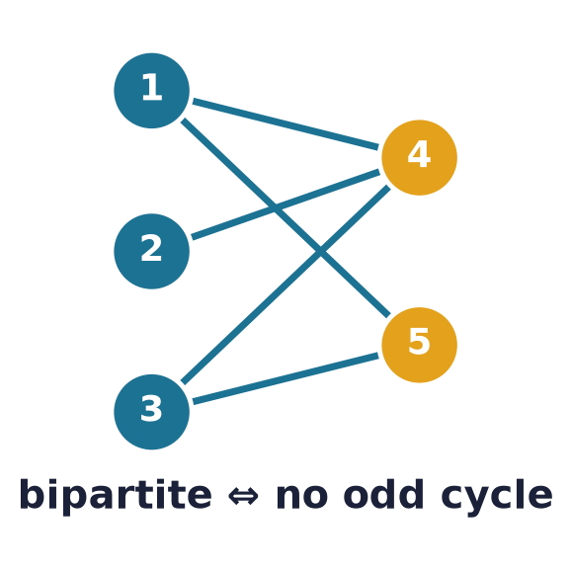
Bipartite graphs
Two sides — the odd-cycle theorem
Vertices split so every edge crosses.
THEOREM: bipartite ⇔ no odd-length cycle.
Model matchings, assignments, schedules.
Notes:
Bipartite graphs are exactly the two-colourable ones, and the clean characterisation is the odd-cycle theorem: a graph is bipartite if and only if it contains no cycle of odd length. This is what you check to detect bipartiteness with a single traversal.

Slide 15
Matchings & Hall's theorem
Pair up without conflict
A matching: edges sharing no endpoint; perfect if it covers every vertex.
Hall: X matches fully into Y ⇔ |N(S)| ≥ |S| for every S ⊆ X.
Proved — and computed — by augmenting paths.
Reading Hall
No k vertices on the left may collectively see fewer than k neighbours on the right.
Fails once some S is starved — that S is the certificate of impossibility.
Notes:
A matching is a set of edges no two of which share an endpoint; it is perfect when it covers every vertex. For a bipartite graph with parts X and Y, Hall's marriage theorem decides whether all of X can be matched into Y: possible if and only if every subset S of X has at least |S| neighbours, |N(S)| >= |S|. Necessity is obvious — a starved subset cannot be matched — and sufficiency is proved constructively with augmenting paths: repeatedly find a path alternating unmatched and matched edges between two exposed vertices and flip it to grow the matching, until Hall's condition finally blocks progress. That same augmenting-path search is the efficient algorithm for a maximum matching.

Slide 16
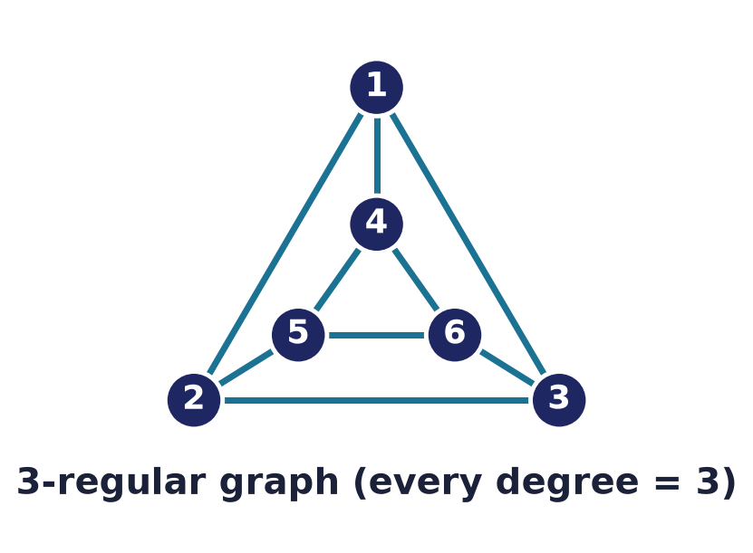
Regular graphs
Every vertex, same degree
k-regular: all vertices have degree k.
Handshaking ⇒ k·|V| is even.
Highly symmetric — cubes, cycles, complete graphs.
Notes:
In a regular graph every vertex looks the same — each has identical degree. Their symmetry makes them favourites for networks and codes. The handshaking lemma immediately constrains them: k times the number of vertices must be even.

Slide 17
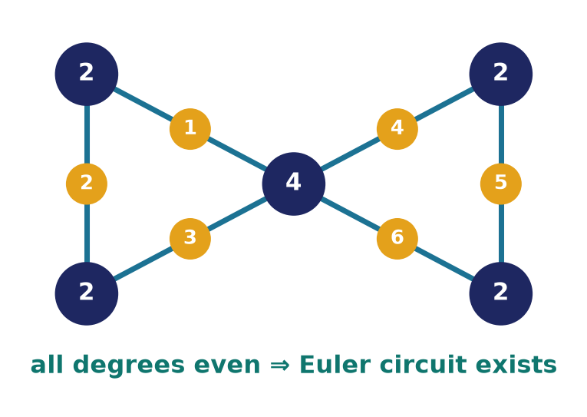
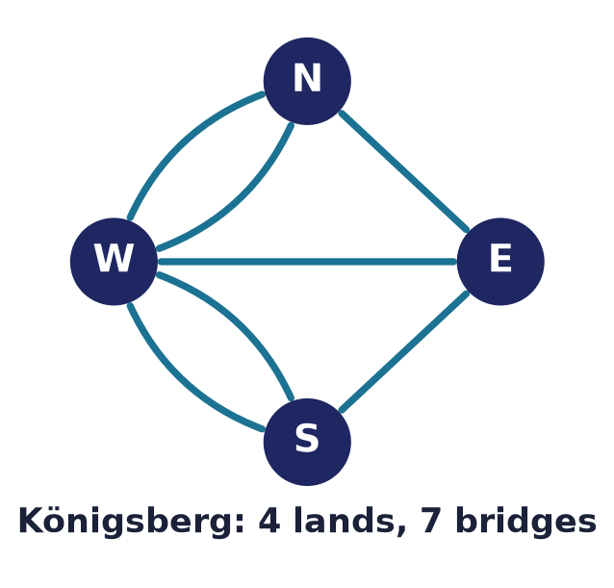
Eulerian graphs
Every edge exactly once
An Euler circuit uses every edge once, returns to start.
CIRCUIT ⇔ connected & all degrees even.
TRAIL (open) ⇔ exactly two odd-degree vertices.
Königsberg's four odd vertices → neither exists.
Notes:
Euler's theorem gives a perfect, checkable criterion. A closed Euler CIRCUIT exists exactly when the graph is connected and every vertex has even degree; an open Euler TRAIL exists exactly when precisely two vertices have odd degree — you must start at one and finish at the other. Each visit spends two edges at a vertex, so odd degree is the obstruction, and Königsberg's four odd landmasses doom both a circuit and a trail.

Slide 18
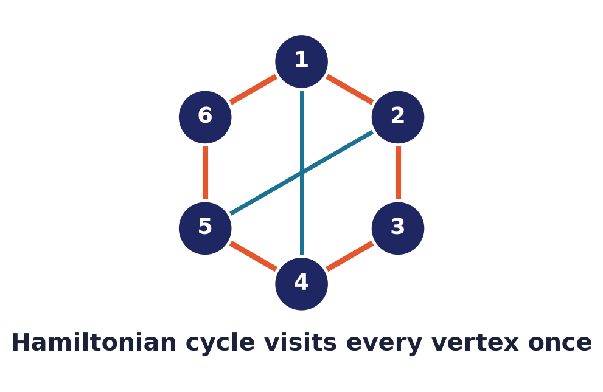
Hamiltonian graphs
Every vertex exactly once
A Hamilton cycle visits every vertex once.
Sounds similar to Euler — but there's NO easy test.
Deciding it is NP-complete.
Notes:
Swap 'edge' for 'vertex' and everything changes. A Hamiltonian cycle passes through every vertex once, yet unlike Euler there is no efficient test — deciding existence is NP-complete. The tiny change in wording hides an enormous change in difficulty.

Slide 19
Dirac & Ore: sufficient conditions
Dirac
If every degree ≥ n/2, a Hamilton cycle exists.
Ore
If deg(u)+deg(v) ≥ n for all non-adjacent u,v — likewise.
One-way
Sufficient, NOT necessary — sparse graphs can still qualify.
Notes:
Since there is no clean characterisation, we settle for sufficient conditions. Dirac and Ore both say: if the graph is dense enough, a Hamilton cycle must exist. They guarantee existence but do not detect every Hamiltonian graph — the arrow goes one way.

Slide 20
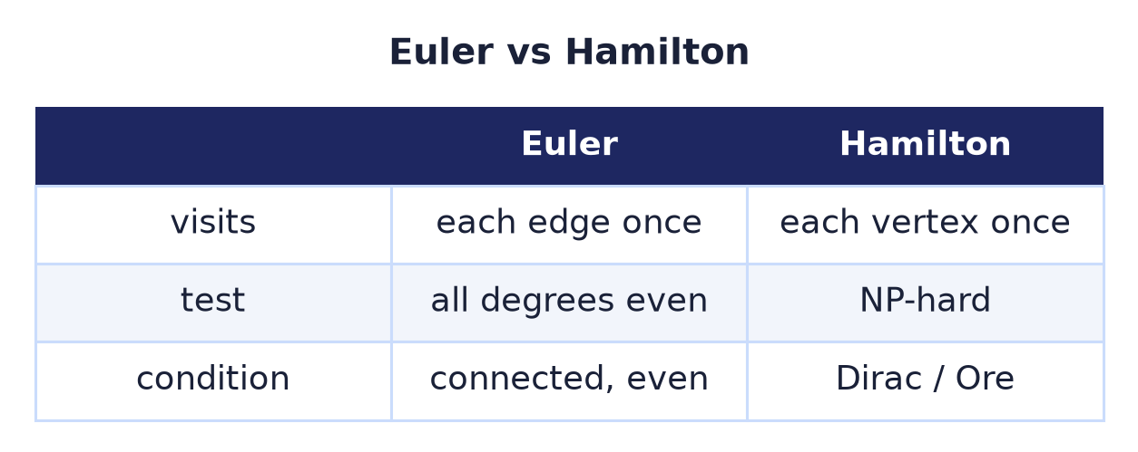
Euler vs Hamilton
One word — edge vs vertex — separates an easy problem from an NP-hard one.
Notes:
The side-by-side sharpens the lesson: Euler and Hamilton differ only in edge versus vertex, yet one has a two-line degree test and the other is NP-hard. It is a vivid reminder that superficially similar problems can live in entirely different complexity worlds.

Slide 21
Special graphs in software
Trees
File systems, ASTs, B-trees, heaps, tries.
Bipartite
Job scheduling, stable matching, recommendation.
DAGs (directed acyclic)
Build order, task scheduling, spreadsheets.
Notes:
These families are the backbone of systems: trees organise file systems, parsers, and databases; bipartite matching drives scheduling and recommendations; and directed acyclic graphs sequence builds, tasks, and spreadsheet recalculation. Recognising the family tells you which algorithm applies.

Slide 22
Common mistakes
'Tree' needs BOTH conditions
Connected AND acyclic — one alone isn't enough.
Euler ≠ Hamilton
Edges once vs vertices once — utterly different.
Dirac/Ore are only sufficient
Failing them doesn't rule out a Hamilton cycle.
Bipartite = no ODD cycle
Even cycles are perfectly fine.
Notes:
Watch these: a tree needs both connectivity and acyclicity; Euler and Hamilton must never be conflated; Dirac and Ore only guarantee, never forbid; and bipartiteness bans odd cycles only — even cycles are allowed.

Slide 23
Summary
— Tree = connected + acyclic ⇒ |E| = |V| − 1.
— Rooted & binary trees give O(log n) via height bounds.
— Spanning trees: Cayley (nⁿ⁻²) and Matrix–Tree count them.
— Bipartite ⇔ no odd cycle.
— Euler (edges, easy) vs Hamilton (vertices, NP-hard).
— Structure turns hard problems into solvable ones.

Slide 24
Next → Lecture 13: Probability
From certainty to chance.
Sample spaces · conditional probability · Bayes' theorem · random variables & expectation — the mathematics of uncertainty that underlies algorithms and machine learning.
Notes:
We leave the world of certainty for the world of chance. Probability quantifies uncertainty — essential for randomised algorithms, hashing, and machine learning — and, fittingly, its tree diagrams and counting build directly on the combinatorics and graphs we have just studied.

