Slide 1
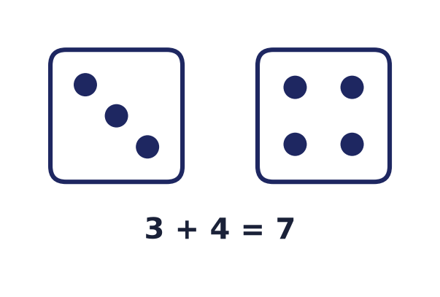
Probability
Lecture 13 · Computer Discrete Mathematics
Sample spaces · counting · conditional · Bayes · expectation
Notes:
Until now every answer was certain. Probability is the mathematics of uncertainty — how to reason precisely about chance. It rests on the counting we already know, and it underlies randomised algorithms, hashing, cryptography, and all of machine learning.

Slide 2
Why probability?
Uncertainty is everywhere
Noise, randomness, incomplete data — chance is unavoidable.
It quantifies belief
A number in [0,1] measures how likely an event is.
It runs modern CS
Randomised algorithms, ML, cryptography, networks.
Notes:
Real systems face uncertainty — unpredictable inputs, random failures, noisy measurements. Probability turns vague intuition about 'likely' and 'unlikely' into precise numbers we can compute with, and it is the foundation of the algorithms and models that dominate computing today.

Slide 3
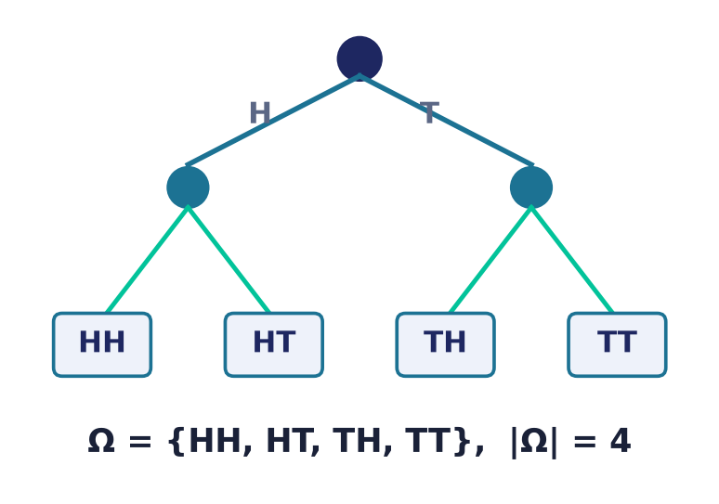
Sample space & events
Ω and its subsets
Sample space Ω: all possible outcomes.
An event is a subset of Ω.
Here: two coin flips, |Ω| = 4.
Notes:
Every probability model starts with the sample space — the set of all outcomes of an experiment. An event is simply a subset of that space: 'at least one head' is the subset {HH, HT, TH}. Enumerating Ω is always the first step.

Slide 4
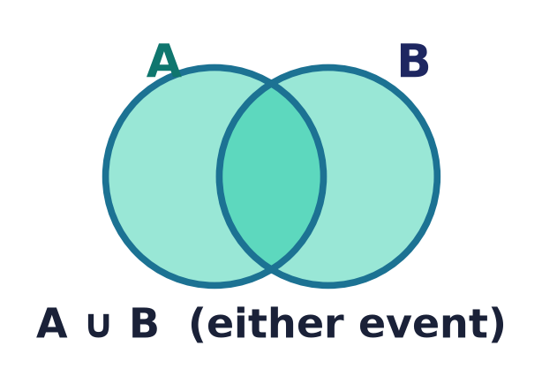
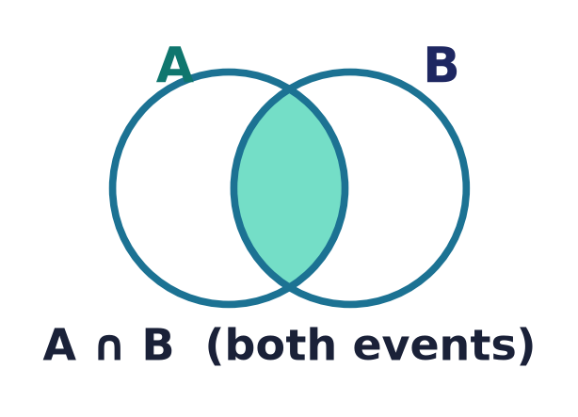
Events are sets
Set operations ARE event logic: union = 'or', intersection = 'and', complement = 'not'.
Notes:
Because events are sets, the whole algebra of sets applies directly. 'A or B' is the union, 'A and B' the intersection, 'not A' the complement. Everything you learned about sets in Lecture 2 is now the logic of events.

Slide 5
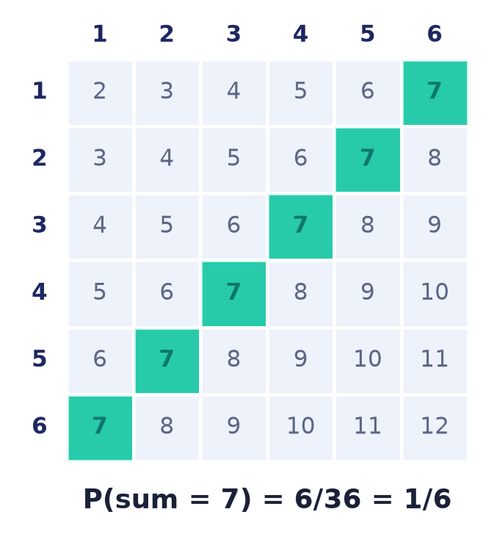
The classical definition
Laplace: count and divide
When outcomes are equally likely:
P(E) = favourable outcomes / total outcomes.
So probability reduces to counting.
Frequentist view: the long-run relative frequency.
Notes:
When every outcome is equally likely, Laplace's definition applies: probability is just the fraction of favourable cases. Rolling two dice, 6 of the 36 equally likely pairs sum to 7, so the probability is one sixth. When outcomes are NOT equally likely, the frequentist view takes over — probability is the long-run relative frequency, and the Law of Large Numbers guarantees the observed frequency converges to it as trials repeat. Either way, counting and repetition are what ground the numbers.

Slide 6
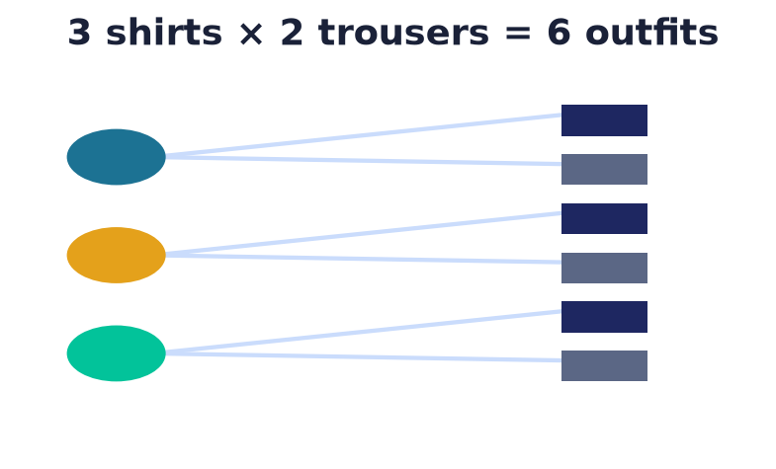
Counting: the multiplication principle
Independent choices multiply
If step 1 has m ways and step 2 has n ways,
the combined choice has m × n ways.
The engine behind all counting.
Notes:
The rule of product is the foundation of combinatorics: independent successive choices multiply. Three shirts and two pairs of trousers give six outfits. From this single principle we derive permutations, combinations, and the sizes of vast sample spaces.

Slide 7
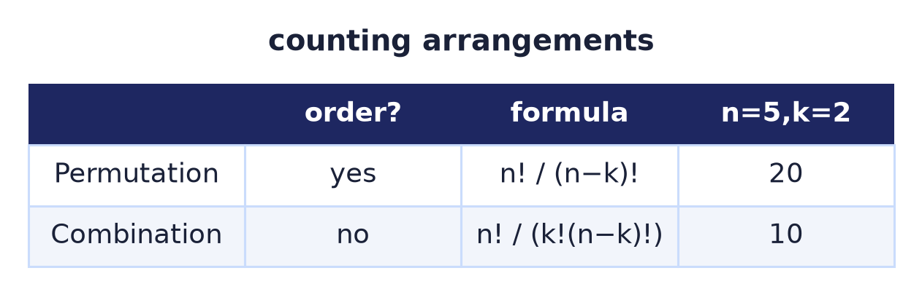
Permutations & combinations
Does order matter?
Arrangement (k-permutation): ordered — n!/(n−k)!.
Combination: unordered — n!/(k!(n−k)!).
A full permutation of all n is n!. 'Order?' decides which.
Notes:
An arrangement (k-permutation) counts ordered selections of k from n and equals n!/(n−k)!; a full permutation of all n is n!. A combination counts unordered selections — which three form a committee. Always ask first whether order matters.

Slide 8
Three more counting tools
Sum rule
Disjoint cases ADD: m1 + m2 + … . 'Or / separate cases' adds, where the product rule's 'and / in stages' multiplies.
Multisets (stars & bars)
Choose k from n types WITH repetition — or k identical balls into n boxes: C(n+k−1, k).
Binomial theorem
(x+y)^n = Σ C(n,k)·x^k·y^(n−k). Set x=y=1 to get Σ C(n,k) = 2^n.
Notes:
Beyond the product rule and permutations/combinations: the sum rule adds over disjoint cases; multisets / stars-and-bars count selections with repetition — equivalently identical balls into distinct boxes — as C(n+k−1,k); and the binomial theorem shows the combinations are the coefficients of (x+y)^n, whence the sum of C(n,k) is 2^n.

Slide 9
Kolmogorov's axioms
Non-negativity
P(E) ≥ 0 for every event.
Normalisation
P(Ω) = 1 — something must happen.
Additivity
Disjoint events: P(A∪B) = P(A) + P(B).
Notes:
Modern probability rests on three axioms Kolmogorov gave in 1933: probabilities are non-negative, the whole space has probability one, and probabilities of mutually exclusive events add. Every rule of probability — no matter how subtle — is derived from just these three.

Slide 10
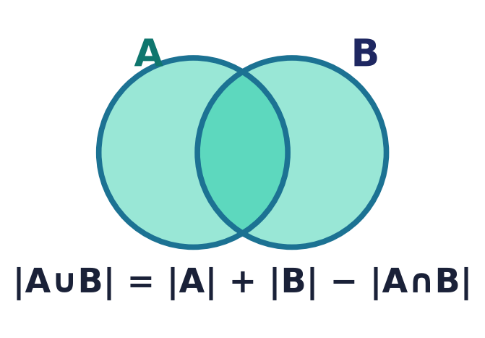
Derived rules
Built from the axioms
Complement: P(Aᶜ) = 1 − P(A).
Inclusion–exclusion for overlapping events:
P(A∪B) = P(A) + P(B) − P(A∩B).
Notes:
From the axioms flow the everyday rules. The complement rule often makes 'at least one' problems easy — compute the opposite and subtract. Inclusion–exclusion corrects for double-counting when events overlap, subtracting the intersection counted twice.

Slide 11
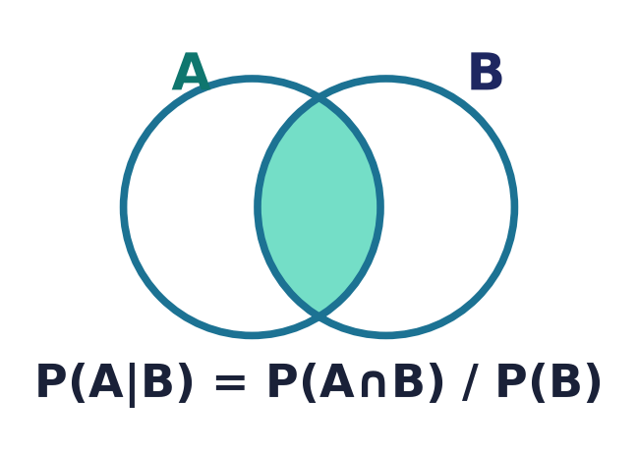
Conditional probability
Update on evidence
P(A|B) = P(A∩B) / P(B).
Learning B shrinks the sample space to B.
The heart of all probabilistic reasoning.
Notes:
Conditioning is how probability incorporates evidence: once we know B happened, B becomes the new sample space, and we ask what fraction of it also lies in A. This single idea — updating beliefs on new information — is the engine of inference and machine learning.

Slide 12
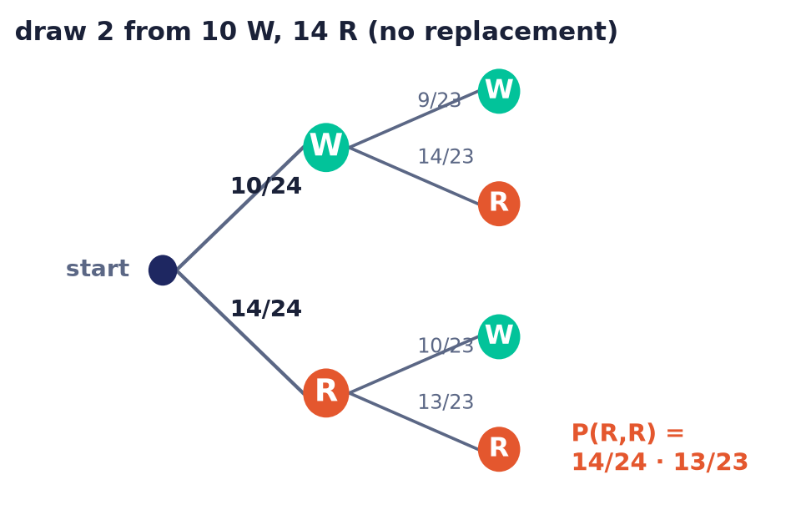
The multiplication rule & dependent events
Chain the draws
Multiplication rule: P(A∩B) = P(B)·P(A|B).
Without replacement, successive draws are DEPENDENT.
Multiply the probabilities along each path.
Notes:
Rearranging the definition of conditional probability gives the multiplication (chain) rule: P(A∩B)=P(B)·P(A|B). A probability tree makes it visual — each branch carries a conditional probability and you multiply along a path. Drawing two balls from an urn without replacement is dependent: after a red is taken, only 13 of the remaining 23 are red, so P(both red)=14/24·13/23. With replacement the second factor reverts to 14/24 and the draws become independent.

Slide 13
Independence
When knowing one tells nothing
A and B independent ⇔ P(A∩B) = P(A)·P(B).
Equivalently P(A|B) = P(A).
Beware: independent ≠ mutually exclusive!
Notes:
Two events are independent when one gives no information about the other — their joint probability factorises. A crucial and common confusion: independent is not the same as mutually exclusive. Disjoint events are in fact highly dependent — if one occurs, the other cannot.

Slide 14
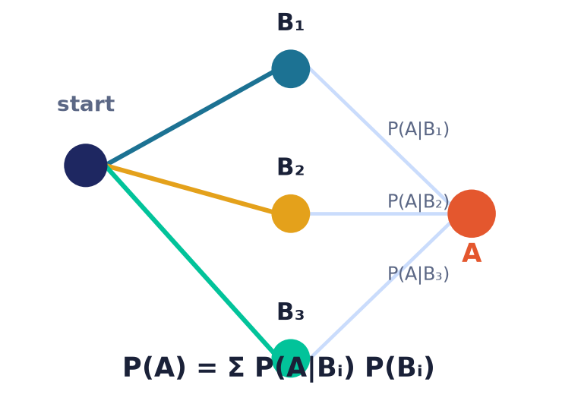
Law of total probability
Divide and conquer
Partition Ω into cases B₁, B₂, …
P(A) = Σ P(A|Bᵢ)·P(Bᵢ).
Average the conditionals, weighted by each case.
Notes:
To find an unconditional probability, split the world into exhaustive, disjoint cases, compute the probability within each, and weight by how likely each case is. This law is the workhorse that makes Bayes' theorem computable.

Slide 15
Bayes' theorem
Reverse the conditioning
P(A|B) = P(B|A)·P(A) / P(B).
Turns P(evidence|cause) into P(cause|evidence).
The mathematics of learning from data.
Notes:
Bayes' theorem flips a conditional probability around. We usually know the likelihood — how probable the evidence is given a cause — but we want the reverse: how probable the cause is given the evidence. Bayes provides the exact conversion, and it is the basis of all statistical learning.

Slide 16
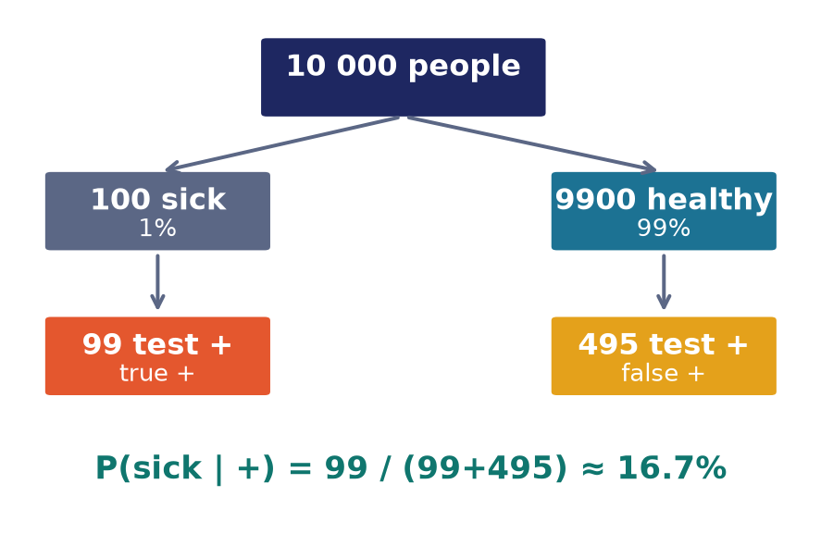
Bayes in action: a medical test
The base-rate surprise
Test: 99% sensitive, 5% false-positive; disease in 1%.
A positive result still means only ≈ 16.7% sick!
Rarity dominates — most positives are false.
Notes:
Here is the classic shock. Even a good test — catching 99% of true cases with only a 5% false-positive rate — produces mostly false positives for a rare disease, because the healthy majority is so large. Thinking in natural frequencies (10 000 people, 100 sick) makes the counter-intuitive 16.7% obvious: 99 true positives against 495 false ones. Ignoring the base rate is a dangerous, common error.

Slide 17
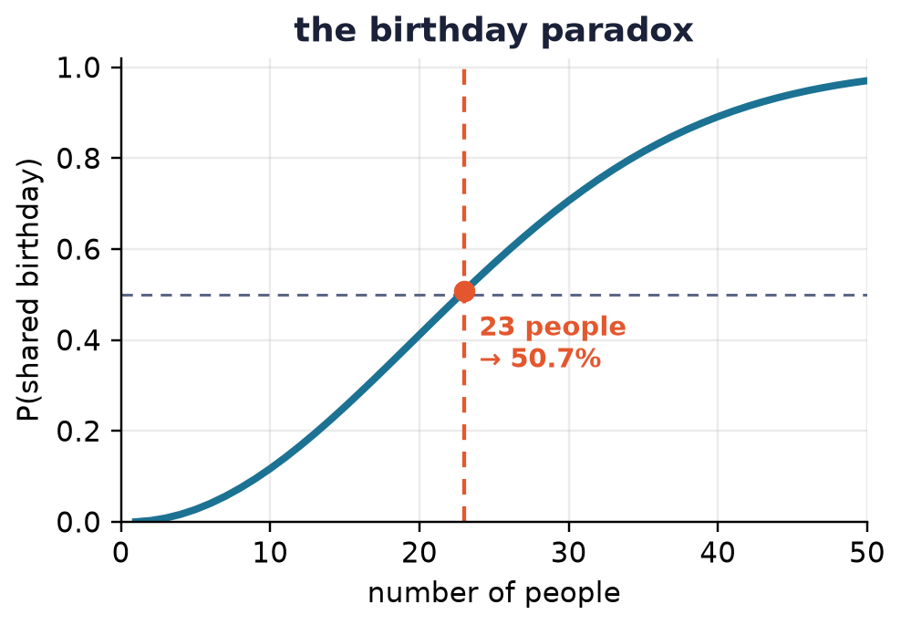
The birthday paradox
Collisions come fast
Just 23 people ⇒ >50% chance two share a birthday.
Pairs grow quadratically, not linearly.
Why hash collisions appear sooner than expected.
Notes:
Intuition says you need hundreds of people for a shared birthday, but only 23 gives better-than-even odds. The reason: it is the number of pairs that matters, and pairs grow with the square. This same maths governs hash collisions and is central to cryptographic attacks.

Slide 18
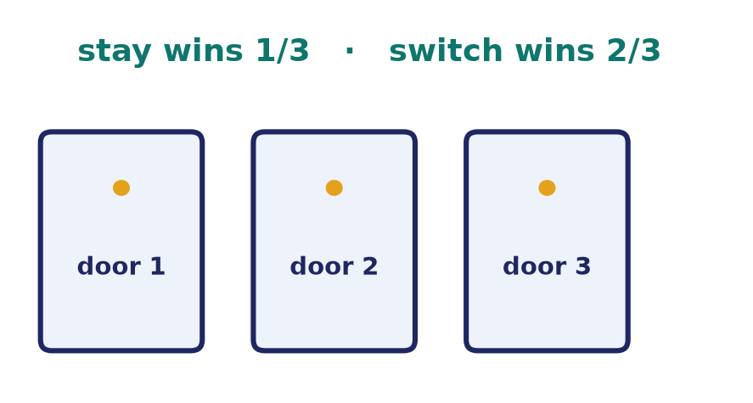
The Monty Hall problem
Switching wins
Pick 1 of 3 doors; the host reveals a goat.
Staying wins 1/3; switching wins 2/3.
The host's knowledge changes the odds.
Notes:
The most argued-about probability puzzle. Your first pick is right one time in three, and that never changes — so the other two-thirds of probability collapses onto the remaining door once the host reveals a goat. Switching doubles your chance. The host's informed action is the key.

Slide 19
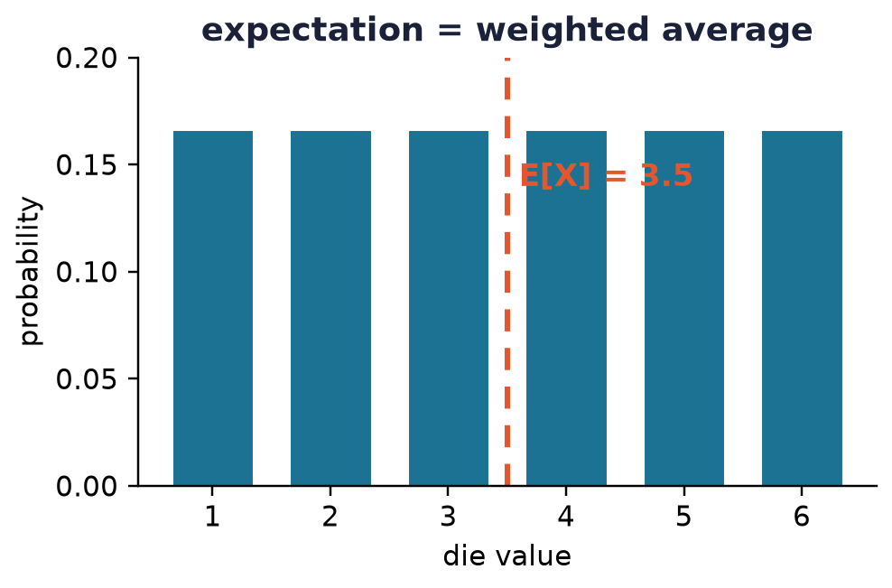
Random variables & expectation
From events to numbers
A random variable assigns a number to each outcome.
Expectation E[X] = Σ x·P(X=x): the long-run average.
Linearity: E[X+Y] = E[X] + E[Y], always.
Notes:
A random variable turns outcomes into numbers we can average. Expectation is that average weighted by probability — a fair die expects 3.5. Its most powerful property is linearity: expectations add even when the variables are dependent, which solves many problems almost magically.

Slide 20
Variance & standard deviation
How spread out?
Variance Var(X) = E[(X−E[X])²] = E[X²] − E[X]².
Standard deviation σ = √Var(X), same units as X.
Dataset: σ² = (1/N)·Σ(xᵢ−μ)² (sample variance ÷ N−1).
Handy rules
Var(aX + b) = a²·Var(X)
independent X, Y:
Var(X+Y) = Var(X) + Var(Y)
Notes:
The mean says where a distribution sits; the variance says how spread out it is — the expected squared deviation from the mean, E[X²]−E[X]². Its square root σ (standard deviation) is in the same units as X. For a dataset the same formula with equal weights gives the population σ² (divide by N); the sample variance divides by N−1 — the definitions Lab 7's statistics task refers to.

Slide 21
Probability in software
Randomised algorithms
Quicksort, primality testing, hashing, load balancing.
Machine learning
Bayesian inference, probabilistic models, uncertainty.
Cryptography & networks
Key generation, protocols, birthday attacks.
Notes:
Probability is not optional in computing. Randomised algorithms are often simpler and faster than deterministic ones; machine learning is applied probability; and cryptography depends on randomness and on collision probabilities like the birthday bound. One workhorse tool deserves a name: the union bound (Boole's inequality), P(A₁∪…∪Aₙ) ≤ ΣP(Aᵢ), which lets you bound the chance that ANY of many bad events occurs — the single most-used inequality in the analysis of randomised algorithms. This lecture is direct groundwork for those fields.

Slide 22
Common mistakes
Base-rate neglect
Ignoring how rare an event is — the test trap.
Independent ≠ exclusive
Disjoint events are dependent, not independent.
Gambler's fallacy
Past independent trials don't 'balance out'.
Confusing P(A|B) with P(B|A)
The prosecutor's fallacy — they differ.
Notes:
The four classic errors: neglecting base rates (the medical test), confusing independence with mutual exclusivity, believing past results influence independent future ones, and swapping the direction of a conditional probability. Each has caused real-world mistakes, including wrongful convictions.

Slide 23
Summary
— Sample space Ω; events are subsets — set logic applies.
— Classical probability = favourable / total (counting).
— Kolmogorov's 3 axioms generate every rule.
— Conditioning updates beliefs; Bayes reverses it.
— Watch base rates: rare + accurate can still mean unlikely.
— Random variables & expectation (linear!) summarise chance.

Slide 24
Next → Lecture 14: Automata theory
Machines, languages, and the limits of computation.
Finite automata · regular languages · deterministic vs non-deterministic · what a machine can and cannot recognise — the theory beneath every compiler and search engine.
Notes:
We close the course with the theory of computation itself: abstract machines that read input and decide languages. Finite automata are the simplest — the pattern matchers behind regular expressions, lexers, and protocols — and they reveal the very first limits of what computers can do.

