Slide 1
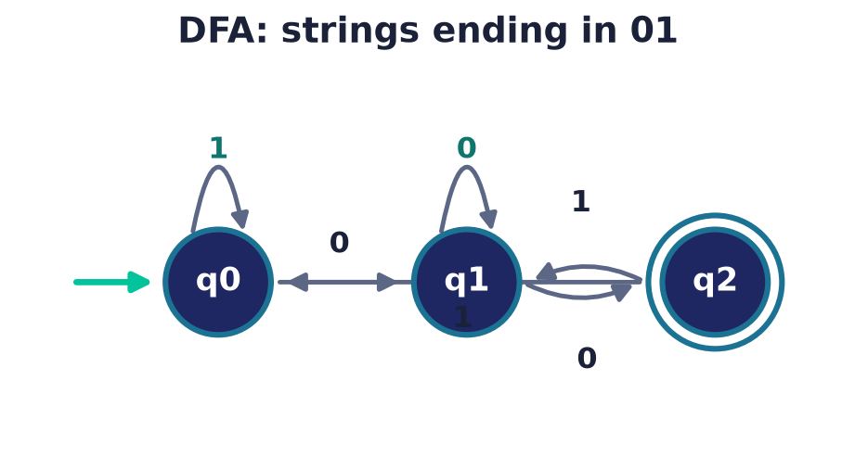
Automata Theory
Lecture 14 · Computer Discrete Mathematics
Finite automata · regular languages · the limits of computation
Notes:
We finish the course at its most profound question: what can a machine compute? We start with the simplest machine — a finite automaton with no memory beyond its current state — and discover both its surprising power and its first hard limit. This is the theory beneath every compiler, search engine, and protocol.

Slide 2
Combinational vs sequential
Combinational
Output depends only on current input. No memory (e.g. an adder).
Sequential
Output depends on input AND history — state, held in flip-flops.
The leap
k flip-flops store k bits → up to 2ᵏ states.
Notes:
A combinational circuit — like the adder of Lecture 5 — maps inputs to outputs with no memory. A sequential machine remembers: its response depends on what came before. In hardware that memory lives in flip-flops (D-type latches); k flip-flops hold k bits and so realise up to 2ᵏ states. Capturing this memory abstractly as 'state' is the conceptual jump from a logic gate to a computer, and the subject of this lecture.

Slide 3
Alphabets, strings & languages
The objects of computation
Alphabet Σ: a finite set of symbols, e.g. {0,1}.
String: a finite sequence over Σ; the empty string is ε. Σ* = all strings.
Language: any set of strings — what a machine decides.
Notes:
Three definitions frame everything. An alphabet is a finite symbol set; strings are finite sequences of those symbols, including the empty string ε (the identity for concatenation, and the base case of the Kleene star); and a language is any set of strings. A machine's job is to decide a language — to answer 'is this string in the set?' Computation, abstractly, is language recognition.

Slide 4
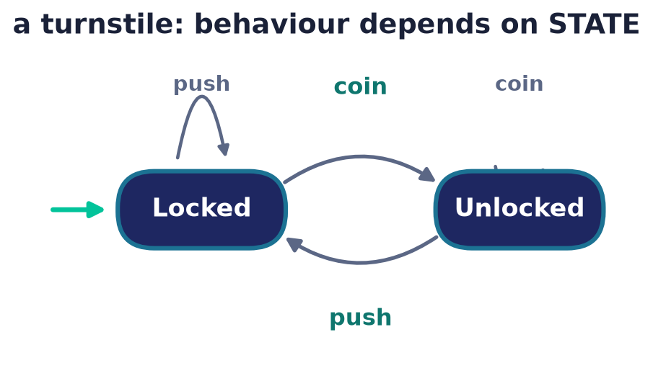
The idea of state
Memory as a state
A state summarises everything the machine remembers.
Input drives transitions between states.
Finite automaton = finitely many states.
Notes:
A state is a compressed memory of the past — all the machine needs to know to react correctly to future input. The turnstile has two: locked and unlocked. Crucially, a finite automaton has only finitely many states, so it can remember only a bounded amount. That bound is the whole story.

Slide 5
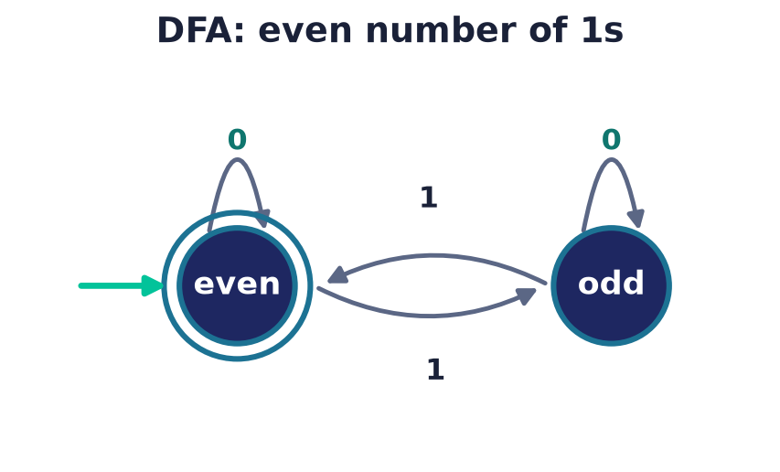
Deterministic finite automata
The 5-tuple (Q, Σ, δ, q₀, F)
States Q, alphabet Σ, transition δ: Q×Σ→Q.
Start state q₀, accepting states F.
Deterministic: each (state, symbol) → exactly one state.
Notes:
A DFA is formally a five-tuple, but the picture says it all: circles are states, arrows labelled by symbols are transitions, the incoming arrow marks the start, and double circles mark acceptance. Deterministic means no choice — every state has exactly one arrow per input symbol.

Slide 6
How a DFA decides
Run, then check
Start at q₀; follow one arrow per input symbol.
Accept if the final state is in F, else reject.
The language = all strings it accepts.
Trace on 'even # of 1s' (even = accept):
1001: e→o→o→o→e ✓ accept
1011: e→o→o→e→o ✗ reject
Notes:
Running a DFA is mechanical: begin in the start state and, symbol by symbol, follow the unique matching arrow. When the input ends, accept if you have landed in an accepting state. The set of all accepted strings is the language the automaton recognises — here, strings with an even number of ones.

Slide 7
Design: ending in 01
States remember progress
Each state tracks how much of '01' we've matched.
q₂ (accepting) = 'the string so far ends in 01'.
Reading resets or advances the match.
Notes:
Designing a DFA is choosing what each state must remember. For 'ends in 01', three states suffice: nothing useful yet, just saw a 0, and just saw 01. Every symbol either advances the match toward acceptance or falls back — the automaton needs no memory beyond this progress.

Slide 8
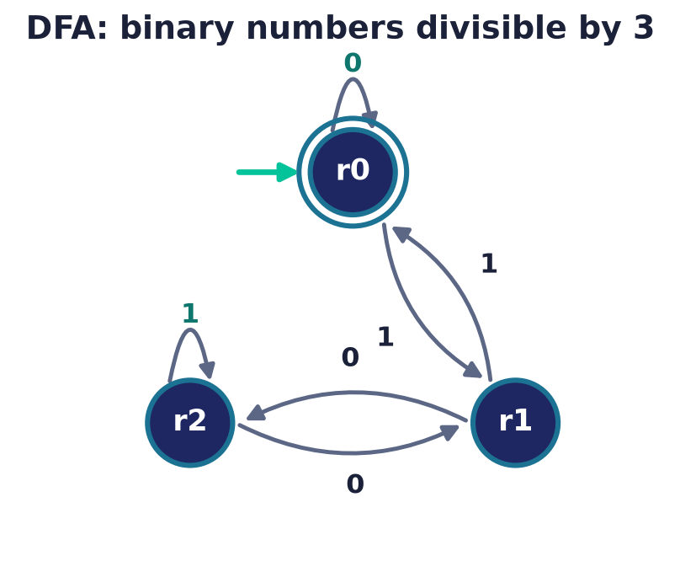
Design: divisible by 3
States as remainders
Read the binary number left to right.
State = current value mod 3 (r₀, r₁, r₂).
Reading bit b: r → (2r + b) mod 3.
Notes:
A beautiful example: to test divisibility by three, let each state be the remainder so far. Appending a bit doubles the value and adds the bit, so the remainder updates by a fixed rule. Three states track an unboundedly large number — because only the remainder matters, not the number itself.

Slide 9
Dead states & totality
Every path must be defined
A DFA needs a transition for EVERY symbol in every state.
A 'dead' (trap) state absorbs doomed strings.
It keeps the machine total — never stuck.
Notes:
Determinism demands totality: from every state, every symbol must lead somewhere. Strings that can never be accepted are funnelled into a dead state — a non-accepting trap that loops to itself. It is often left implicit in drawings, but formally it must be there.

Slide 10
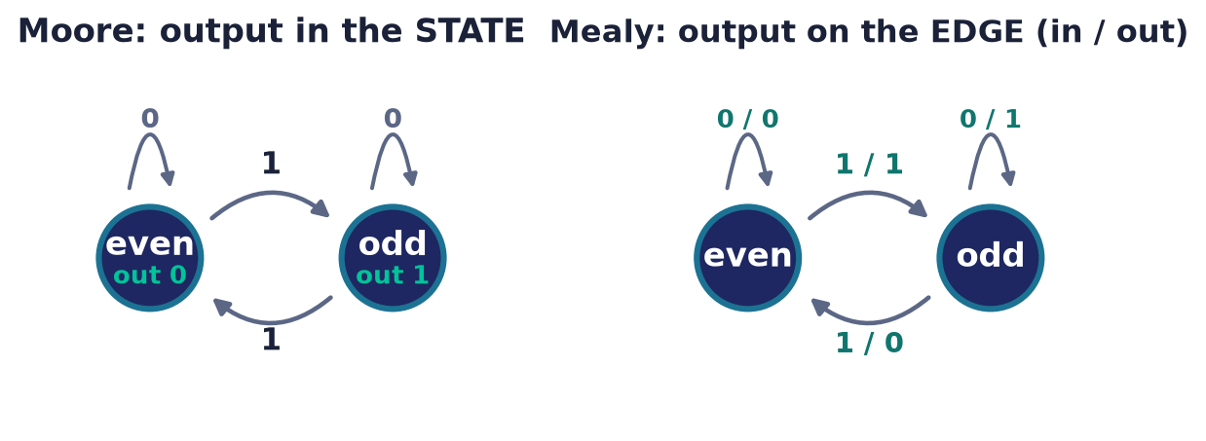
Machines with output
Transducers, not just acceptors
Moore: output attached to each STATE.
Mealy: output attached to each TRANSITION.
Equivalent in power — both report running parity below.
Notes:
Pure acceptors say only yes or no. Add output and you get transducers. Here both machines report the running parity of the 1s seen: a Moore machine labels each STATE with its output (even→0, odd→1), while a Mealy machine labels each EDGE with input/output. They are equivalent in expressive power, and are the finite-state controllers inside hardware, vending machines, and network protocols — the same theory, now producing signals.

Slide 11
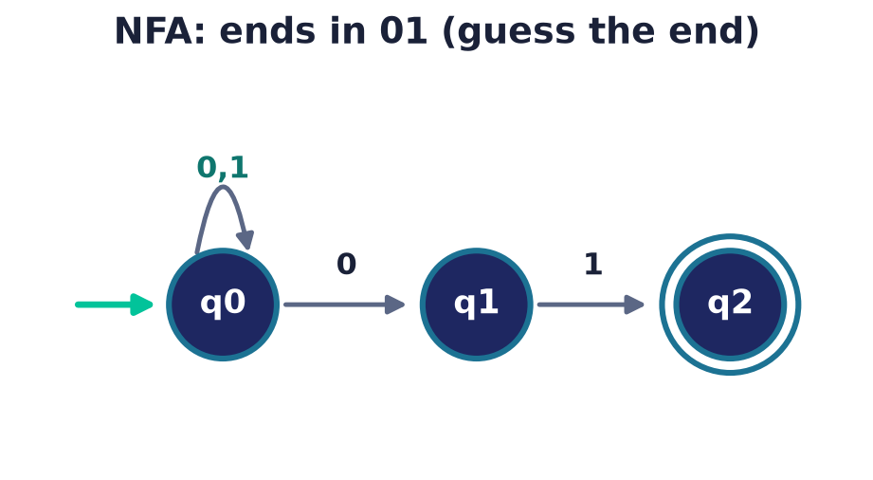
Nondeterministic finite automata
Allow choices
An NFA may have several arrows for one symbol — or none.
It accepts if SOME path leads to acceptance.
Often far simpler to design than a DFA.
Notes:
Nondeterminism relaxes the one-arrow rule: a state may offer several choices, or none, for a symbol. The machine accepts if any sequence of choices reaches acceptance. This 'lucky guessing' makes NFAs wonderfully compact — 'ends in 01' needs almost no bookkeeping.

Slide 12
ε-transitions & ε-closure
Move without reading
An ε-transition changes state on the EMPTY string — no input is consumed.
So δ maps Q × (Σ ∪ {ε}) → subsets of Q.
Handy glue for building NFAs from pieces: union, concatenation, star.
ε-closure E(S)
All states reachable from S by following zero or more ε-moves.
Read a symbol = take the ε-closure, read, then close again. Accept if that set meets F.
Notes:
An ε-transition lets an NFA change state without consuming a symbol, so the transition function is extended to accept ε as an input. To reason about them we use the ε-closure E(S): all states reachable from a set S by ε-moves alone. Processing a symbol becomes close-read-close, and the machine accepts when the resulting set of states meets an accepting state. ε-moves add no recognising power — the subset construction eliminates them — but they make NFAs easy to assemble from smaller machines for union, concatenation, and the Kleene star.

Slide 13
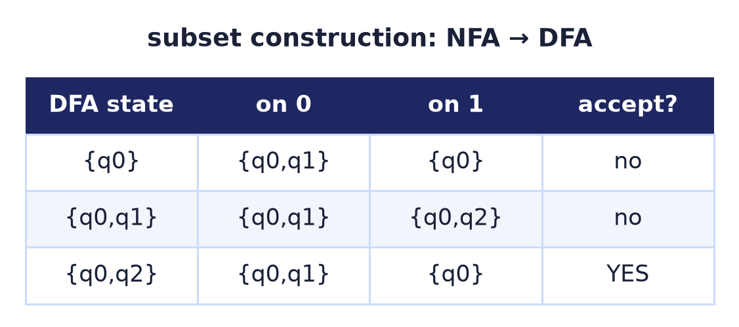
NFA = DFA: subset construction
Same power, no magic
Track the SET of states an NFA could be in.
Each subset becomes one DFA state.
Nondeterminism adds convenience, not power.
Notes:
Remarkably, nondeterminism buys no extra power. The subset construction simulates an NFA by a DFA whose states are sets of NFA states — 'all the places we might be'. It can cost exponentially many states, but it proves NFAs and DFAs recognise exactly the same languages.

Slide 14
Regular expressions
Patterns as algebra
Built from three operations: union |, concatenation, star *.
Example: (0|1)*01 = 'anything, then 01'.
The syntax behind grep, lexers, and validation.
Notes:
Regular expressions describe languages algebraically: union for choice, concatenation for sequence, and the Kleene star for zero-or-more repetition. The pattern you write in a text editor or lexer is exactly this formalism — and it describes precisely the same languages as automata.

Slide 15
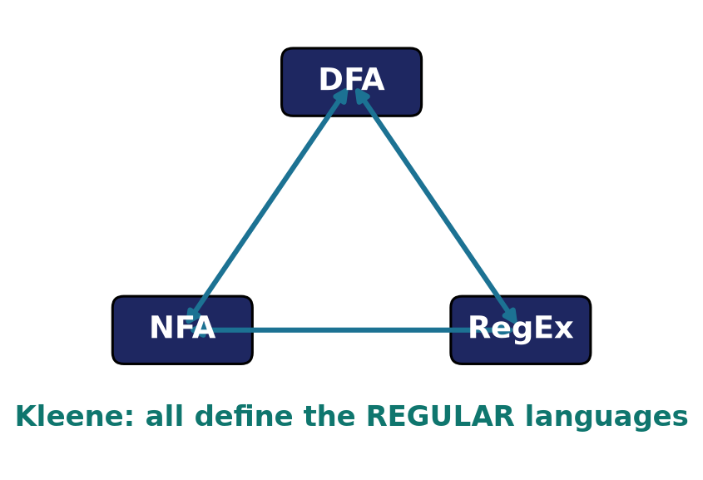
Kleene's theorem
Three views, one class
DFAs, NFAs, and regular expressions are EQUIVALENT.
Each describes exactly the regular languages.
Convert freely among all three.
Notes:
Kleene's theorem is the cornerstone: deterministic automata, nondeterministic automata, and regular expressions all define precisely the same family — the regular languages. Three utterly different-looking formalisms converge, and we can mechanically translate between them.

Slide 16
Closure properties
Boolean
Union, intersection, complement stay regular.
Operations
Concatenation and star stay regular too.
Why it matters
Build complex patterns from simple ones, safely.
Notes:
Regular languages are robustly closed: combine them by union, intersection, complement, concatenation, or star and the result is still regular. This is what lets you compose regular expressions freely and reason that the combination is still recognisable by a finite automaton.

Slide 17
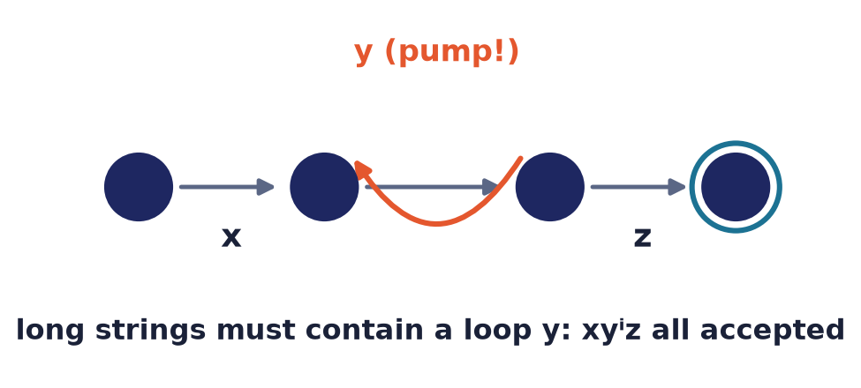
The limits of finite memory
The pumping lemma
Every long enough regular string has a loop y.
That loop can be repeated: xyⁱz all stay in the language.
If no such loop can exist — the language isn't regular.
Notes:
With only finitely many states, any sufficiently long run must revisit a state — creating a loop. The pumping lemma turns this pigeonhole fact into a tool: the loop can be pumped any number of times and every result is accepted. When that leads to a contradiction, the language cannot be regular.

Slide 18
A language no DFA can recognise
0ⁿ1ⁿ is not regular
Match n zeros followed by exactly n ones.
Counting n needs unbounded memory.
Finite states can't — proven by pumping.
0 0 0 1 1 1 ✓
0 0 0 1 1 ✗
remembering 'how many' needs
infinite states — impossible.
Notes:
The classic non-regular language: equal numbers of zeros then ones. To check it, a machine must count the zeros to compare against the ones — but counting to an unbounded n needs unbounded memory, which a finite automaton lacks. The pumping lemma makes this intuition a rigorous proof.

Slide 19
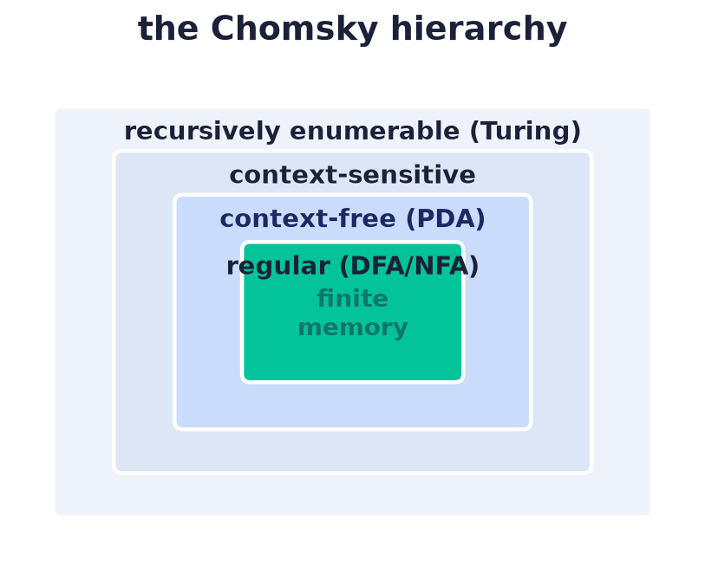
Beyond finite automata
More memory, more power
Add a stack → pushdown automata (context-free).
Add a tape → Turing machines (everything computable).
A hierarchy of machines and languages.
Notes:
The finite automaton is the first rung of a ladder. Give it a stack and it recognises context-free languages — the grammars of programming languages. Give it an unbounded tape and it becomes a Turing machine, the model of all computation. Each added memory strictly enlarges what is recognisable.

Slide 20
Automata run real software
Lexers & regex
Every compiler and grep is a finite automaton.
Protocols & hardware
State machines drive TCP, controllers, chips.
Model checking
Verify systems by exploring their state space.
Notes:
This is among the most applied theory in the course. Regular expressions and lexers are automata; network protocols and hardware controllers are state machines; and model checkers verify software by systematically exploring reachable states. The abstraction you learned today is running on every device you own.

Slide 21
Common mistakes
Forgetting a transition
A DFA needs one arrow per symbol per state.
NFA 'more powerful' than DFA
No — subset construction makes them equal.
Every language is regular
0ⁿ1ⁿ isn't — finite memory has limits.
Pumping proves regularity
It only DISPROVES it — never confirms.
Notes:
Four frequent errors: omitting transitions and breaking totality; believing NFAs are stronger than DFAs; assuming all languages are regular; and misusing the pumping lemma, which can only refute regularity, never establish it.

Slide 22
Summary
— Computation = deciding languages over an alphabet.
— A DFA is finite memory: state = what it remembers.
— NFA = DFA = regular expressions (Kleene's theorem).
— Regular languages are closed under all common operations.
— The pumping lemma exposes finite memory's limit (0ⁿ1ⁿ).
— More memory ⇒ pushdown & Turing machines: a hierarchy.

Slide 23
Course complete
From logic to the limits of computation.
Sets & logic → relations & functions → proof → number theory → combinatorics → graphs & algorithms → probability → automata.
One toolkit of rigorous, discrete reasoning — the mathematical foundation of computer science.
Notes:
We have travelled the whole arc: from the logic of true and false, through the structures of sets, relations, and functions, the discipline of proof, the integers, counting, graphs and their algorithms, the calculus of chance, and finally the machines that compute. Together these form the rigorous, discrete foundation on which all of computer science is built. Congratulations on completing the course.

